Slide 1
WWII- Lecture 5
1939-1945

Slide 2
Last Class
D-Day
Liberation of Holland
1st Nations role
Women's role
Japanese internment

Slide 3
This class
Current events
Lecture
Video

Slide 4
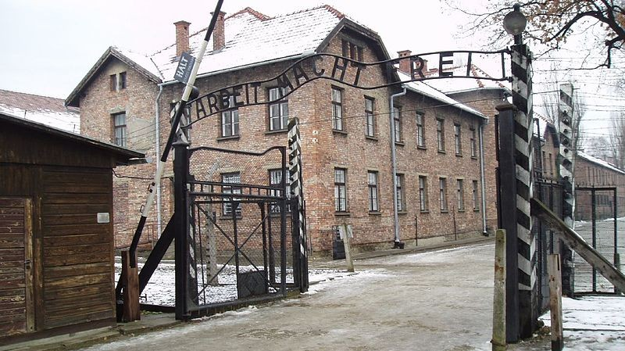
The holocaust
Jewish, gypsies, and other people/races the Nazi’s determined to be inferior were sent to concentration camps

Slide 5
The holocaust
Estimates vary, but around 6,000,000 people were murdered by Nazis in concentration camps
Genocide: the deliberate and systematic destruction of an ethnic, racial, religious, or national group

Slide 6
holocaust
Read the paper supplied by Mr. Hoy
Discuss how it makes you feel within your table
Underline facts and information that you find interesting/disturbing/shocking.
Discuss as a class how these documents shed light on the Holocaust and the persecution of the Jewish

