Slide 1
WW2: Lecture 4
1939-1945

Slide 2
Day’s preview
Current Events
Lecture
Video

Slide 3
Review of last class
Battle of Britain
-German attempt to invade Britain, fought in air
Battle of Ortona
-major Canadian victory
Operation Barbarossa/Invasion of Russia
-arguably cost Germans the war
Pearl Harbor
-brought USA into was against Axis

Slide 4
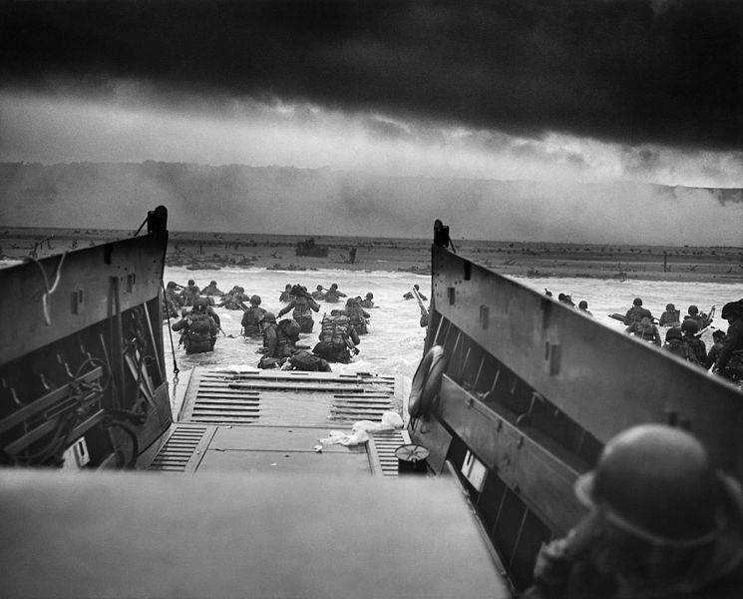
D-Day

Slide 5
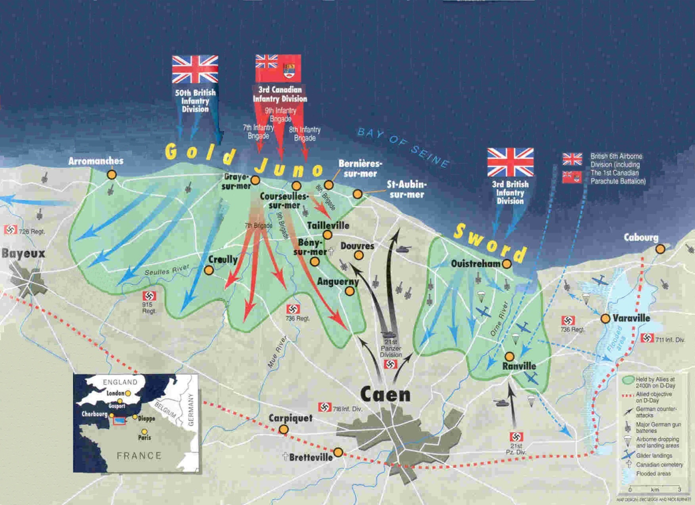
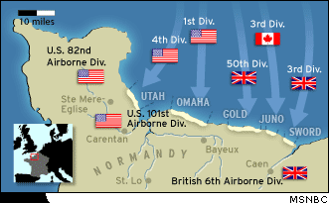
D-Day
June 6, 1944
Allied invasion of Europe- Normandy region of Northern France
A 5 pronged attack, along an 80km stretch of beach.

Slide 6
D-day beaches
Canadian forces attacked at “Juno” beach
30,000 Canadian soldiers fought
359 Canadians died on D-day
By the end of the day Canadian forces had reached farther into German territory than any other force.

Slide 7
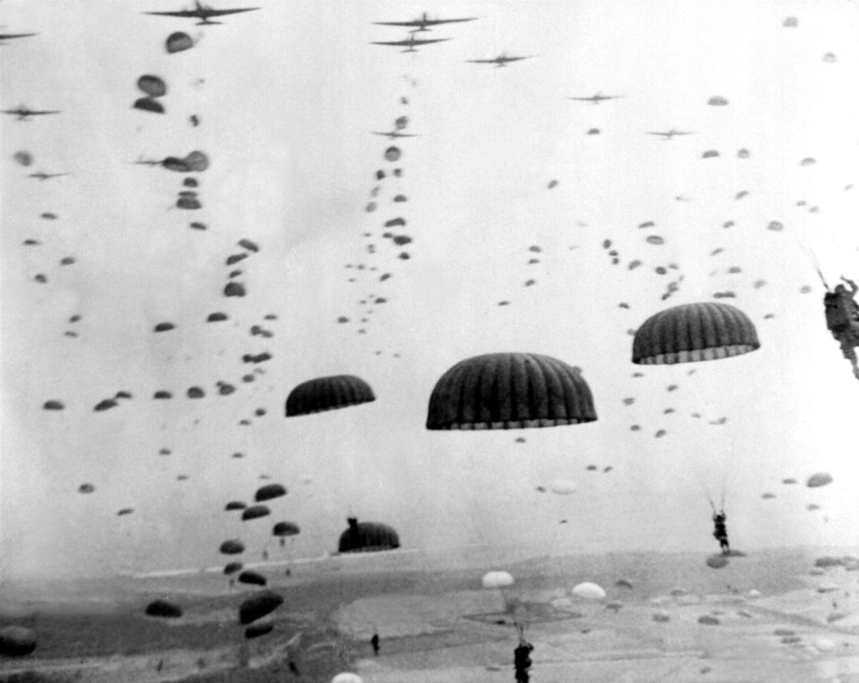
D-day
Operations began @ midnight with paratrooper being dropped in behind
enemy lines
What would be the job
of these men?

Slide 8
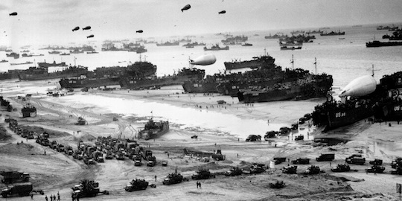
D-day

Slide 9
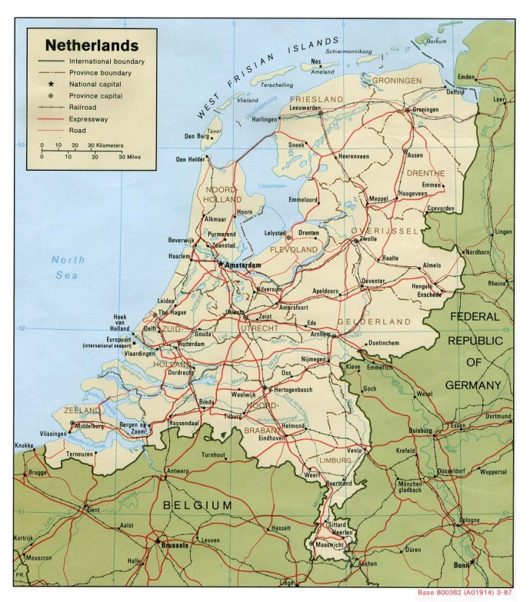
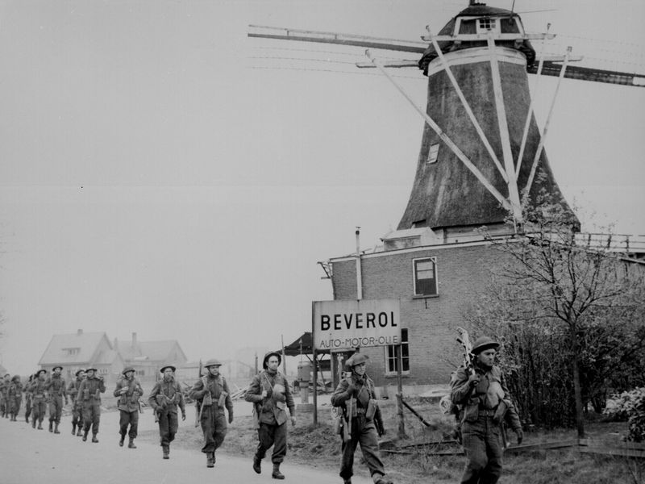
Canada liberates Holland
In 1945 as allied forces move across Europe liberating cities from the Germans, Canada was assigned the task of liberating Holland

Slide 10
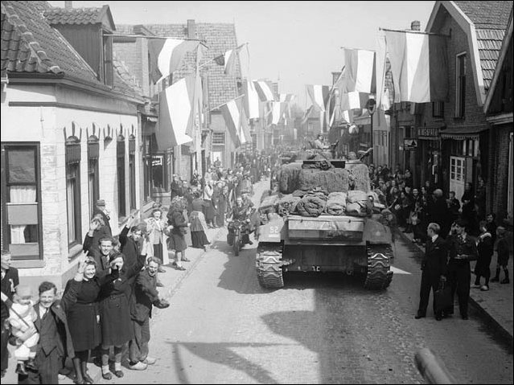
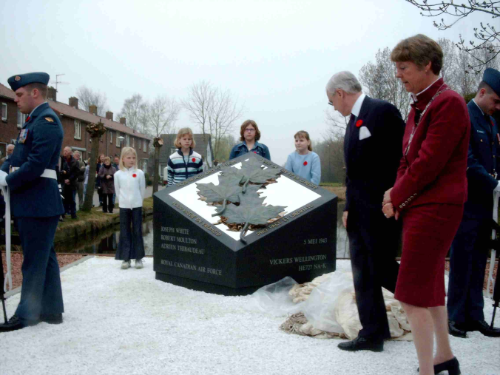
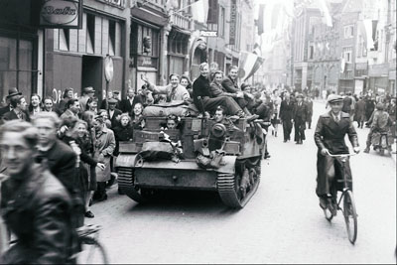
Canada liberates Holland
Fighting was hard; mostly in cities, Canadian casualties were high- 6300
Canadian forces gave a great deal of aid to the citizens of Holland who were starving after German
Ever since people from Holland have held a high esteem and great respect for Canadians.

Slide 11
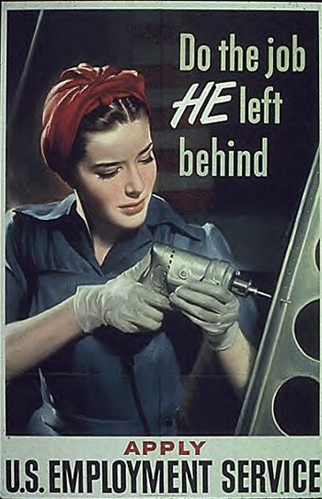
Women in the war

Slide 12
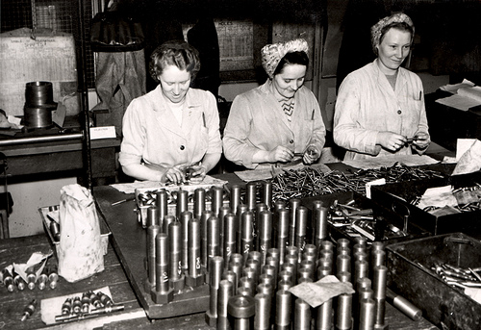
Women in the war

Slide 13
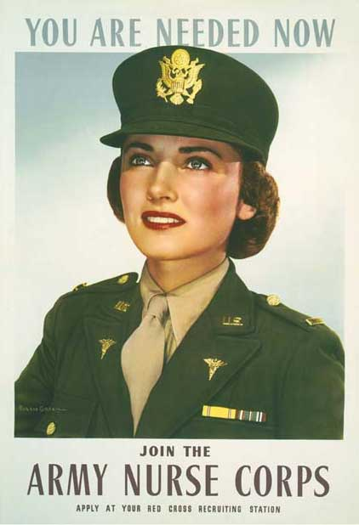
Women in the war

Slide 14
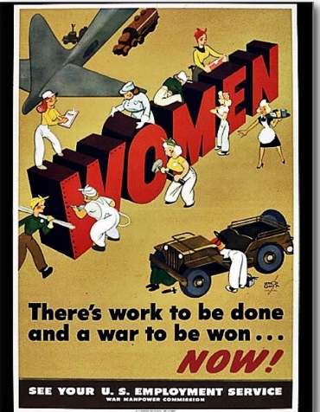
Women in the war
Much like WWI, women filled the jobs of men who had left to fight in the war.
Single women were in demand because they had limited family obligations.

Slide 15
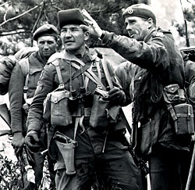
1st Nations Involvement
Reasons to join war effort:
Pay- many were living in poverty
Nazi ideals conflicted with their own
Pressured by recruiters

Slide 16
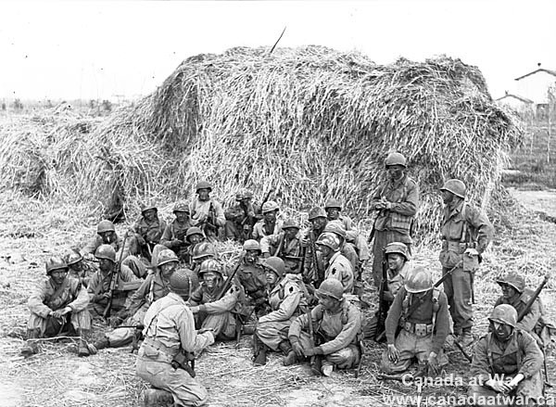
1st Nations Involvement
Mostly served as infantry because:
Infantry need the most bodies
Navy & air force had restrictions for who could serve; education and race being limiting factors

Slide 17
1st Nations Involvement
“Pure European descent”, “…be a British born subject, of a white race”= racism
1st N. served in every military campaign in the war from Dieppe to Normandy
Donated over $23,000 to the red cross and various war efforts- financial contributions
Over 200 1st N. died during WWII

Slide 18
1st Nations Involvement
3,090 men and women enlisted in the war effort
This number does not represent the real number because:
Some 1st N. had given up their status due to treaty negotiations and marriage laws
Metis and Inuit were not included as “Indians”
Those bands close to the US border served in the American army
Over 200 1st N. died during WWII

Slide 19
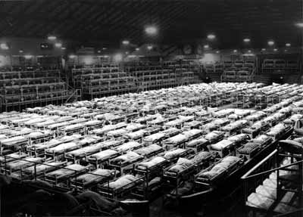
Japanese internment
Canadians began to fear Japanese invasion and thought Japanese descendants in Canada would aid the potential invaders.

Slide 20
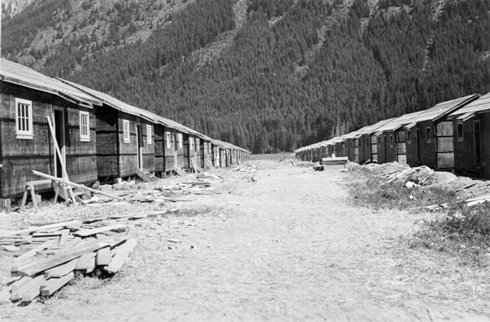
Japanese internment
As a result 21,000 Japanese were moved into internment camps or east of the Rockies

Slide 21
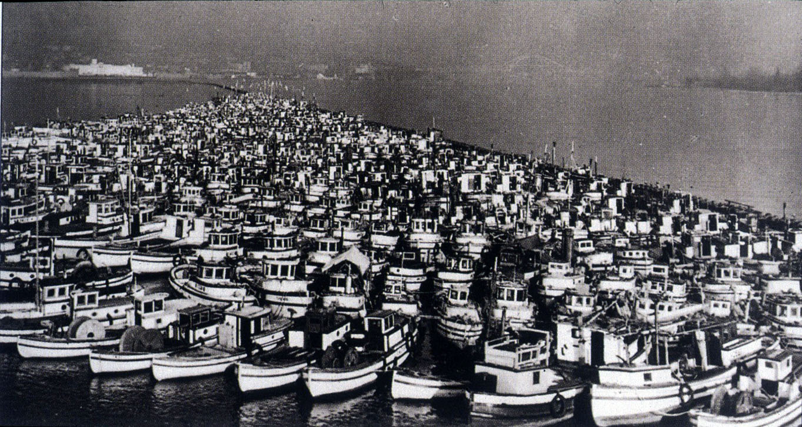
Japanese internment
All belongings of Japanese people were confiscated by the government and sold.

