Slide 1
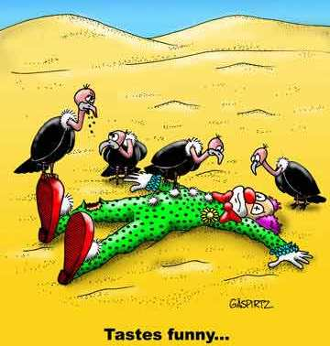
A little humor to start the class..

Slide 2
What is Propaganda?

Slide 3
Propaganda
Information, especially of a biased or misleading nature, used to promote or publicize a particular political cause or point of view.
Examples you know of??

Slide 4
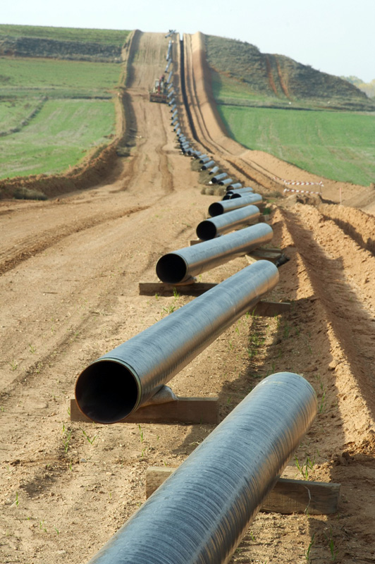
Propaganda
Enbridge Pipeline support
Pipeline opposition

Slide 5
Critical Literacy
Definition:
Critical literacy is the ability to actively read text in a manner that promotes a deeper understanding of socially constructed concepts; such as power, inequality, and injustice in human relationships.

Slide 6
Critical Literacy
Critical literacy encourages individuals to understand and question the attitudes, values, and beliefs of written texts, visual applications, and spoken words.

Slide 7
Developing Critical Literacy
Whose view point is expressed?
What does the author want us to think?
Whose viewpoints are missing, silenced, or discounted?
How might alternative perspectives be represented?
What action might you take on the basis of what you have learned?

Slide 8
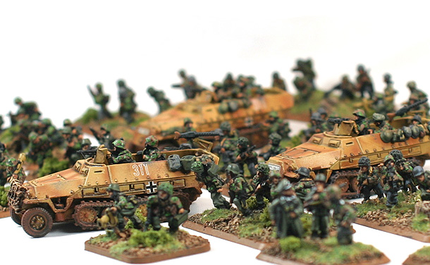
Activity
Using critical literacy techniques lets look at some propaganda from WW2…

Slide 9
Battle Assignment
1.Battle of the Atlantic
2. Liberation of Holland
3. Orton/Italy
4. Pearl Harbor
5. Canada and Hong Kong
6. Operation Sea Lion/Battle of Britain
7. Operation Barbarossa

