Slide 1
WWII: lecture 2
1939-1945

Slide 2
Class Preview
Current Events
Hand in letters
Lecture
Dieppe video?
http://www.history.ca/daysofremembrance/video/dieppe+uncovered/video.html?v=2270629742#dieppeuncovered/video/featured+presentation

Slide 3
Current Events

Slide 4
Previous Class
What did we learn?
Hands Please!

Slide 5
Previous Class
Fascism- Mussolini, Franco, Hitler
German Aggression: Anschluss, Rhineland, Sudetenland
Appeasement
Non-Agression Pact
1939- Germany invades Poland- War begins
Winston Churchill
Remember: the war was to created to end the great depression, it just happened to stop it.

Slide 6
WWII- Lesson 2
What is worth going to war for?

Slide 7
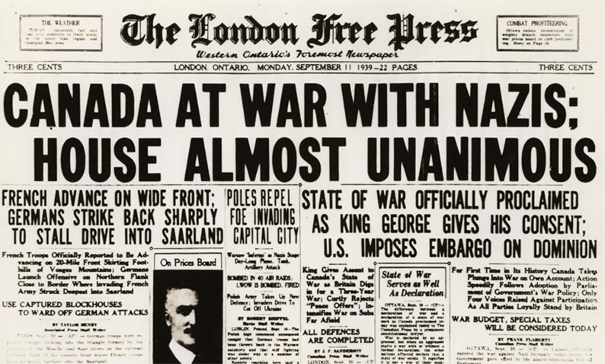
WWII-LESSON 2
Sept 1, 1939: Germany invades Poland
Sept 3: :Britain & France declare war on Germany
September 10: Canada declares war on Germany

Slide 8
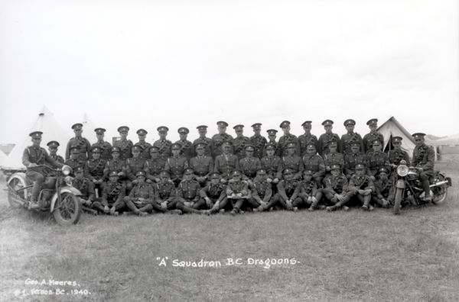
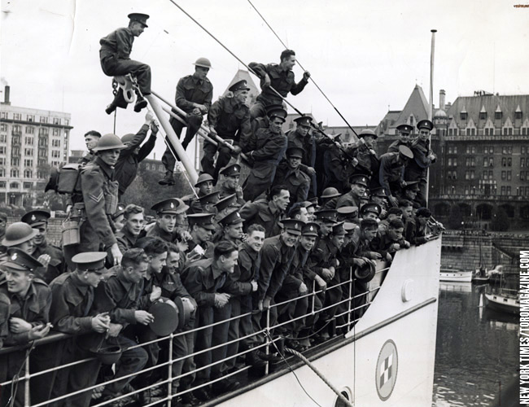
Canadians go to war 1939
People not happy to go back to war however
58 330 people volunteered in September ’39= A lot!!
First Nations volunteered at the highest proportion of their population than any other group in Canada

Slide 9
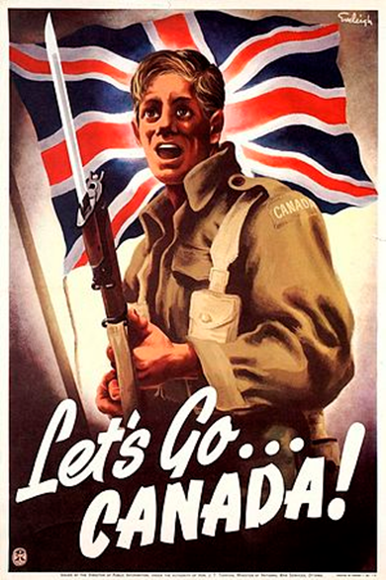
Canadians go to war 1939
Canadians were drawn into service for:
Pay- get out of the depression
Loyalty to European blood lines
Canadian national pride
Adventure

Slide 10
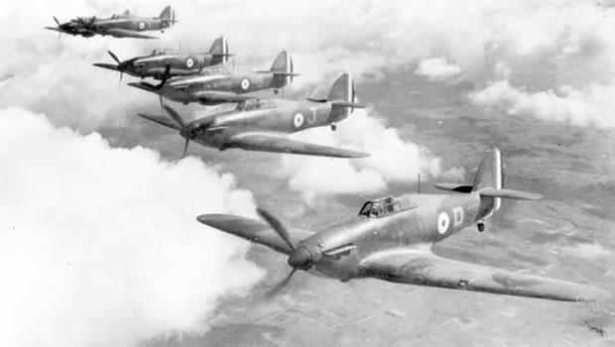
Canadians go to war 1939
British Commonwealth Air Training Program: British instructors trained pilots from all over the commonwealth in Canada.
Canada suited the needs because it:
Open skies
Safe distance from enemy
Climate

Slide 11
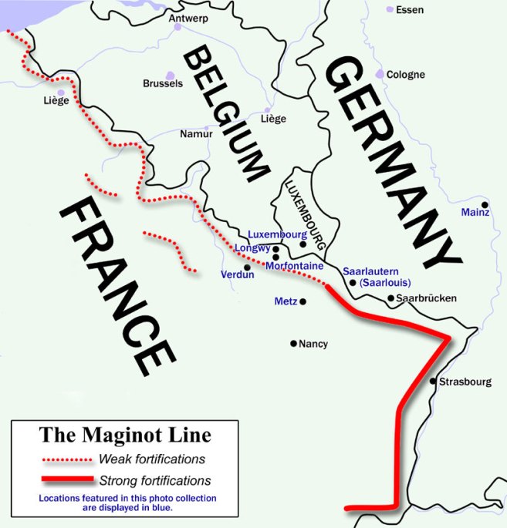
WWII-LESSON 2
Strong wall of defensive garrisons built up after WWI along the French border- The Maginot Line
Allied forces build up defences on the French/German border waiting for Germany to make their next move.

Slide 12
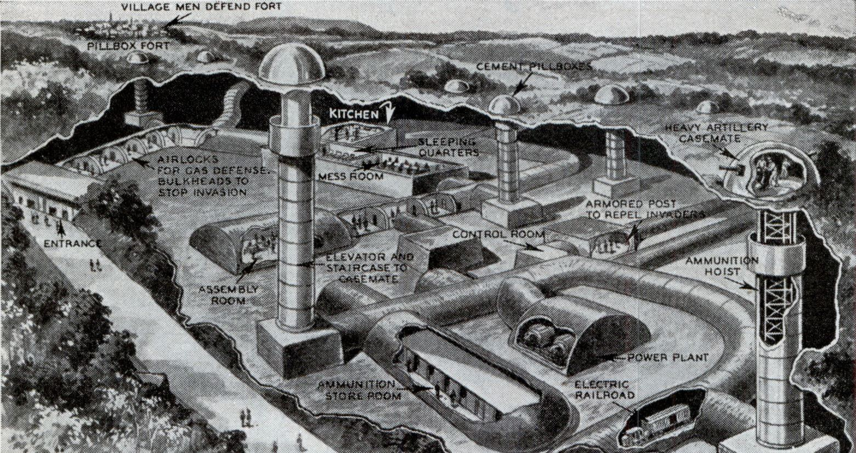
Maginot Line

Slide 13
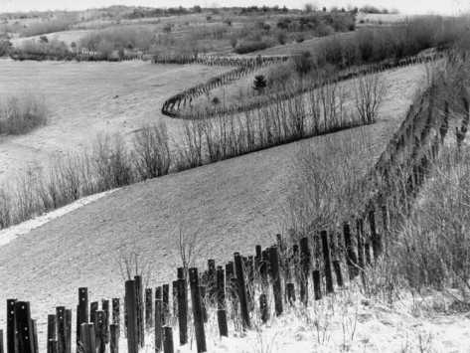
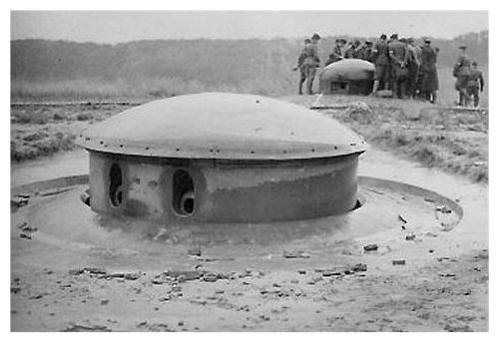
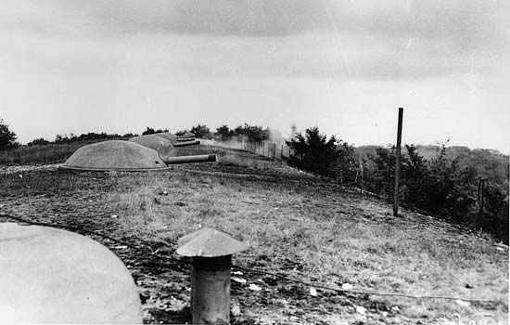
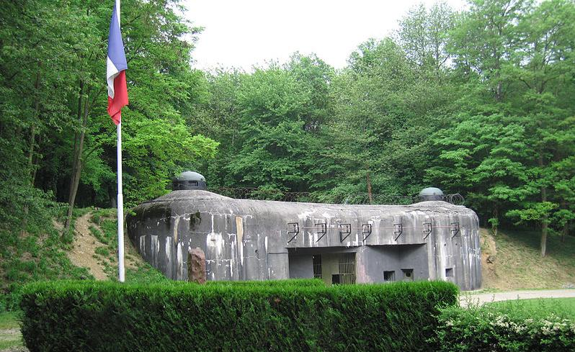
Maginot Line

Slide 14
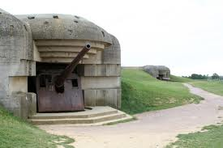
WWII-LESSON 2
From September 1939 to May 1939, no fighting occurred, people began to call this the “phoney war” because they believed nothing was going to happen.

Slide 15
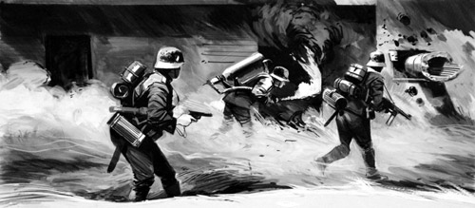
WWII-LESSON 2
German army travels through the Arden forest, thought to be impassable
Able to attack Maginot line from behind
Maginot line not built to fire in this direction, quickly falls

Slide 16
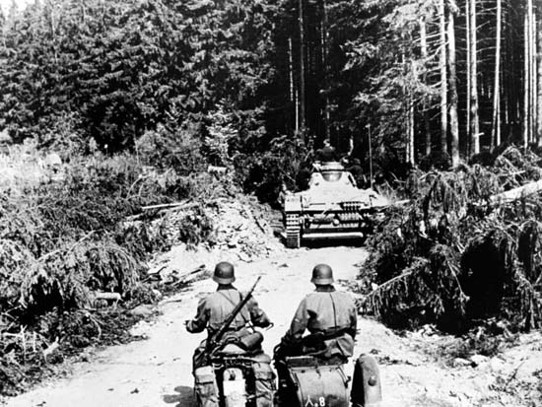
WWII-LESSON 2
German army travels through the Arden forest, thought impassable

Slide 17
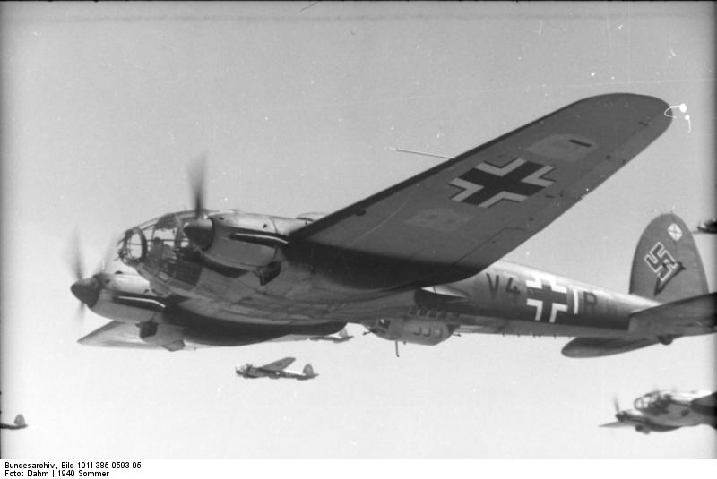
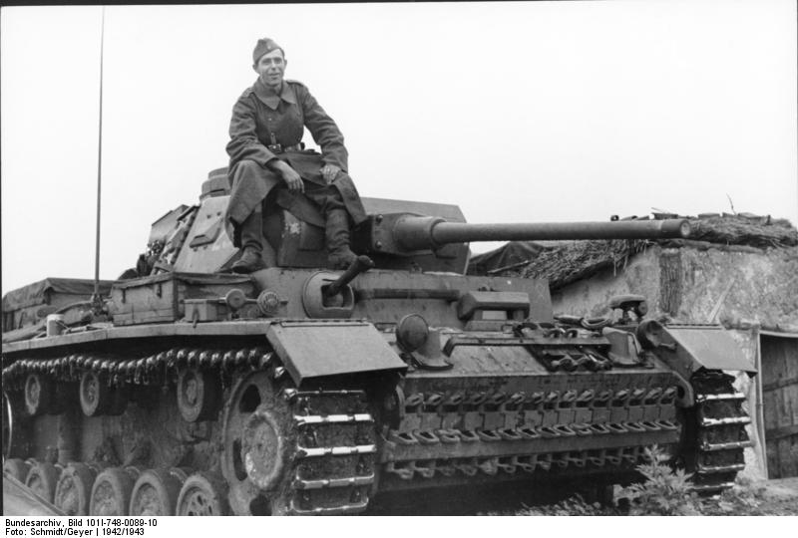
Blitzkrieg- Lightning war
German war strategy that utilized surprise, tanks, and aerial assault
This was the reason Germany was able to invade Norway, Denmark, Netherlands, Belgium, Luxembourg, and France in one year!

Slide 18
Blitzkrieg
Blitzkrieg was the key to German military power
Allies expected a war similar to WWI- trenches but technological advances made this warfare obsolete.

Slide 19
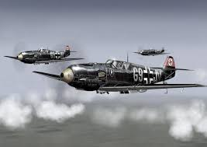
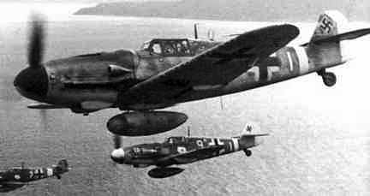
Luftwaffe
Luftwaffe- German air force, during WWII Germany had the largest air force.

Slide 20
Luftwaffe
German air superiority played a major factor in the Allies attempts to retake continental Europe

Slide 21
1940 German movements
April: Nazi forces invade Norway and Denmark
May: Nazi forces invade Netherlands, Belgium, Luxemburg, France
June: France surrenders
Interactive Map:
http://www.worldology.com/Europe/world_war_2_imap.htm

Slide 22
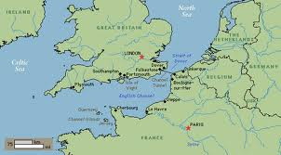
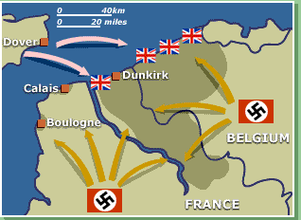
1940 German movements
Dunkirk: French Port town where Allied forces became surrounded

Slide 23
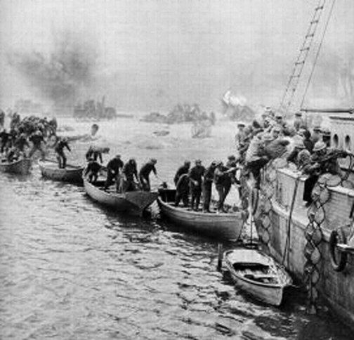
Dunkirk
Allied armies congregated in the port town of Dunkirk while German forces surrounded them
British navy summoned every ship capable of crossing the English channel to ferry troops away from the mainland and back to Britain.

Slide 24
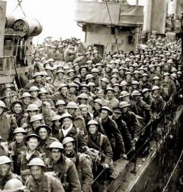
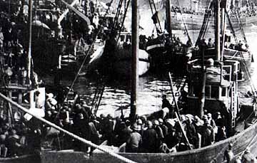
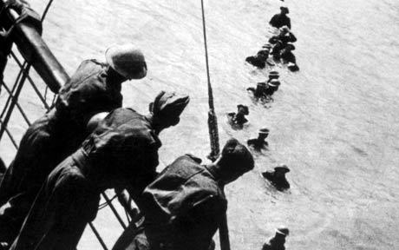
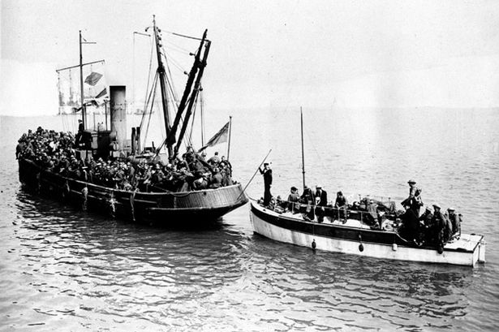
Dunkirk

Slide 25
Dunkirk
100’s of fishing boats and pleasure craft answered the call
After 9 days of evacuating troops, 340,000 troops were saved
French soldiers fought hard to repel German offensive, and German's waited for reinforcements before reengaging the troops in Dunkirk

Slide 26
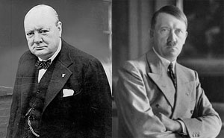
1940 German movements
By July 1940 France had fallen, leaving Britain and the Commonwealth alone to battle Germany.

