Slide 1
World war 2- wwii
1939-1945

Slide 2
wwii
Independently, think about what you already know about WWII, write down a few things you know
Talk to the person on your left to and share knowledge
Share with your table and pool your knowledge
Each table will share their 2 most interesting facts

Slide 3
1930’s- rise of dictators
Fascism- a totalitarian state that involves extreme nationalism, militarism, and racism. Force and fear are used to intimidate the populace into compliancy.
During the 20’s & 30’s 3 fascist governments came to power in Europe: Italy, Spain, and Germany.
Italy, Germany, and Japan constituted Axis powers

Slide 4
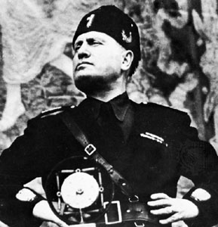
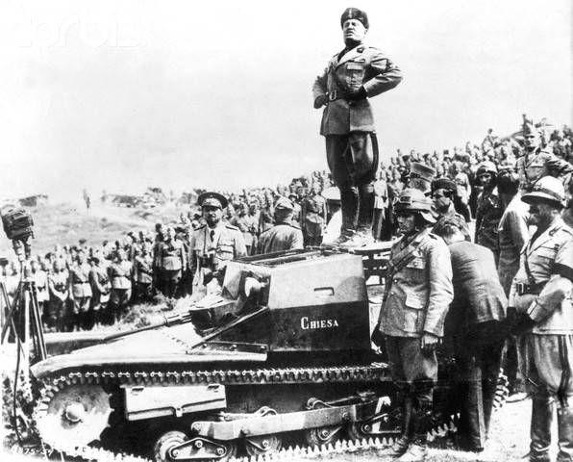
1930’s- rise of dictators
Italy: Benito Mussolini
Black Shirts- Police squads

Slide 5
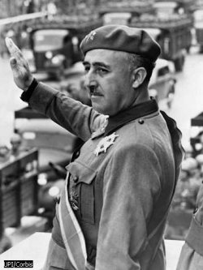
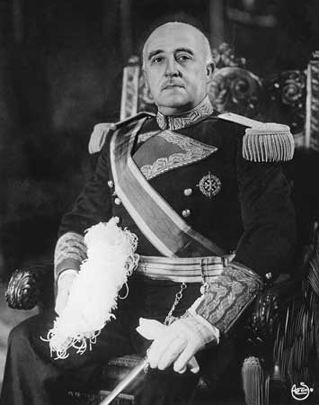
1930’s- rise of dictators
Spain: General Francisco Franco
Overthrew Spanish government in a military coup

Slide 6
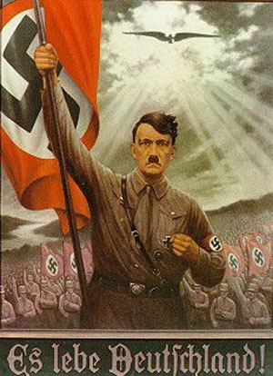
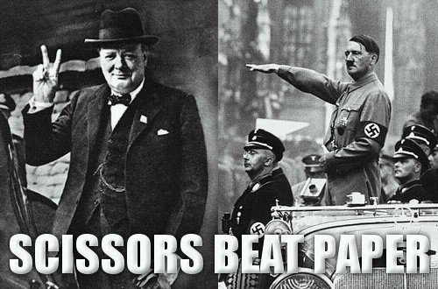
1930’s- rise of dictators
Germany: Adolf Hitler
4 women in his life, 3 committed suicide one failed

Slide 7
Wwii- Hitler
Hitler Speech (go to minute 6)
What kind of body language does he use?
What is his tone, tempo, and pace like?
What is the message he is giving the German youth?

Slide 8
Class Preview
Current events
Lecture WWII
War Connections
Speeches activity

Slide 9
Wwii- Hitler
Blamed German suffering on treaty of Versailles- Why?
Also blamed Jewish people for the troubles of Germany
He was a great orator and able to sell his policies to millions through brainwashing and theatrical speeches.
Hitler studied opera singers to refine his style

Slide 10
Wwii- Hitler & Great depression
Came into power by promising Germans an end to their suffering- the great depression.
Hitler began massive infrastructure spending on highways and farming networks.
Efforts paid off and the German economy began to improve- the people were happy.
Nazi’s abolished all other political parties, trade unions, and controlled the media.- would you be getting worried at this point?

Slide 11
Wwii- Hitler
Aryan Race: Nazi belief in a master race of Northern Europeans. Lead to abominable human experimentation by Nazi doctors.
Racism- to rid German society of “impurities” Nazi’s began the process of genocide. The first to be exterminated were the mentally and physically disabled. Jews, gypsies, and Slovaks were systematically targeted, persecuted, and murdered.

Slide 12
Early Nazi aggression: Before war is declared
Like a bully, Hitler began to push the boundaries to see what he could get away with. Initially his justifications were to reclaim territory lost during after WWI.
1936- Germany sends soldiers into the Rhineland, a zone of demilitarization decreed in the treaty of Versailles
1938- Germany occupies Austria in a move called: Anschluss
1938- Sudetenland- a piece of Czechoslovakia given to Germany in negotiations with Britian & France. Hitler agreed to ending territorial claims at this point.

Slide 13
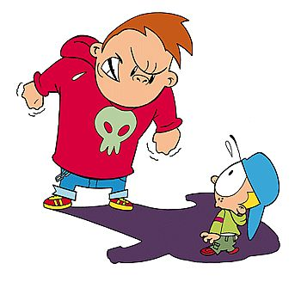
Early nazi aggression: Before war is declared
Appeasement- A policy adopted by Western countries to avoid starting another world war. They let Hitler get away with his aggressive tactics.
-Appeasement just made Hitler bolder- how does this relate to a school yard bully?

Slide 14
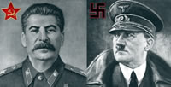
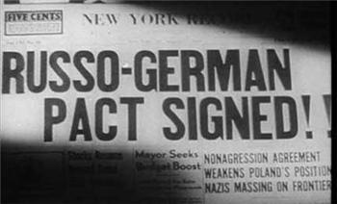
The final straw
Non-aggression pact: Germany (Hitler) and Russia (Josef Stalin) promise not to attack each other if one goes to war. By doing so Hitler avoided drawing Russia into battle when invading Poland.
1939- Hitler invades Poland

Slide 15
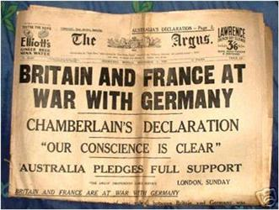
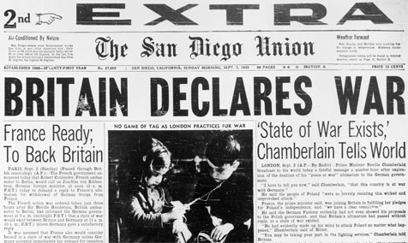
The final straw
When Germany invades Poland, Britain and France declare war on Germany.
Winston Churchill is British PM during WWII

Slide 16
Activity: Great Speeches
In groups analyze your speech and answer the following questions:
Who do you think is giving this speech?
Who do you think is the intended audience? Why?
What kind of language is used to convey mood?
What imagery is used?
Underline sections that you believe the orator would emphasize.

Slide 17
Speeches in Audio
We shall fight on the beaches
I have a dream

Slide 18
WW2 Assignment
War Connections
In order to bring the subject of WW2 home, and give you reason to connect to an assignment; this project requires you to research a family members role in WW2. You can research anyone related to you, they did not have to serve overseas; many women supported the war effort at home working in fields, mines, and factories. Everyone’s contributions from the period between 1939 and 1945 can be considered relevant for this project.

Slide 19
WW2 Assignment
If you have no know family connections to the war, there are members of the Comox Valley Legion who would be happy to provide students with firsthand accounts of this time period.

Slide 20
WW2 Assignment: Deliverables
Option 1 | Option 2 | Option 3 | Option 4
Questionnaire & written report | Research & written report | Questionnaire OR Research & Suitcase of Artifacts & Presentation or write-up | Questionnaire OR Research & Comic strip

