Slide 1
The Crusades- your turn to sum up some literature using Google Read & Write

Slide 2
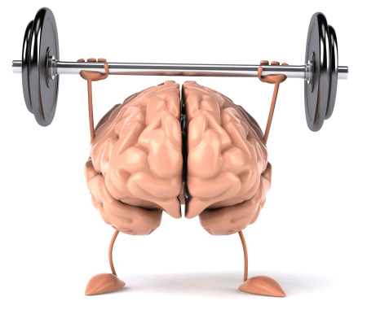
The Crusades- your turn to sum up some literature using Google Read & Write
Read an article provided by Mr. Hoy. Choose the challenge you wish to attempt. If you choose one and realize its too easy or hard, move up or down one in difficulty. But do try to challenge yourself- its how you grow.

Slide 3
The Crusades- your turn to sum up some literature using Google Read & Write
Use the note taking icon in Google Read and Write to select notes from the material you are reading.
You want to find information on what were the affects of the crusades on Europe.
Compile your notes on a document and email that document to Mr. Hoy: Jeffery.hoy@sd71.bc.ca

Slide 4
The Crusades- your turn to sum up some literature using Google Read & Write
Light challenge- http://medievaleurope.mrdonn.org/effects_of_the_crusades.html
Medium Challenge- https://en.wikipedia.org/wiki/Crusades#Legacy
Hard Challenge- https://www.khanacademy.org/humanities/world-history/medieval-times/medieval/a/the-impact-of-the-crusades-4-of-4

