Slide 1
Week 2, lesson 6
Welcome back, how was the weekend?

Slide 2
Presentations!
Groups who are ready to present please come see me

Slide 3
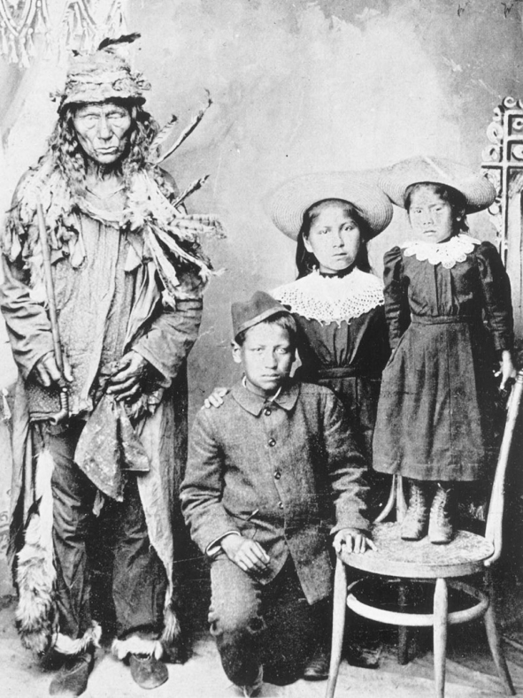
Follow up-
Mr. Hoy made a mistake!
Last week I asked you to define “Holocaust” and…
Do you think residential schools could be considered a holocaust? Why?

Slide 4
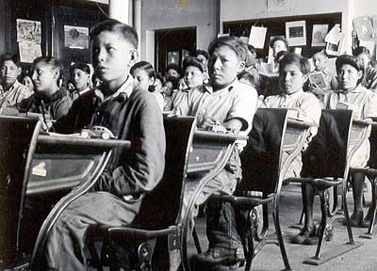
Follow up- HANDS UP
What I meant for you to define was “Genocide”
Lets do it now- you can use your smart phones for this one!

Slide 5
Thoughts…
Do you think residential schools could be considered genocide? Why?

Slide 6
Follow up
In 2008 the government of Canada apologised for the assimilation policies of residential schools
2006- Survivors of the schools were given $10,000 for the first year in the schools and $3,000/yr for subsequent years.

Slide 7
Indian Act 1876
Formalized document of 1st N assimilation
-1st N were wards of the state, only live on reserves
-1st N. required to register with the government, if they did not they were ‘non-status’ and would loose their rights
-1st N needed special passes to leave reserves, Europeans were not allowed on reserves

Slide 8
Indian Act 1876 cont’d
-1st N children had to attend residential schools
-traditional ways of self-governance were not allowed
-1st N religion was not allowed ex: sun dance & potlatch

Slide 9
Treaties
As Canada sought to open the prairies to settlers they need to deal with the issue of 1st N. title to the land.
1st N leaders knew they had to share some of the land, wanted to make the best possible deal for future generations.

Slide 10
Treaties
1st N leaders believed they were sharing their land for the protection and support of their people
-the bison and fur bearing animals across Canada were becoming scarce and could not support 1st N populations any longer.
1871 the treaty process began when Canada sent Wemyss Simpson to negotiate with the plains 1st N.

Slide 11
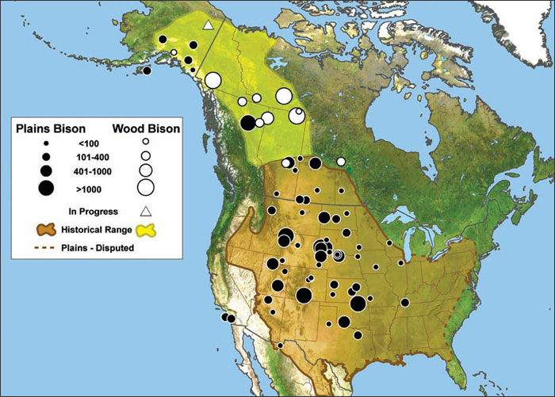
Historical Bison range

Slide 12
Treaties
“God intends this land to raise great crops for all his children, and the time is come when it is to be used for that purpose. White people will come here to cultivate it under any circumstances. No power on Earth can prevent it.”
-Wemyss Simpson, 1871

Slide 13
Treaties
“I have turned this matter of a treaty over in my mind and I cannot see anything in it to benefit my children. This is what frightens me. After I showed you what I meant to keep for a reserve, you continued to make it smaller and smaller… Let the queen’s subjects go on my land if they choose. I give them liberty. The them rob me. I will go home…”
-Ay-ee-ta-pe-pe-tung, 1871

Slide 14
Treaties
Do you think these 2 points of view would lead to successful negotiations?

Slide 15
Treaties- farming
1st N. gave up land and the Canadian government promised to provide food, animals, wagons, seed and tools to begin agriculture.
However tools provided were not adequate and seed was delivered to late in season.
Most 1st N gave up farming by 1900 (24yrs later)

Slide 16
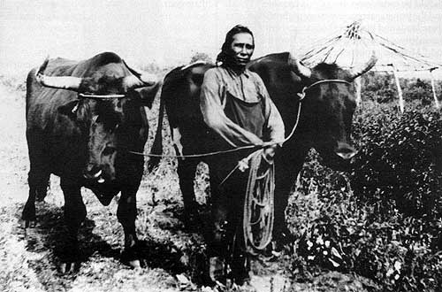
Treaties- farming
Some reserves did succeed in farming.
However 1st N were encouraged to grow only what was needed to support their families?
-What is wrong with this
kind of encouragement?
-Why do you think the
govn’t promoted this
kind of idea?

Slide 17
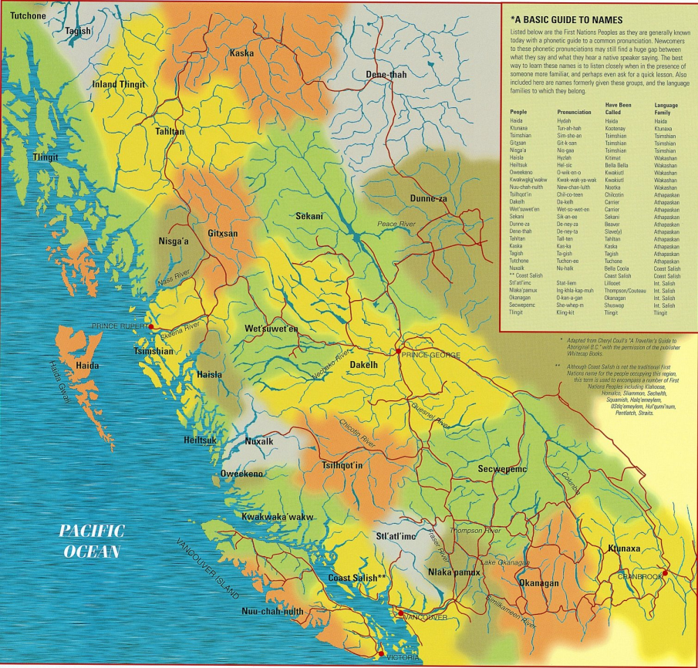
Treaties today
Many 1st N bands have still not signed treaties today.
Especially in BC,
governments are
trying to establish
treaties with 1st N

Slide 18
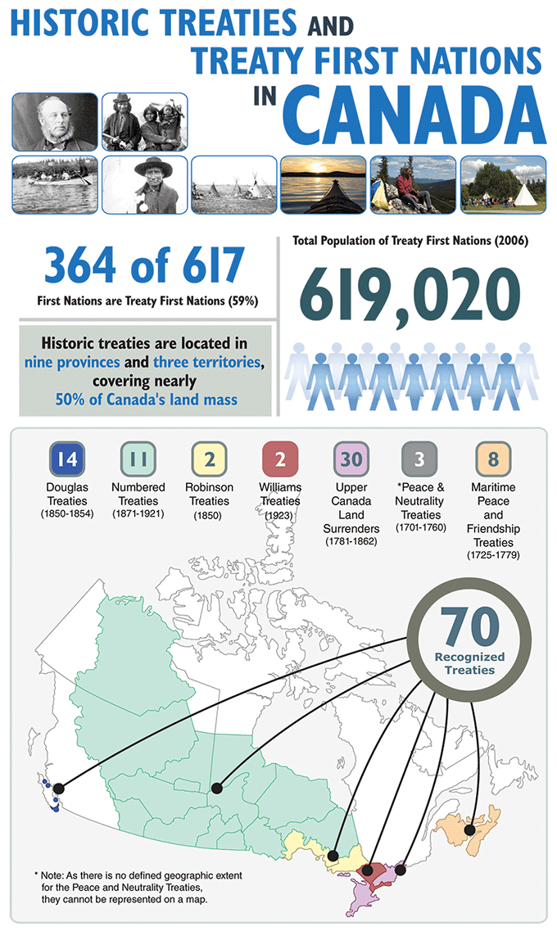
Modern treaties
What kind of
Implications do you think occur in areas where treaties have not yet been established?

