Slide 1
West coast totem poles

Slide 2
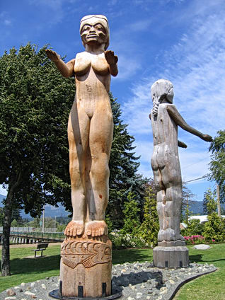
Pole Types
Nuu-chach-nulth welcome pole
West coast van isle
Human figure with outstretched arms
Larger than life
Greeted visitors at beaches in front of villages

Slide 3
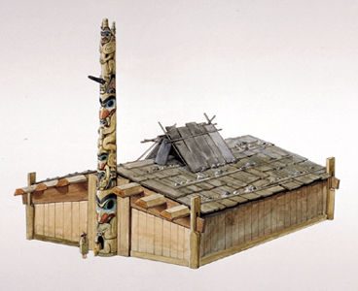
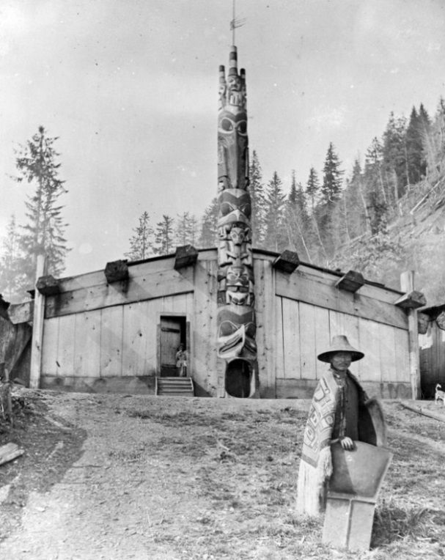
Pole types
Haida house portal pole
Haida gwaii
Attached to a house, the door passed through the pole
The door was used for special ceremonies

Slide 4
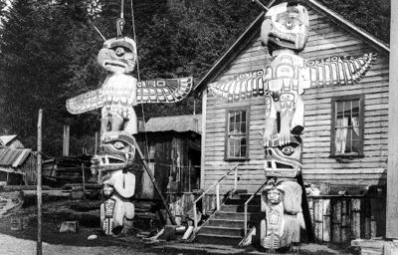
Pole types
Haida, Tlingit, Tsimshian, Kwakiutl, nuu-chah-nulth
Memorial Pole
Made for the passing of a chief by the new incoming chiefs family
Built in front of a house but not attached to it
Carvings displayed special events or achievements achieved in the persons life

Slide 5
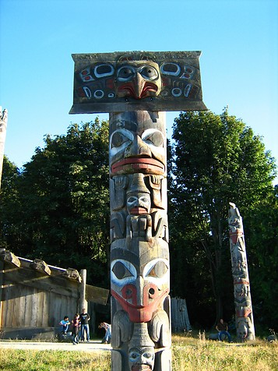
Pole Types
Haida & Tsimshian
Mortuary Pole
Made for very highly ranked people
Remains were placed in a hollow cavity in the pole, and was covered by a panel or box
Unlike normal poles mortuary poles were erected with the wide end in the air.

Slide 6
Pole types
Tlingit
Shame Pole
Public proclamation of another’s misdeed or unpaid debt
When the debt was paid or forgiven the pole came down

Slide 7
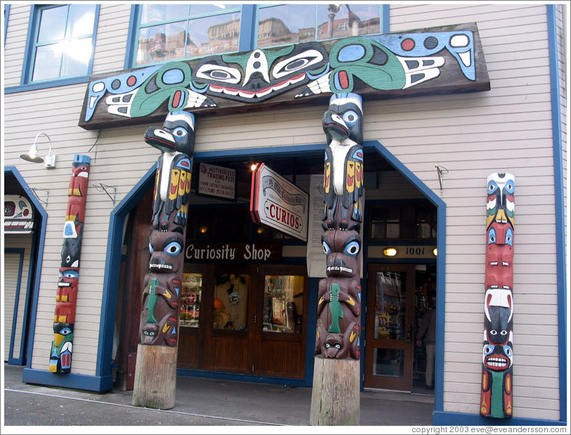
Pole types
anyone
Commercial pole
Commissioned for purposes outside the culture often for governments, businesses, or individuals

Slide 8
Purposes of poles
Displayed peoples origins and lineages,
Rights & privileges
Supernatural experiences
Exploits and achievements
Acquisitions and territories
Marriages and memorials

Slide 9
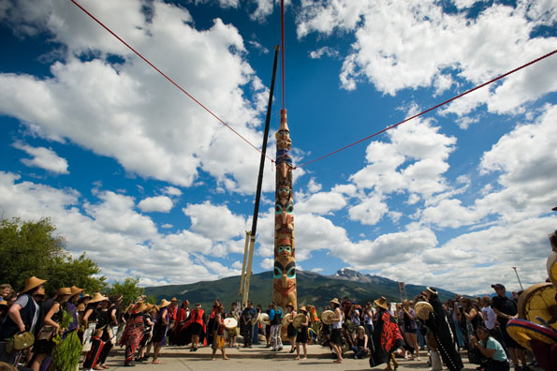
Purpose of poles
Totem poles gave the people cultural identity, and proclaimed their wealth and status within the village and within their nation

Slide 10
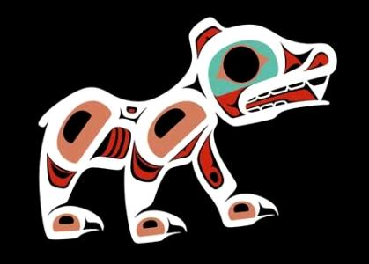
Animal Symbology
The Bear
meaning
Strength
Calm
Family

Slide 11
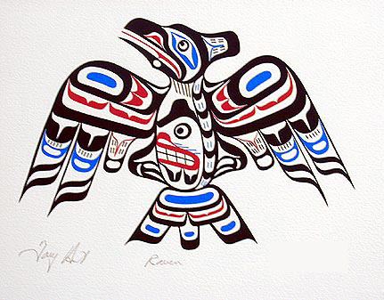
Animal symbology
The Eagle
meaning
Courage
Healing
Grace
Intelligence

Slide 12
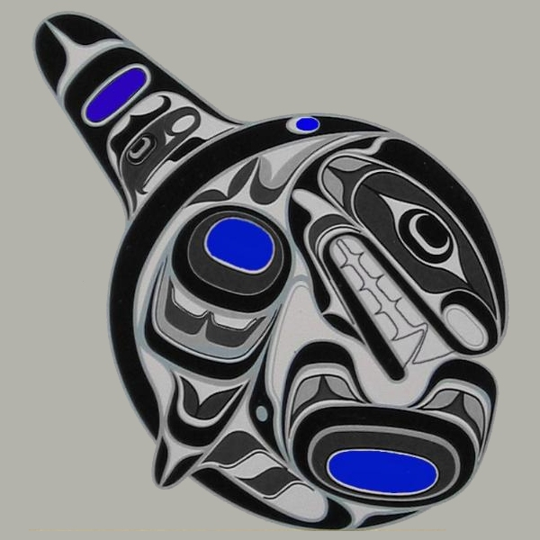
Animal Symbology
The whale
Meaning
Wise
Kindness
Compassion

Slide 13
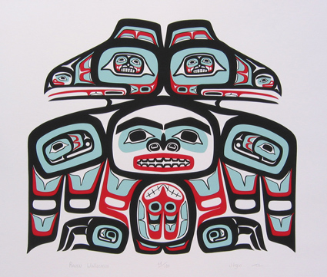
Animal Symbology
The Raven
Meaning
Courage
Trickster
Creativity
Change

Slide 14
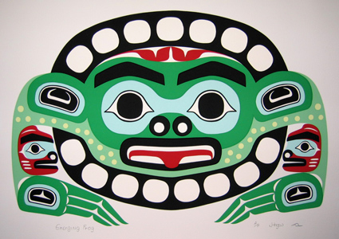
Animal Symbology
The Frog
Meaning
Adaptable
Cleansing
Rebirth
peace

Slide 15
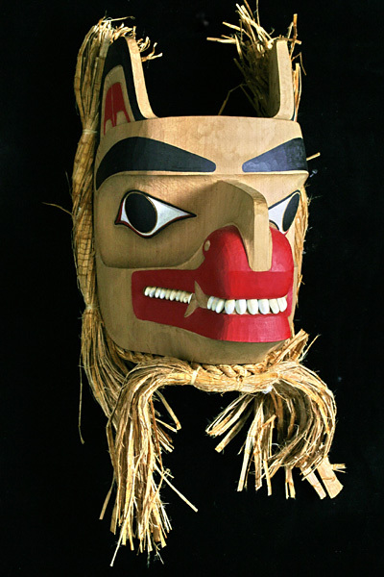
Animal Symbology
The Wolf
Meaning
Intelligence
Leadership
Family

Slide 16
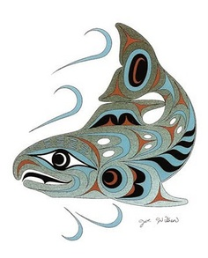
Animal Symbology
The Salmon
Meaning
Instinct
Determination
Renewal
Wealth

Slide 17
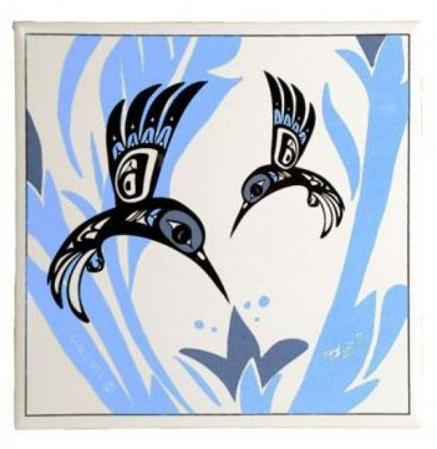
Animal Symbology
The hummingbird
Meaning
Beauty
Intelligence
Love

Slide 18
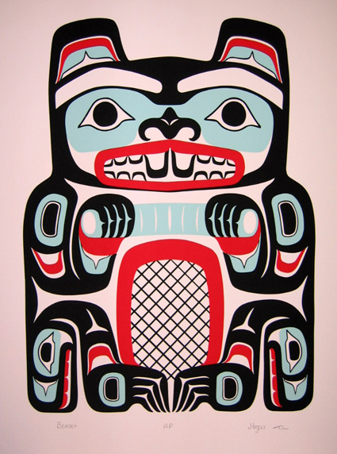
Animal Symbology
The Beaver
Meaning
Hard work ethic
Protector
Strong will

Slide 19
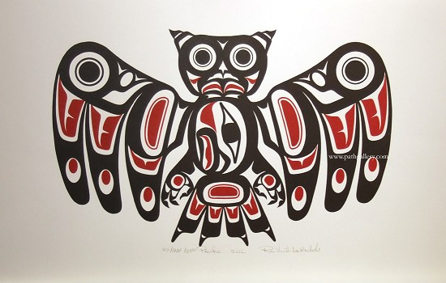
Animal Symbology
The Owl
Meaning
Knowledge
Wisdom
Afterlife, seer of souls

Slide 20
Ticket out the door:
On a piece of paper write which animal you feel represents you.
What qualities (meaning) do you share with the animal?
Give me 4 examples of things you have done in the past that exemplify a trait of that animal?

Slide 21
Answering Questions
Owl:
I feel the owl best symbolizes me. I believe this because the owl represents the qualities of knowledge, wisdom, and connection to the after life. Like the owl, I seek knowledge in areas I am interested in. For example, I love cars and I read something everyday on engines and car performance.

Slide 22
Answering Questions
Eg: “I feel the owl best symbolizes me.”
-opening (1st) sentence states the fact you wish to prove
Eg: “I believe this because the owl represents the qualities of knowledge, wisdom, and connection to the after life.”
-2nd sentence lists the reasons or evidence to support you fact from sentence 1

Slide 23
Answering Questions
-3rd sentence connects you and the topic you are writing about.
Eg. “Like the owl, I seek knowledge in areas I am interested in.”

Slide 24
Answering Questions
-4th sentence (most important) provides EVIDENCE to support your claims in sentence 2 & 3.
Eg. “For example, I love cars and I read something everyday on engines and car performance.”

Slide 25
Ticket out the door:
On a piece of paper write which animal you feel represents you.
What qualities (meaning) do you share with the animal?
Give me 4 examples of things you have done in the past that exemplify a trait of that animal?

