Slide 1
Canadian Explores
Mr. Hoy has wanted to be an explorer ever since he was a small boy….. Today he lives his dream!

Slide 2
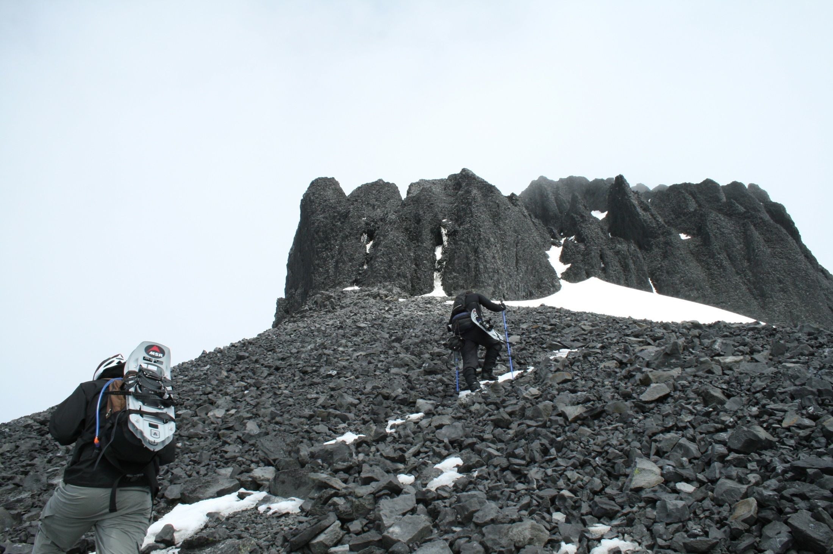

Slide 3
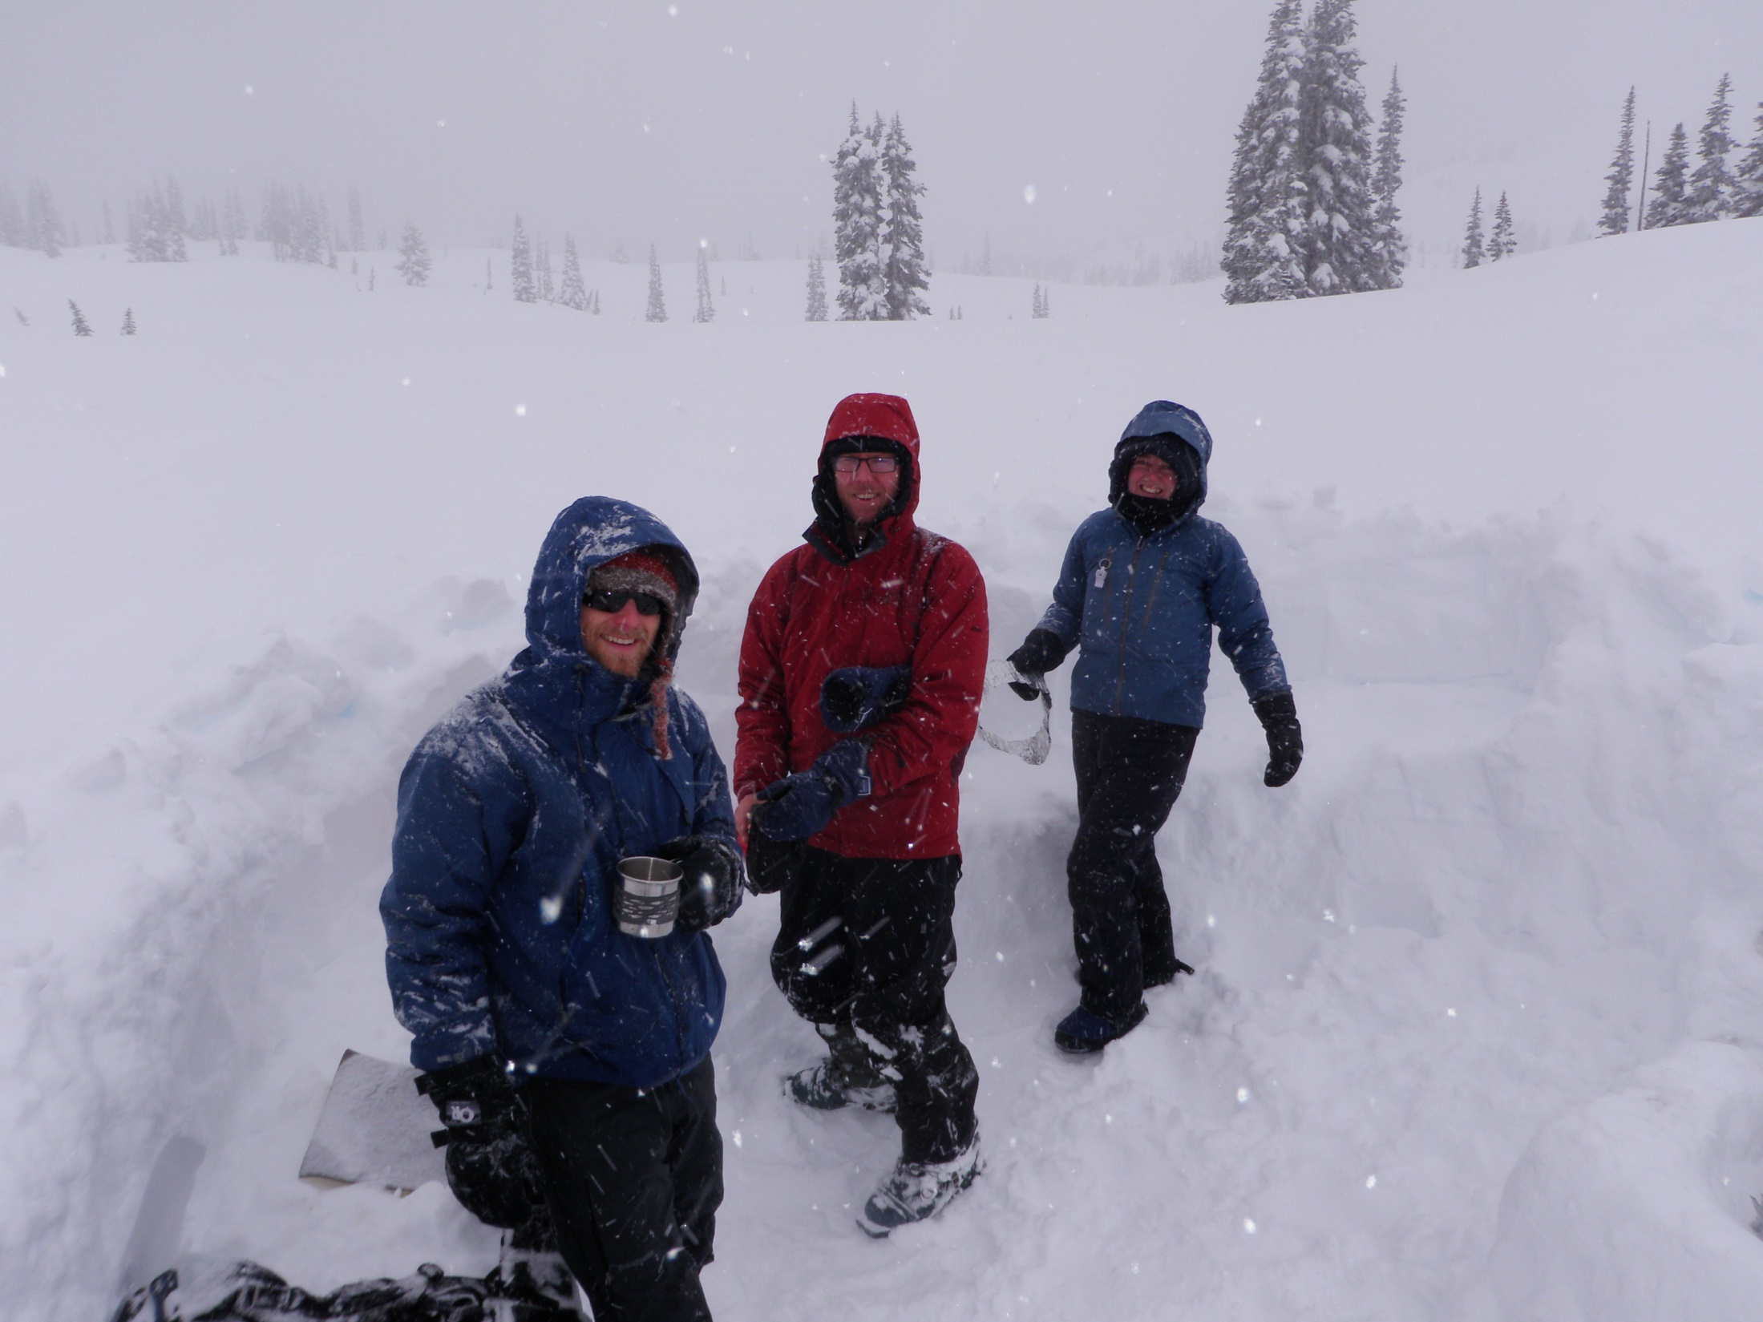

Slide 4
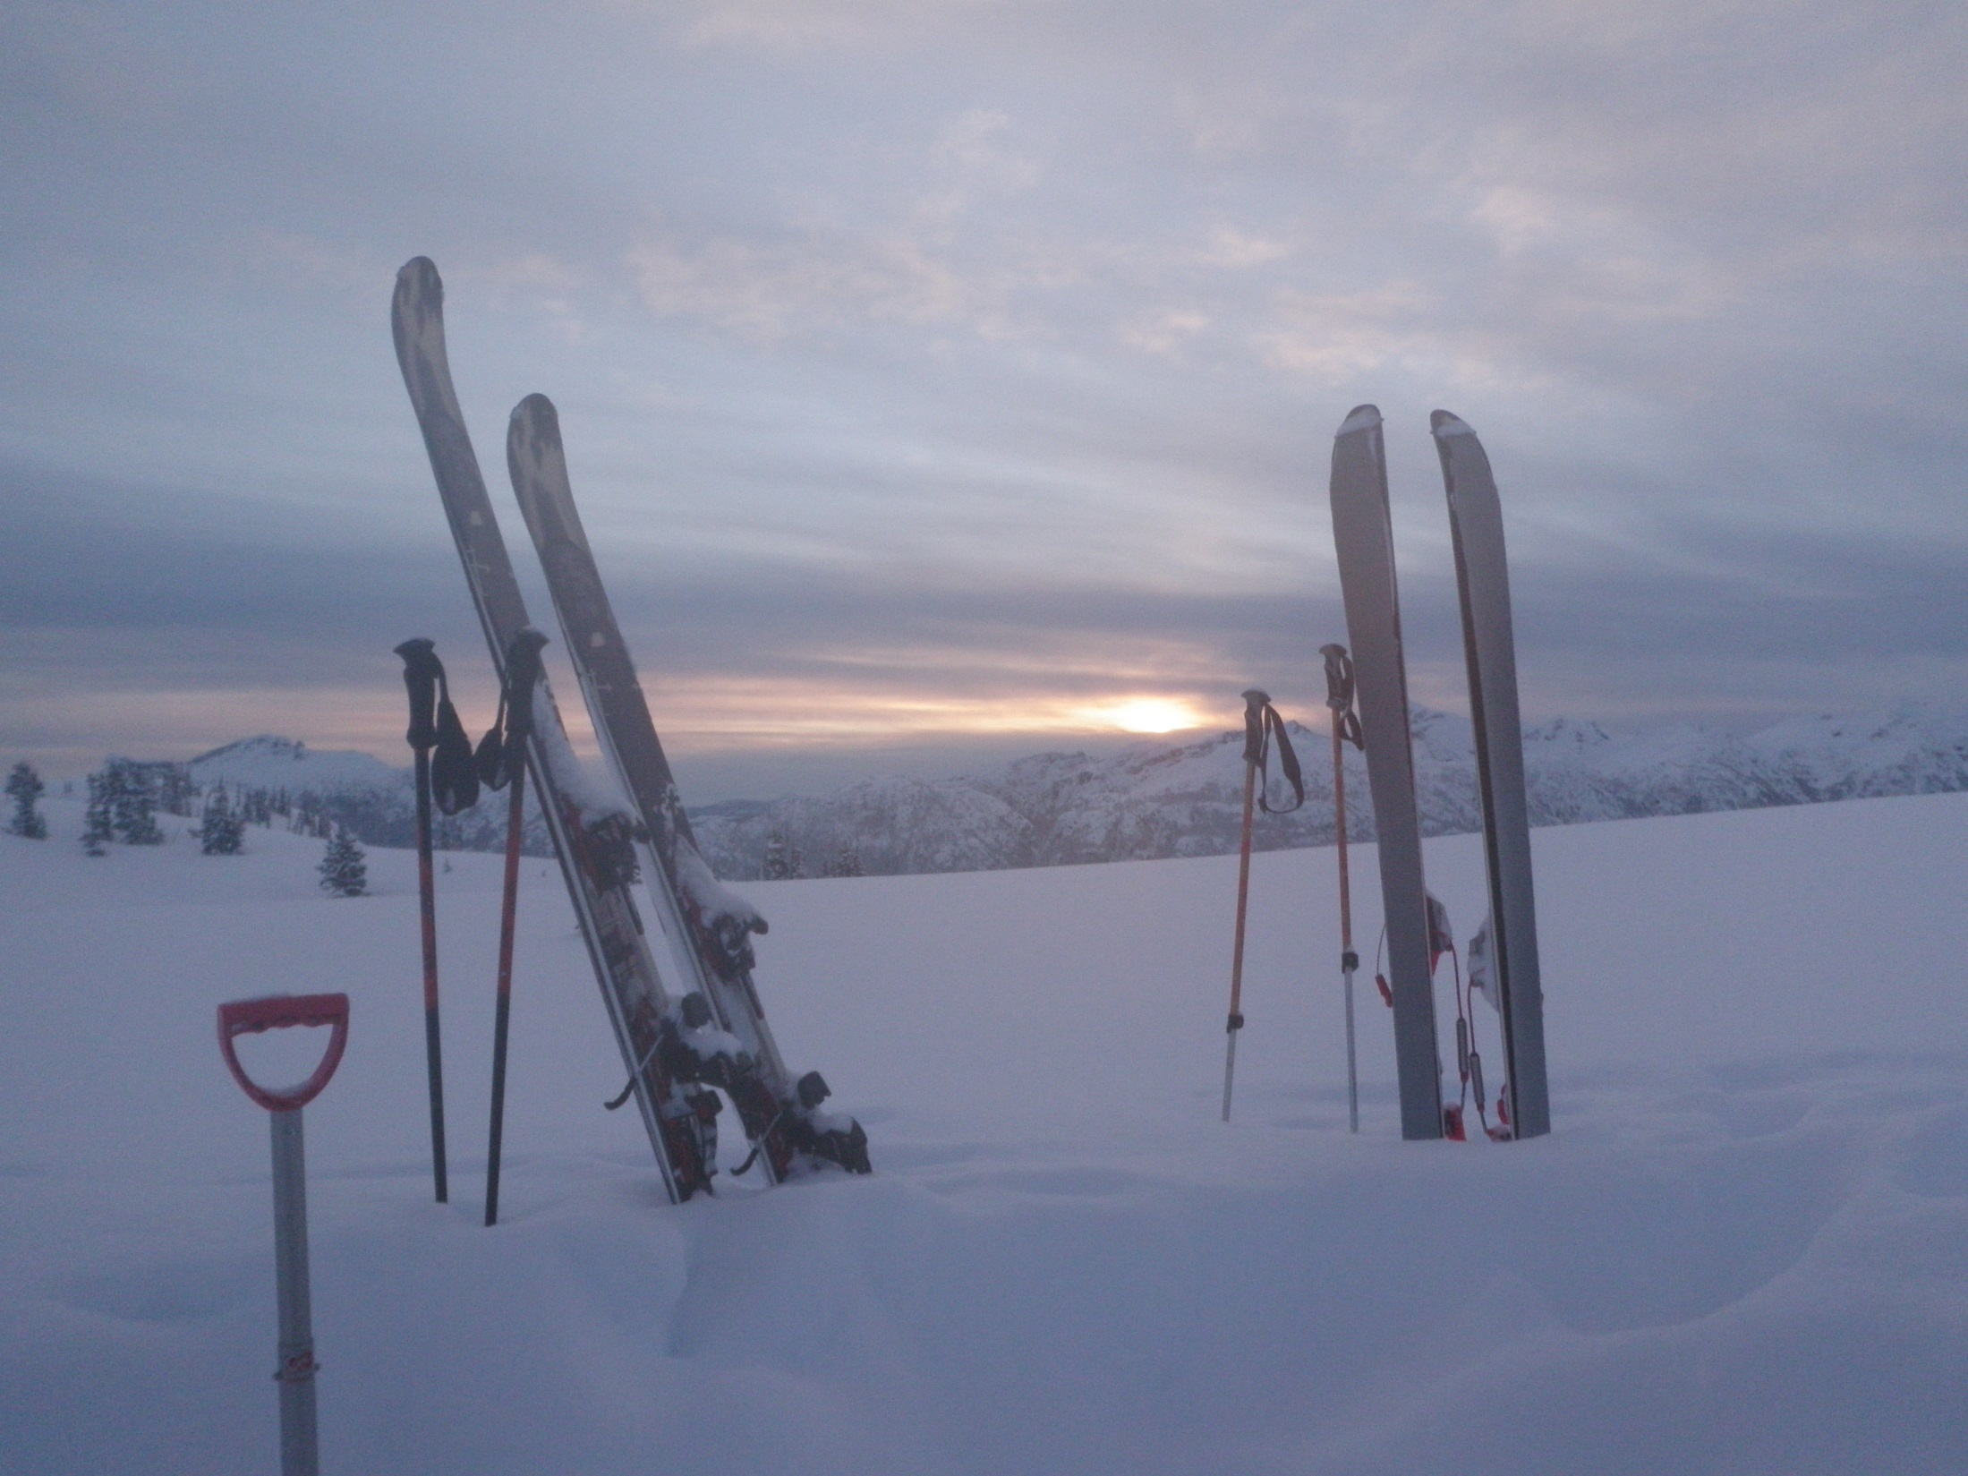

Slide 5
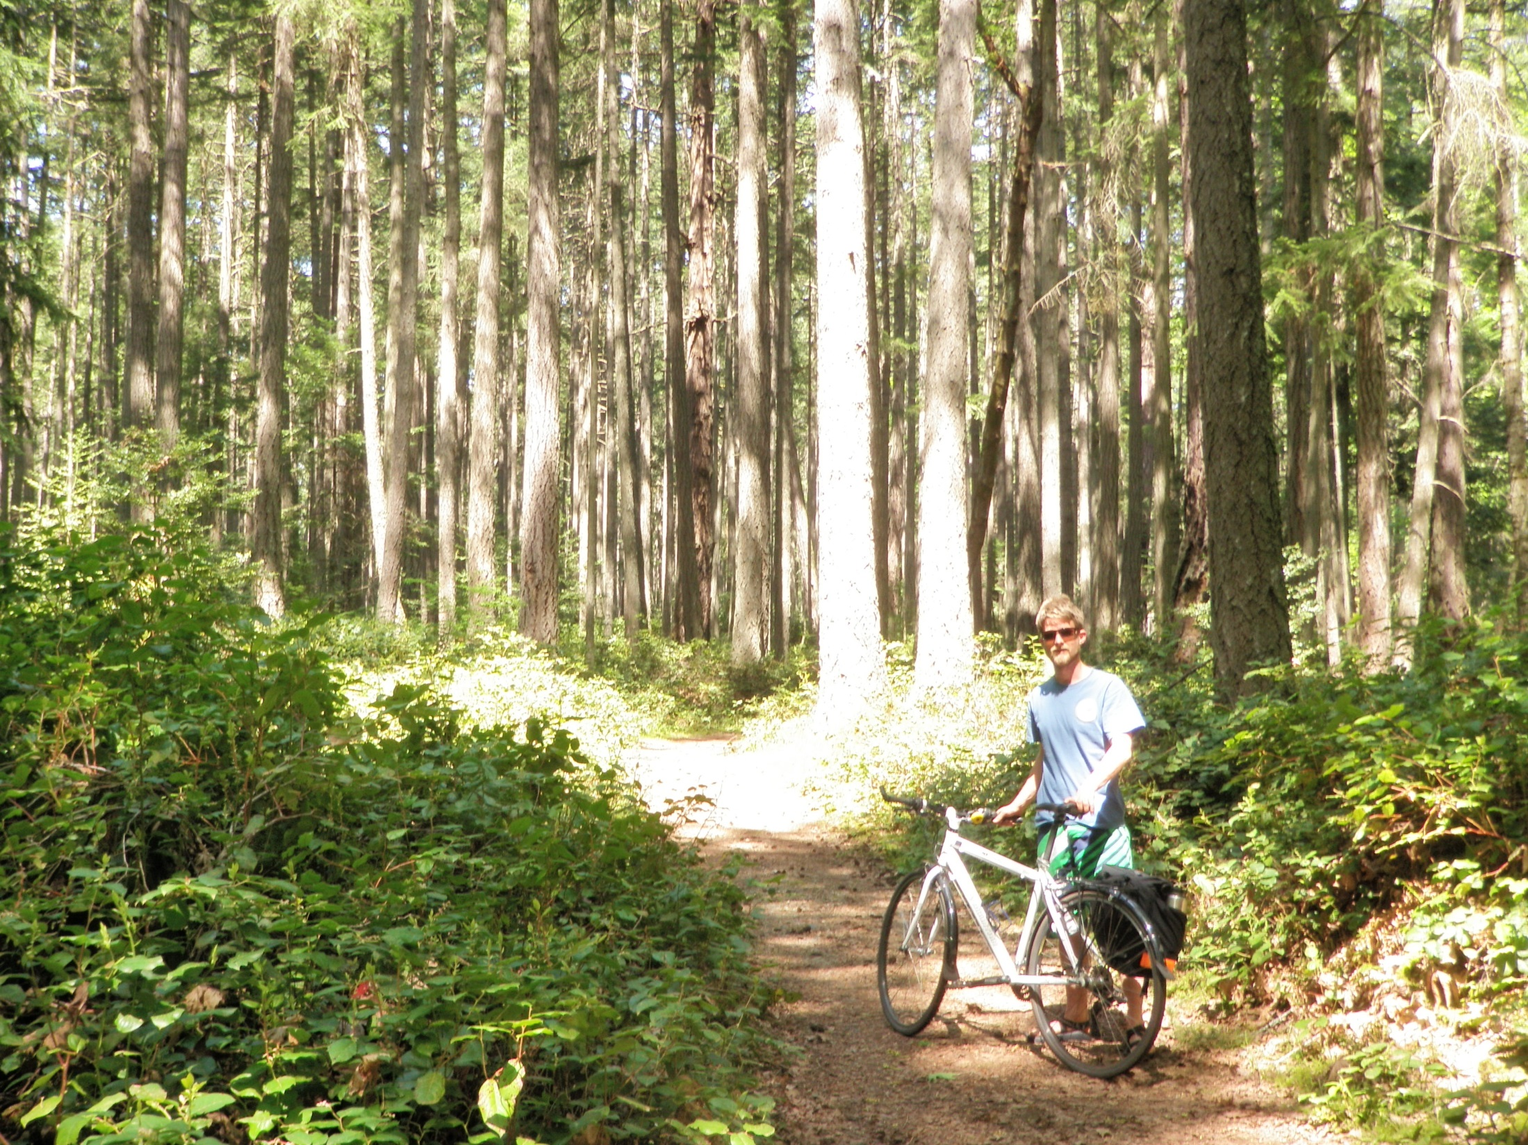

Slide 6
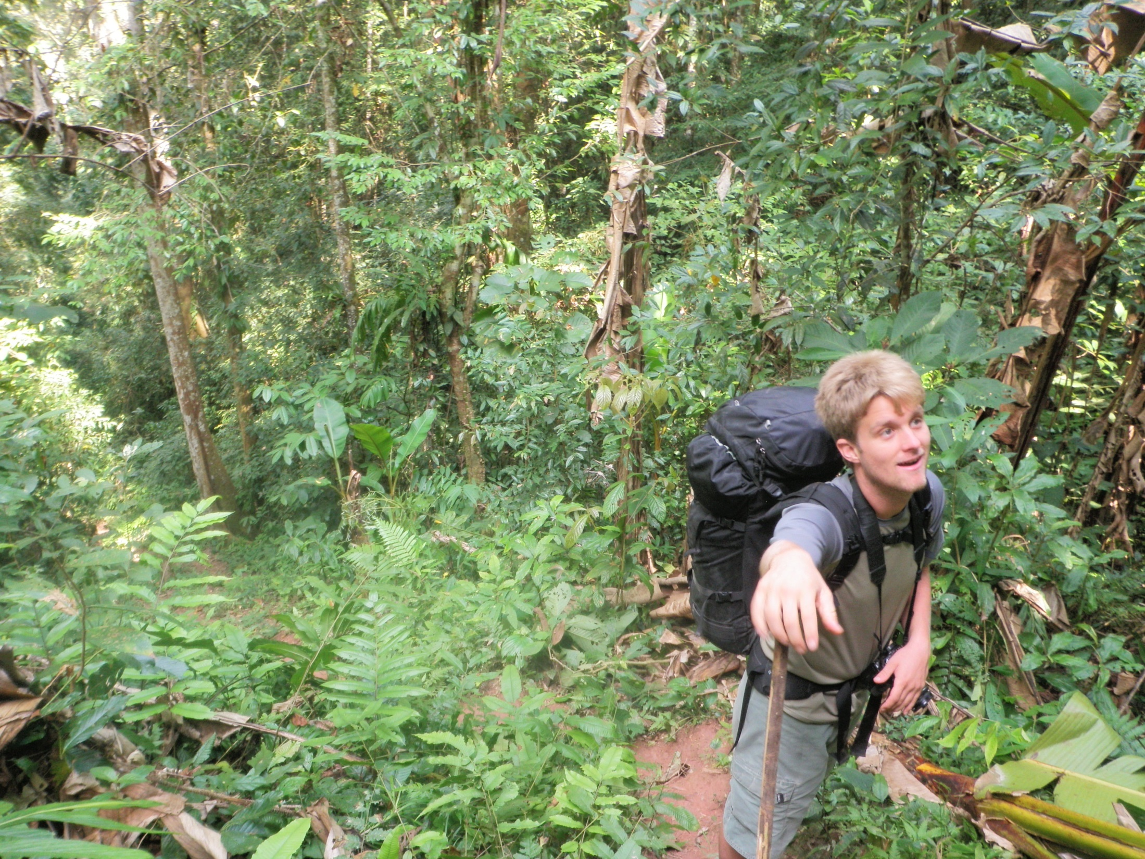

Slide 7
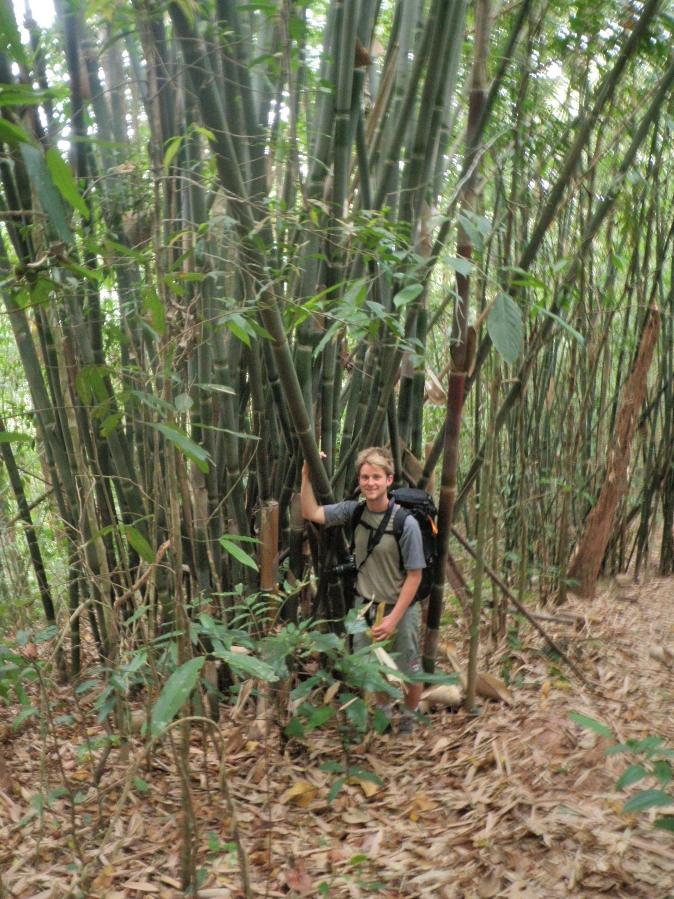

Slide 8
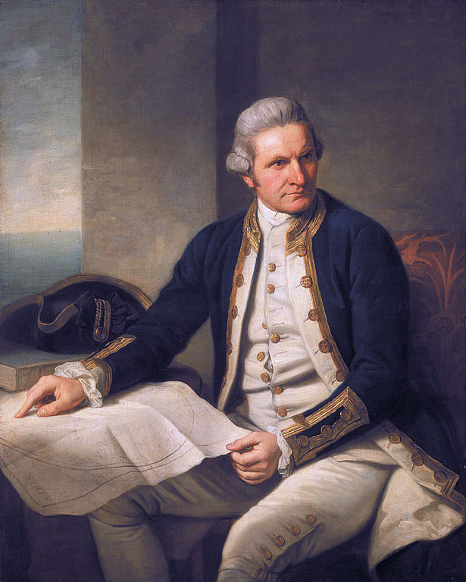
Exploration: British Columbia
CAPITAN COOK
1st European explorer in BC, claimed BC for Britain
Looking for the North West passage
Landed in Nootka Sound repair ships 1778
Traded for sea otter furs
Pg. 82

Slide 9
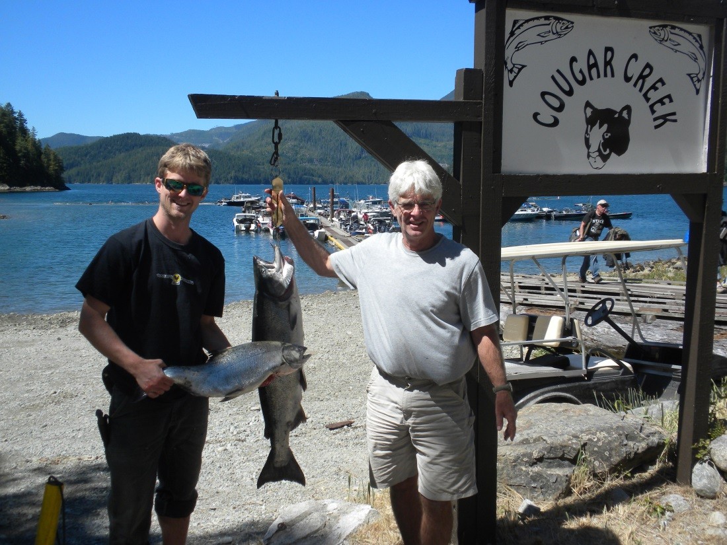
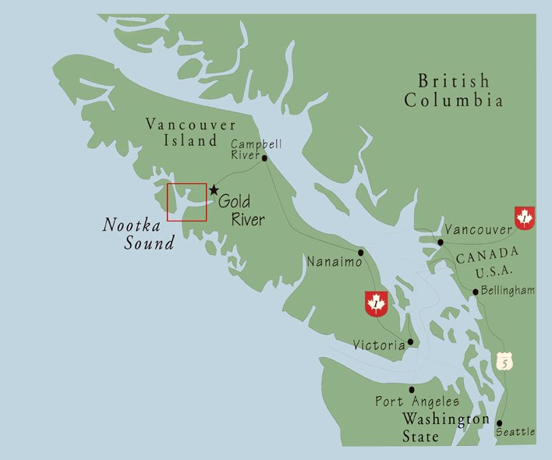
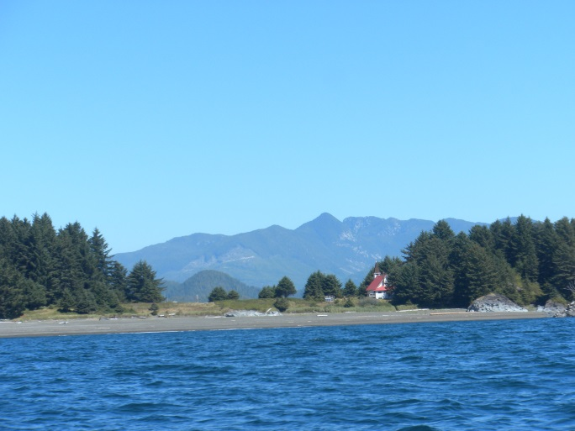
Exploration: British Columbia by Sea
Nootka Sound

Slide 10
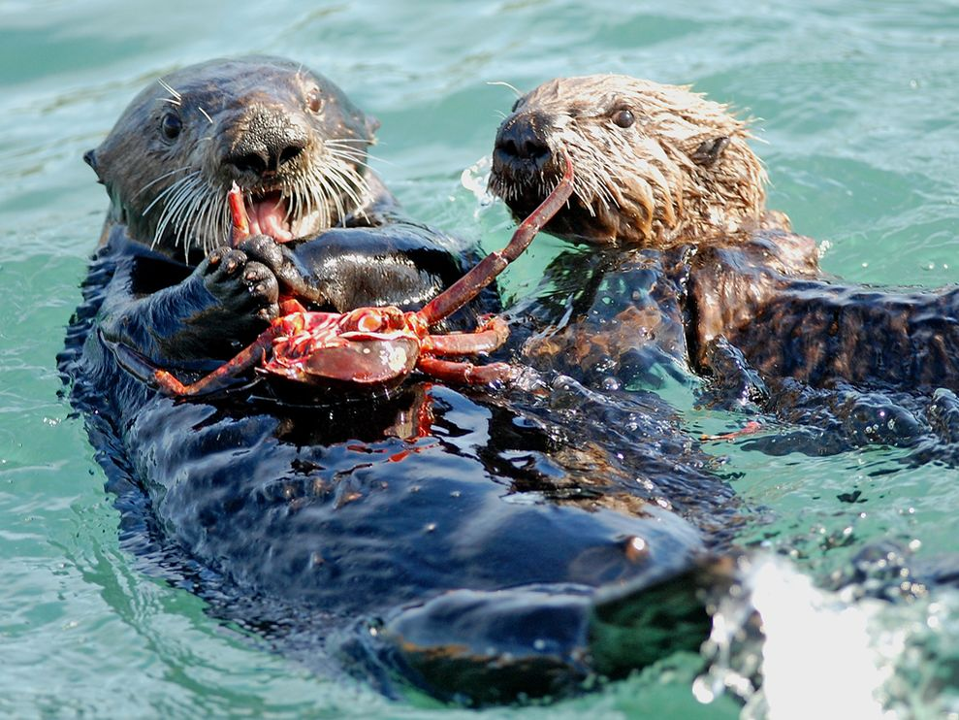
Exploration: British Columbia by Sea
Sea Otter furs fetched high prices in China, resulting in a “fur rush” off BC’s coast.
Britain and Spain almost went to war over the control of the area

Slide 11
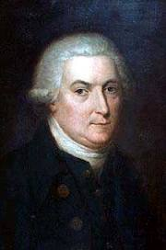
Exploration: British Columbia by Sea
Capitan Vancouver and Capitan Quadra (Spain) negotiated peace and explored the waters around Van Isle together 1792-94.
Ex: Cortez Isle, Valdez, Galliano,

Slide 12
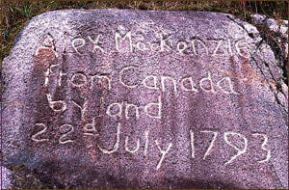
Exploration: British Columbia by Land
Alexander Mackenzie
1793 1st European to reach the Pacific over land.
Aided by 1st N guides and hunters
NWC employee
Found the Mackenzie River but called It “Disappointment River” b/c it lead to the Arctic ocean rather than the Pacific

Slide 13
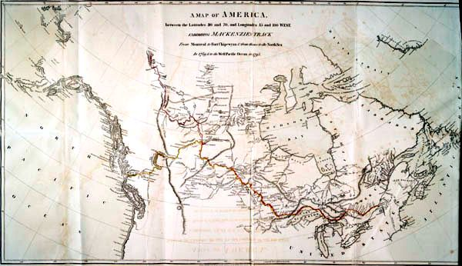

Slide 14
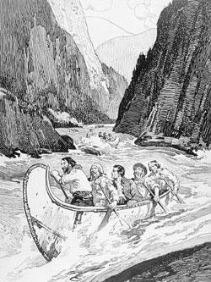
Exploration: British Columbia by Land
Simon Fraser
1st European to descend the river that bears his name
NWC employee

Slide 15
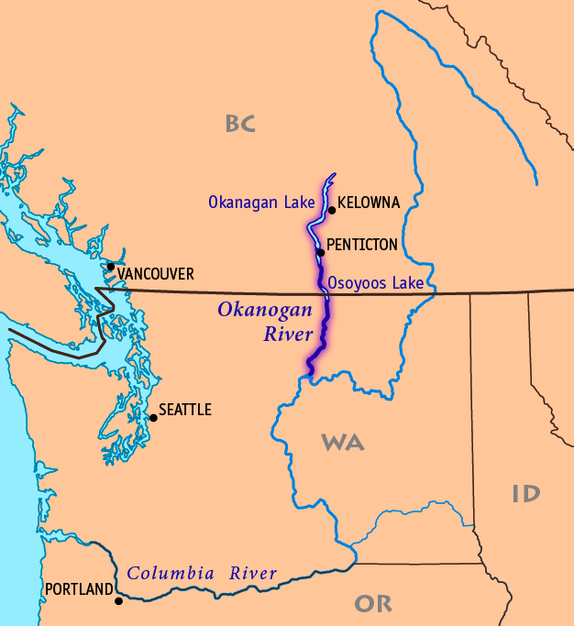
Exploration: British Columbia by Land
David Thompson
NWC employee
Built a trading post on the Columbia River
1811 Reached the Pacific via the Columbia River only to find an American fur trading fort there.
NWC buys out American fur traders land= NWC controlled all land west of the Rockies

Slide 16
Business Merger
In 1821 NWC & HBC merged, reasons:
By 1820 NWC & HBC were suffering financially
NWC expanded too fast- too many outposts were expensive to maintain
Lawsuits over the Red River Colony= $$$
Beaver in decline = less profits

Slide 17
Business Merger
Cutting Costs:
NWC route between Fort William and Montreal was closed, shipping furs from York Factory to England was cheaper.
Many workers laid off, and many trading posts closed
George Simpson became head of operations
Simpson was hands-on, travelling to forts unannounced to inspect operations

Slide 18
Modern day Explorers
Deep Sea
Deep Earth (6min)
Deep sea, deep mind
How are explorers of today different than explorers we study in SS10?
How are they similar?
What is another realm of exploration in the human world?

Slide 19
Test On Friday

