Slide 1
Lesson 2 part2

Slide 2
Current events?

Slide 3
1st N. Sports
YouTube: https://www.youtube.com/watch?v=1QVdyhpsOaY (head pull)
You tube (ear pull) https://www.youtube.com/watch?v=VdzYBkiwcdk
YouTube (2 foot kick and one arm balance) https://www.youtube.com/watch?v=jzljyVAJ8IY

Slide 4
Lesson 5
Jig Saw

Slide 5
Current Events

Slide 6
Disclaimer:
We are going to tackle a very difficult and dark subject in Canadian history, one that is not found in your text books.
Memories and feelings about residential schools can be painful and depressing, if you begin to feel uncomfortable at any time during this class you may be excused to compose yourself and return to the classroom.

Slide 7
Question
In your head- no shouting out…
Think about everything you know or don’t know but want to learn about what residential schools are..
Lets make a mind map

Slide 8
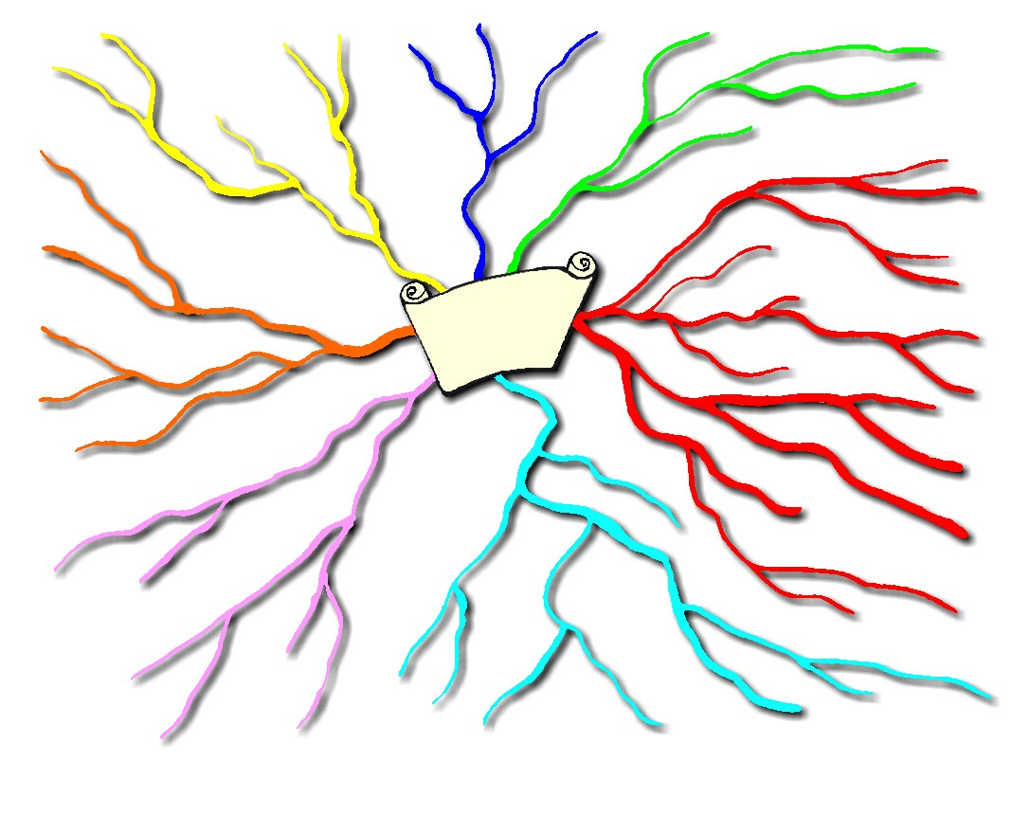
Residential
schools

Slide 9
Activity
Read articles quietly in groups
After everyone in your group has read the article work through the question sheet together
Groups elect one person to present their findings to the class

Slide 10
Follow up
In 2008 the government of Canada apologised for the assimilation policies of residential schools
2006- Survivors of the schools were given $10,000 for the first year in the schools and $3,000/yr for subsequent years.

