Slide 1
Leaders

Slide 2
What are some qualities of leaders?

Slide 3
What do we expect from leaders?

Slide 4
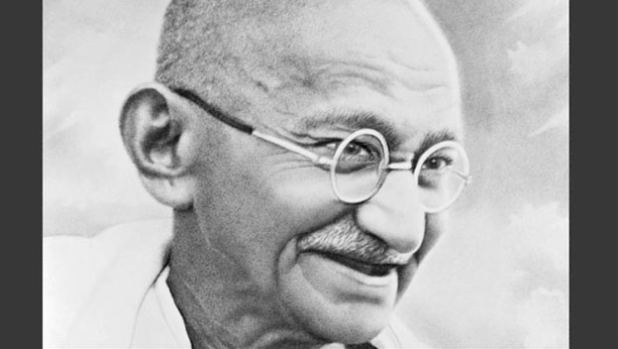
Mohandas Gandhi

Slide 5
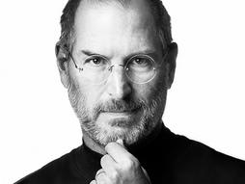
Steve Jobs

Slide 6
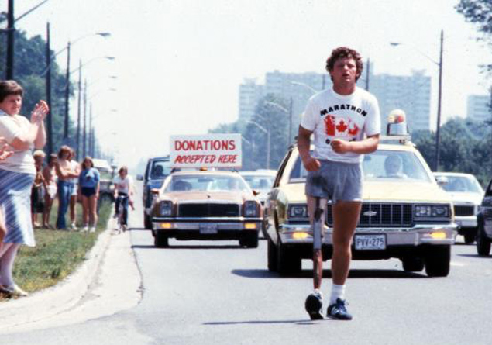
Terry Fox

Slide 7
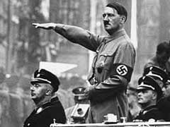
Adolf Hitler

Slide 8
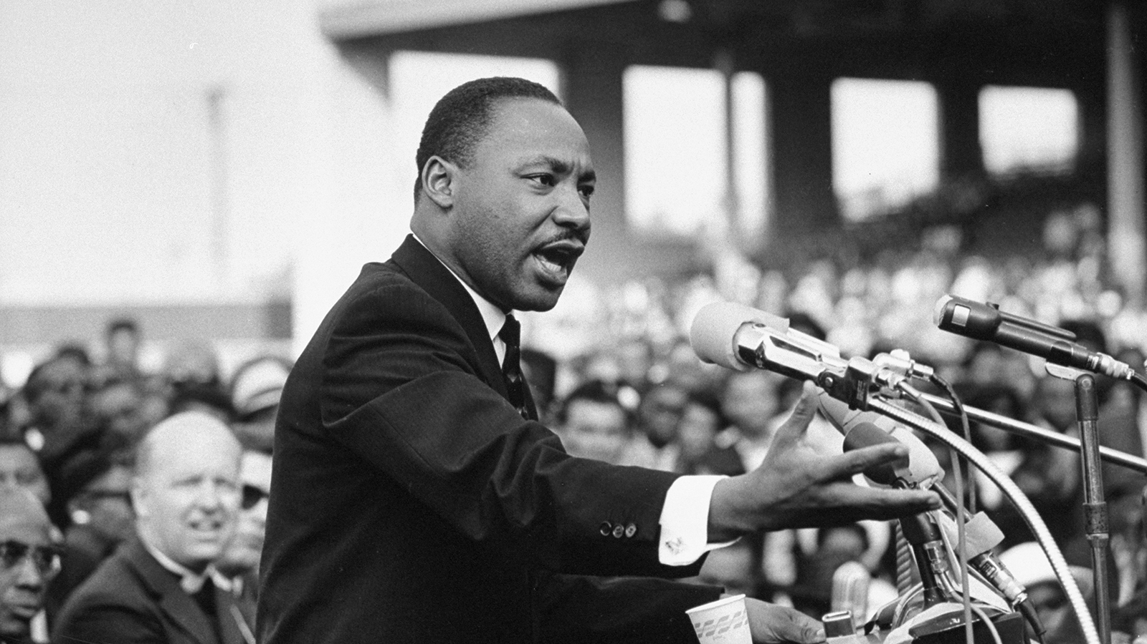
Martin Luther King Jr.

Slide 9
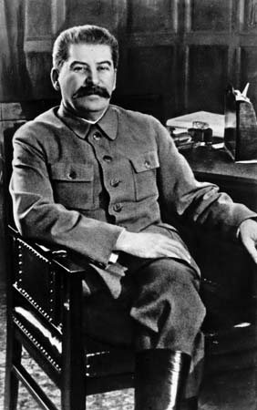
Joseph Stalin

Slide 10
Leader Research Project
Choose a leader who inspires or interests you
Create a short power point presentation to give to the class (5 minutes max, 5-10 slides long)
Include:
character traits that made them great leaders (/4)
Accomplishments they did (/5)
2 quotes & why the quote is important (/4)
Their legacy- how the world has changed in response to their actions (/7)

