Slide 2
Lesson 1 Part 2

Slide 3
Sedentary Lifestyle
Can you think of any first nation groups that were able to live a sedentary life style?
Pacific coastal 1st N- great salmon runs afforded them time to hone fine arts and crafts
1st N. in the great lakes lowlands used agriculture to live a sedentary life.

Slide 4
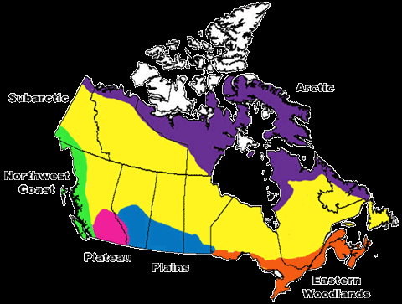
1st Nation (1st N) cultural areas

Slide 5
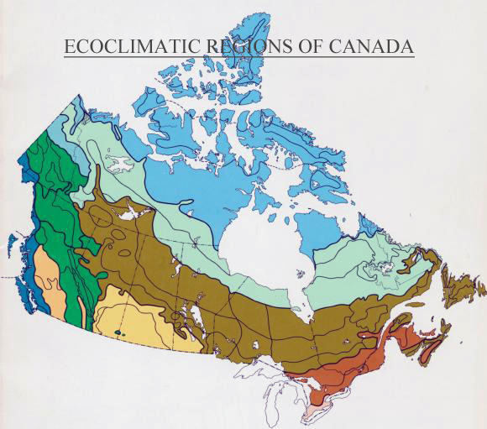
Climatic regions of Canada

Slide 6
Cultural and climatic zones
Climatic areas
1st N cultural areas

Slide 7
Culture and Ecosystem connections
Climate and ecosystems have a very strong effect on creating different cultures.
Our research project will explore how different 1st N groups adapted and survived in different geographic locations across Canada

Slide 8
1st N. Project
Step 1: Pick a group to study from the 7 cultural regions
Pacific NW coast
The Plateau/ Interrior
The Plains
The Sub-Arctic
The Arctic
The Eastern Woodlands
The Great Lakes- St. Lawrence Lowlands
*We must have each region represented in presentations

Slide 11
Next
Go to library and log on to a computer, we will receive a lesson on research from Mrs. Richards

