Slide 1
First Nations Culture
SS10: Lesson 1

Slide 3
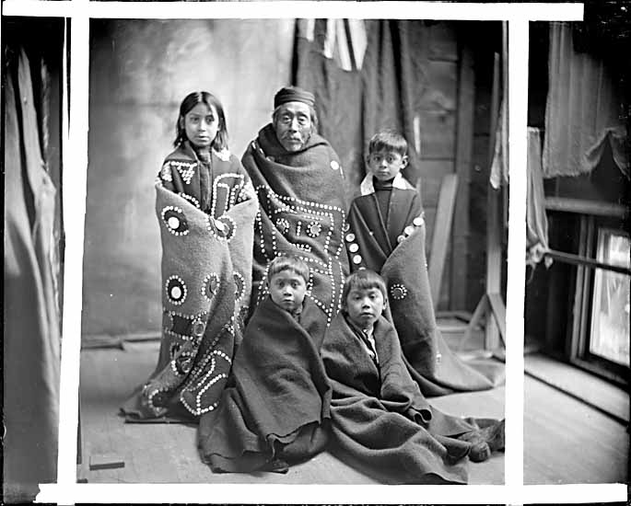
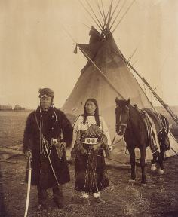
How our textbook portrays 1st Nations….

Slide 4
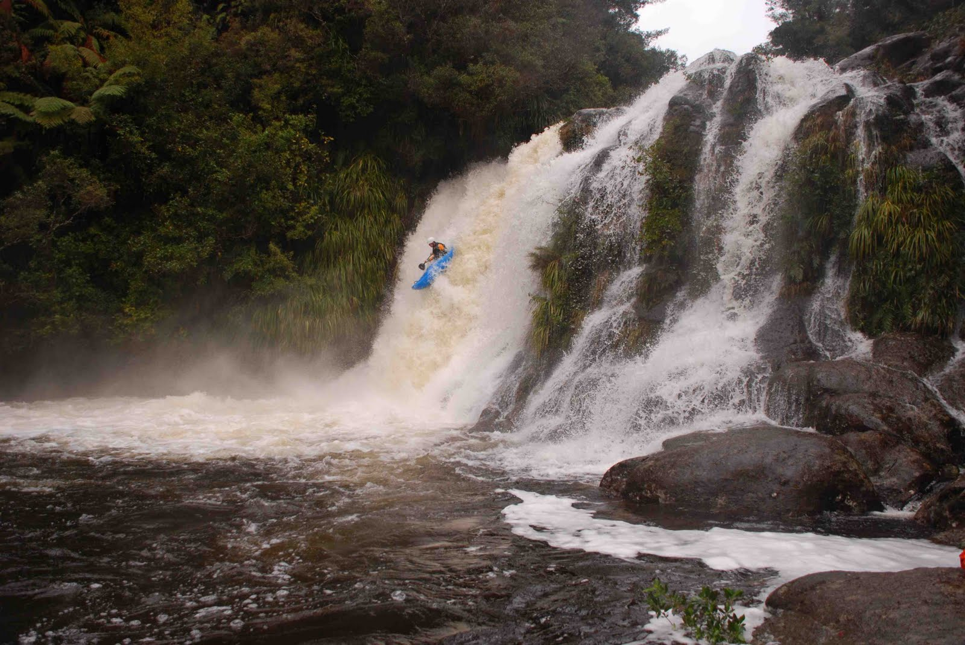
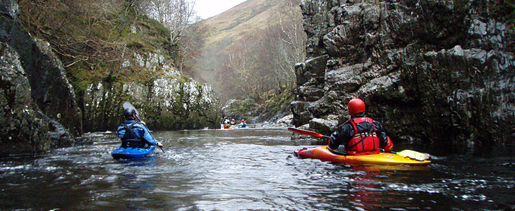
Some things the first nations of North America gave to the world….

Slide 5
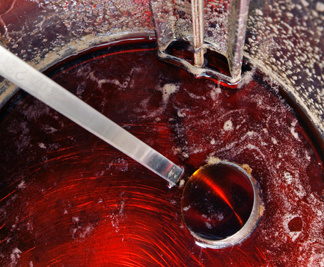
Some things the first nations of North America gave to the world….

Slide 6
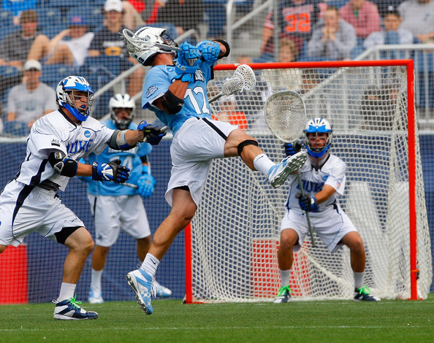
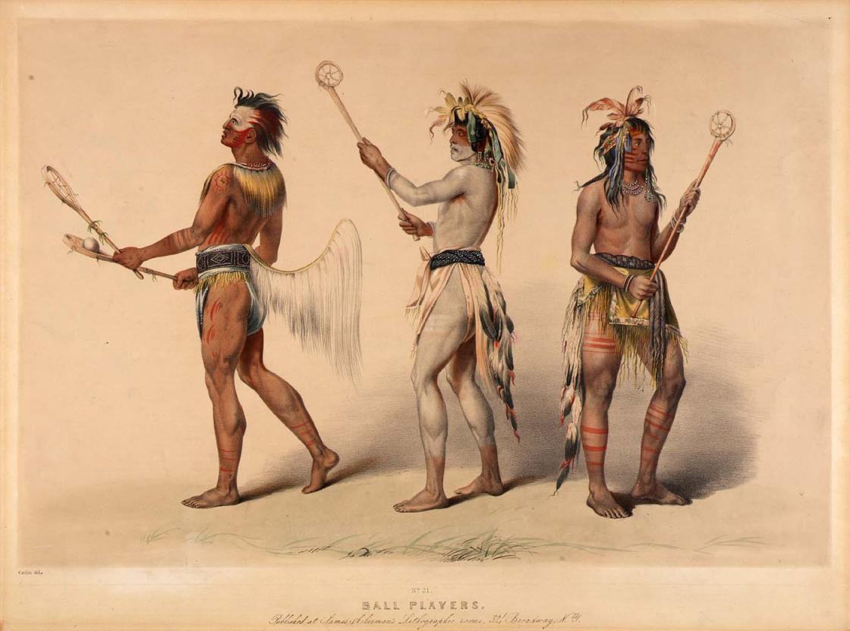
Some things the first nations of North America gave to the world….

Slide 7
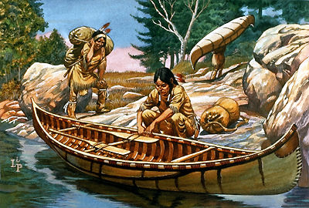
Some things the first nations of North America gave to the world….

Slide 8
Nomadic lifestyle
What does a nomadic life mean?
Nomadic lifestyle: never staying in one place for long, never living in a settled home
Some 1st Nations lived nomadic lifestyles in order to survive.
Why do you think this?

Slide 9
Nomadic lifestyle
1. Changing seasons

Slide 10
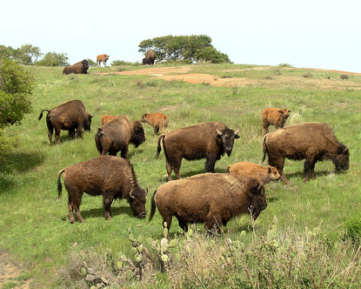
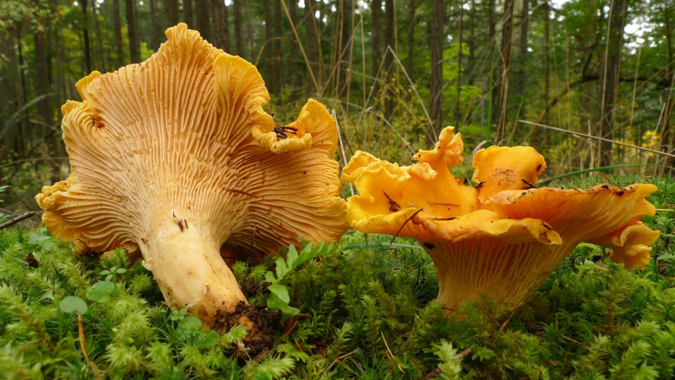
Nomadic lifestyle
2. Food resources

Slide 11
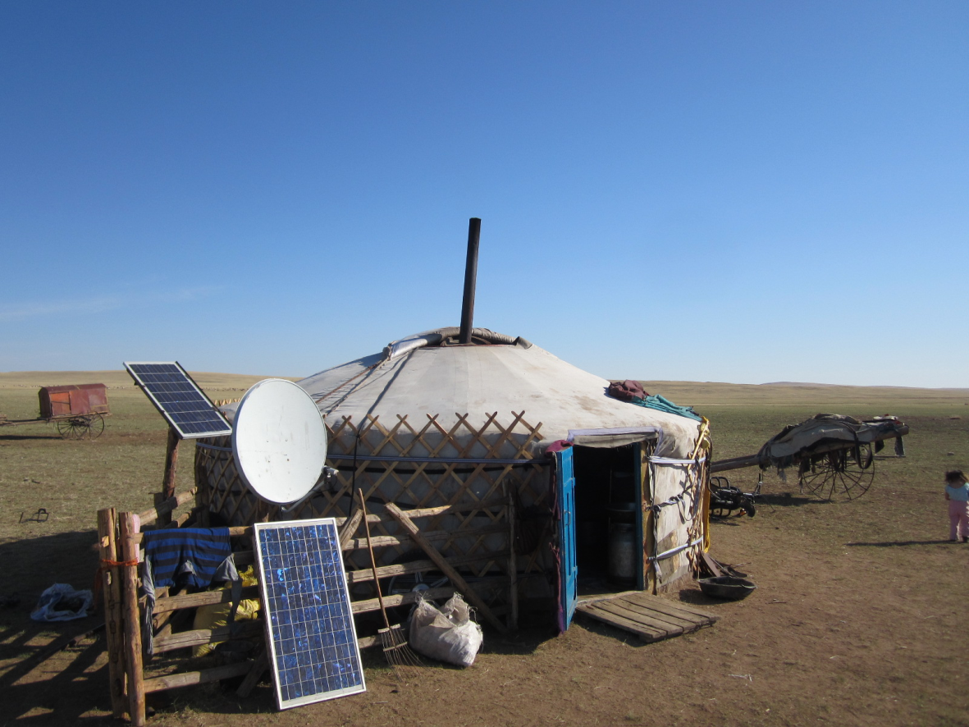
Nomadic lifestyle
Do you think nomads still exist today?

Slide 12
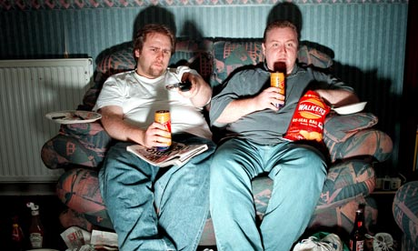
Sedentary Lifestyle
Now you know nomadic lifestyle what is a sedentary lifestyle?

Slide 13
Sedentary Lifestyle
Now you know nomadic lifestyle what is a sedentary lifestyle?
Sedentary life: living in one location, settling down for a long period of time
What do people need to be able to live this form of lifestyle?

Slide 14
Sedentary Lifestyle
Reliable food: agriculture or abundant natural resources
When cultures are able to become sedentary they can begin to develop complex social customs and art.

