Slide 1
What does a healthy lifestyle look like to you?
Take 10 min to draw you living a healthy lifestyle
Hand in when you are done
At the end of the Health unit we will add anything that you have learned

Slide 2
Health- Physical

Slide 3
Mmmmm food
Homer likes food!

Slide 4
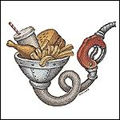
Food do we measure it?
Calories: A unit of measurement for how much energy is in food.

Slide 5
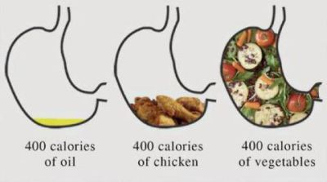
Food do we measure it?
In pairs discuss what you see in this image

Slide 6
Calories- how much do you need?
Males age 14-17: 2300- 3100 Cal.
Females 14-17: 1750- 2350 Cal.
Mr. Hoy (age?): 2500- 3000 Cal.
Based on a sedentary lifestyle.
If you live a very active lifestyle
your intake can be up to 5000 Cal!

Slide 7
How many calories do you need?
What factors determine your “caloric requirements”?
Age
Gender
Activity Level
Metabolic Rate
Body Size

Slide 8
So what about fat?
(Partners) Are all fats bad?

Slide 9
So what about fat?
(Partners) Are all fats bad?
Answer: No
We need fats for:
Energy, build the body, absorb nutrients

Slide 10
So what about fat?
Good fats
Bad Fats
Unsaturated
Ex: avocados, fish, nuts
Saturated
Trans-fats
Ex: bacon, cheese, deep fried food,
(anything that tastes good!)

Slide 11
Comedy Break
Who knows who Chris Farley is?

Slide 12
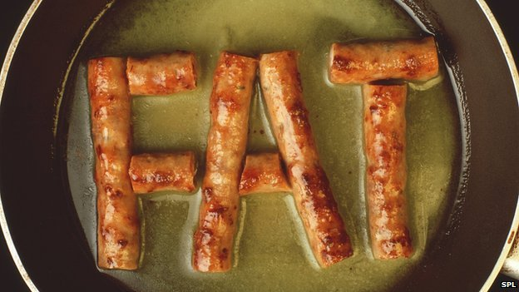
So what about fat?
Saturated Fats: Solid at room temperature
Sources: animal products, dairy,
Effects: Cause Cholesterol in blood to rise, which increase your chances of a___________

Slide 13
So what about fat?
How much is OK?
5% to 6% of calories from saturated fat. That means, if you need about 2,000 calories a day, no more than 120 of them should come from saturated fats. That’s about 13 grams of saturated fats a day.

Slide 14
Reading Labels
Labels are found on all packaged food
Use Nutrition Facts…
to easily compare similar foods
to look for foods with a little or a lot of a specific nutrient
to select foods for special die
…to make informed food choices

Slide 15
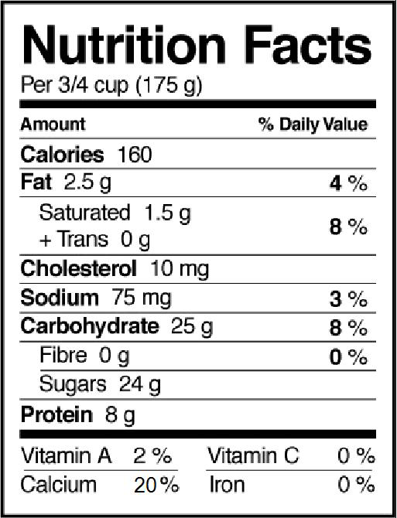
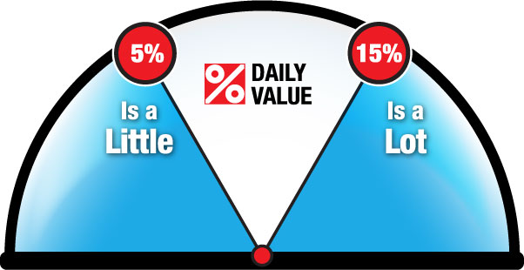
How to use the % Daily Value
READ the % DV
The % DV helps you see if a specific amount of food has a little or a lot of a nutrient.
5% DV or less is a LITTLE
15% DV or more is a LOT
Notes:
Slide #11- Speaker’s Notes
Step 2: Read the % Daily Value.
The % DV helps you see if a specific amount of food has a little or a lot of a nutrient.
As a rule of thumb, remember the following numbers:
5% DV or less is a little.
15% DV or more is a lot.
This applies to all nutrients in the Nutrition Facts table.

Slide 16
How to use the % Daily Value
CHOOSE
Make a better choice for you. Here are some nutrients you may want…
more of…
Fibre
Vitamin A
Calcium
Iron
less of…
Fat
Saturated and trans fats
Sodium
Notes:
Slide #12- Speaker’s Notes
Step 3: Choose.
Make a better choice for you.
You may want to look for food products with higher % DVs for fibre, vitamin A, calcium and iron.
You may also want to look for foods with lower % DVs for fat, saturated and trans fats, and sodium.
Remember to compare similar amounts of food.
Additional information for speaker:
There is no mention of vitamin C in the nutrients to increase list, but for some individuals, it could be a nutrient to increase. Vegetables and fruit are the best food sources of vitamin C.

Slide 17
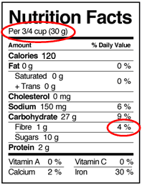
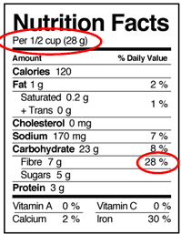
For example, if you would like to eat more fibre…
Cereal A Cereal B
… cereal A would be a better choice for you as part of a healthy lifestyle.
Remember: 5% DV or less is a little and 15% DV or more is a lot.
Notes:
Slide #13- Speaker’s Notes
Now let’s see how we can use what we have just learned to choose a cereal that would provide more fibre.
Here are 2 Nutrition Facts tables for cereals A and B. You can compare these 2 products since their weights in grams, 28 g and 30 g, are similar.
Cereal A provides 28% of the Daily Value for fibre, whereas cereal B provides 4 % DV. Cereal A would be a better choice for you as part of a healthy lifestyle.
Remember: 5% DV or less is a little and 15% DV or more is a lot.
Additional information for speaker:
When comparing similar food products, such as these two cereals, you should compare the amount of food by weight or volume (usually given in g or mL). This way, you are certain that you are comparing similar amounts of food.
You may also be able to compare products that don’t have similar amounts of food. For example, you could compare the % DVs of a bagel (90 g) to the % DVs of 2 slices of bread (70 g) because you would most likely eat either amount of food at one meal. It is also appropriate to compare the % DV listed for calcium in two single servings of yogurt, one containing 125 g of yogurt and the other containing 175 g, as they are both sizes that you would eat at one sitting.

Slide 18
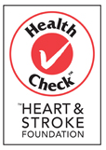
General Health Claims
General health claims are generally developed:
Should we rely solely on health claims?
by third party organizations | by corporations
Notes:
Slide #19 - Speaker’s Notes
As we have just seen, the Nutrition Facts table, the list of ingredients, nutrition claims and some health claims are regulated by Health Canada. These elements of nutrition labelling provide reliable and useful information.
Other types of claims, often referred to as general health claims, have appeared in recent years on front-of-package labelling. They include broad "healthy for you" or "healthy choice" claims as well as symbols, logos and specific words. These claims are generally developed by third parties or corporations based on information that is closely regulated by the federal government.
While it is required that this information be truthful and not misleading, consumers should not rely solely on general health claims to make informed food choices.

Slide 19
Lets go out for Lunch
Dairy Queen
MacDonald's
Subway

