Slide 1
Battle of Britain
June 1940 – September 1940
Emily, Marina, Ashley B, Nick, Kyle

Slide 2
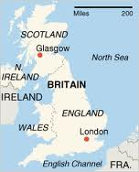
General Information
Between Germany (axis) and Canada + Britain + New Zealand + Australia (allies)
It was an aerial battle fought above Britain
Canada + Britain + New Zealand + Australia were defending against the German’s assault
The Germans wanted to take the English Channel

Slide 3
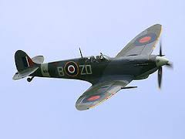
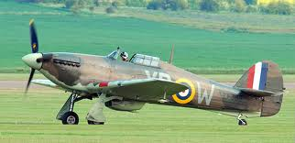
Canada’s Role
To better prepare against the soon to come German assault, Canada’s 1st Division joined the 7th British Army Corps with New Zealand and Australia as well, under General McNaughton.
Canadians flew Spitfires and Hurricanes against the German Luftwaffes and became the first Royal Canadian Air Force unit to actually fight against the Germans
They received their “baptism of fire” (A soldier's first experience of actual combat conditions)
Great Britain survived the blitz because of the tenacity of the allies despite the continuous waves of Luftwaffes

Slide 4
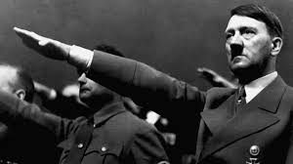
Significance
Casualties: allied = 23,002 dead (mostly civilains)
Germans lost around 600 men and 1887 aircraft
Adolf Hitler was heartbroken and felt his dream of world domination had gone
It was the first significant loss for Germany due to their failure to gain air superiority over the Royal Air Force
The Battle of Britain drained German economy because of their constant bombing on Britain
Approximately 35,000 tones of bombs were dropped by the Luftwaffe – all resources were wasted, as they lost the battle

Slide 5
Summer 1940- Mr. Hoy’s additions
-After conquering most of Europe, Germany looked to Britain as their next conquest.
-Because the British navy was so strong, Germany could not invade by sea= air was the battle ground for the Battle of Britain
-Germans called the Battle of Britain “Operation Sea Lion”
-Initially German bombers targeted air fields, navy, and military bases.
-German Luftwaffe out numbered British Royal Air Force

Slide 6
Summer 1940- Mr. Hoy’s additions
-The Blitz: The German bombers hit London for 55 days straight- mistake?
-British retaliated by bombing Berlin
-Germans underestimated the power of radar, giving the Allies a huge advantage

Slide 7
The Operation Barbarossa
By: Carly, Sean and Rob

Slide 8
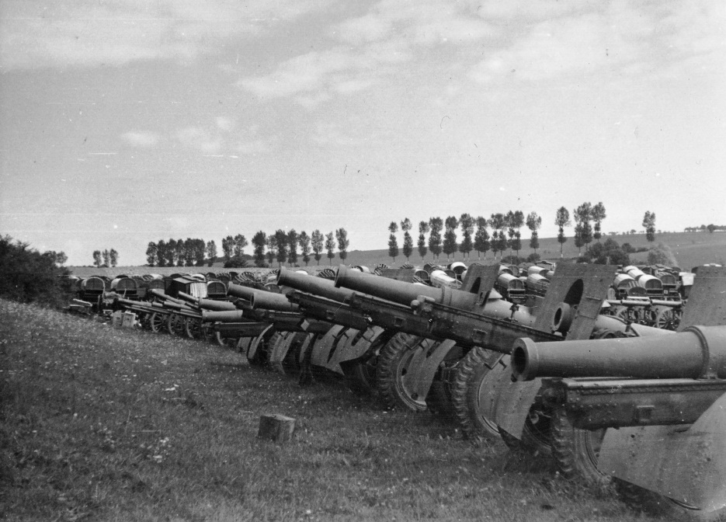
Objectives for the Germans
They wanted to gain control of the soviet union and their assets
Economic recourses from the Ukraine and southern Russia in the south.

Slide 9
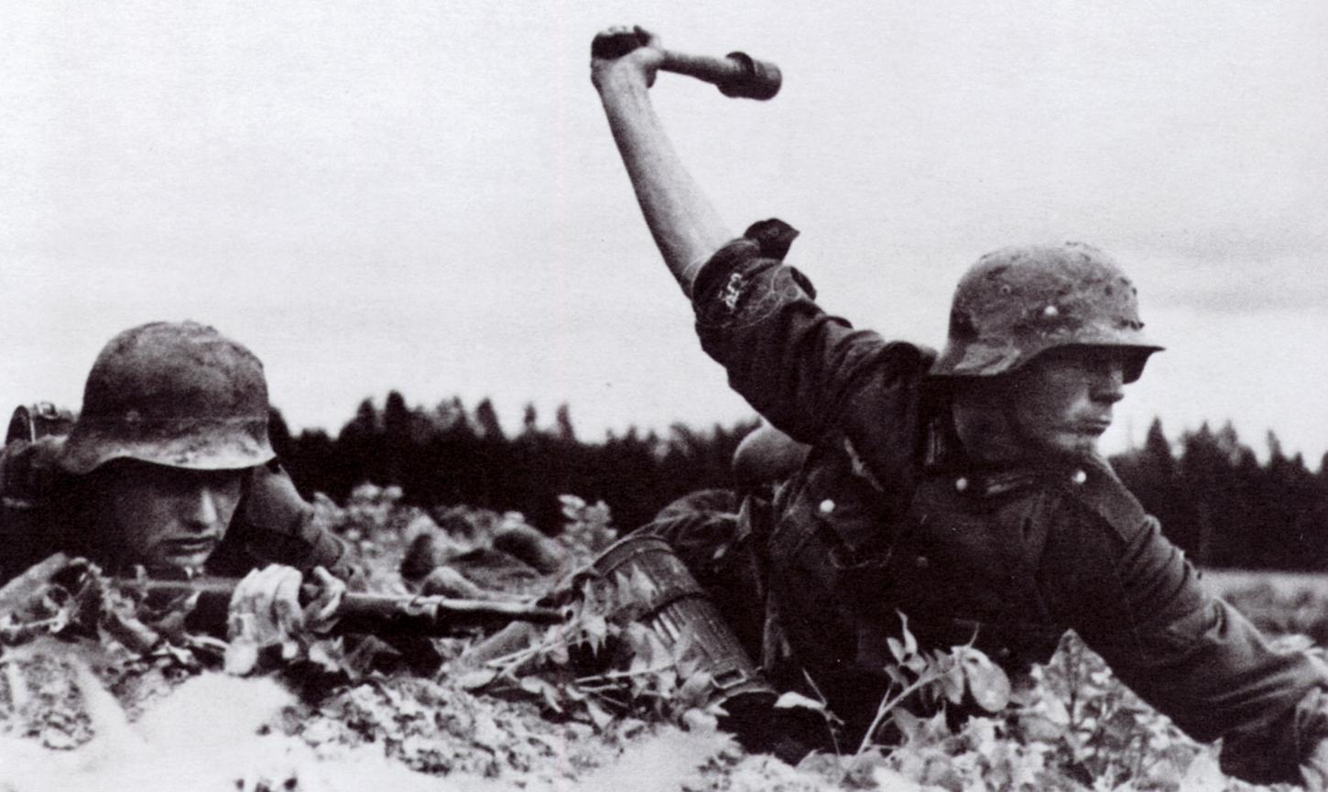
On June 22 1941 Germany attacked Russia with their military troops
Their over all force 4,300 tanks, 4,389 aircraft, 46,000 artillery pieces and 3,767,000 men on the front line
Russia over all force was 2.1 million men on the front line, 15,000-25,000 tanks, 35,000-40,000 aircraft but only 11,357 were combat ready.

Slide 10
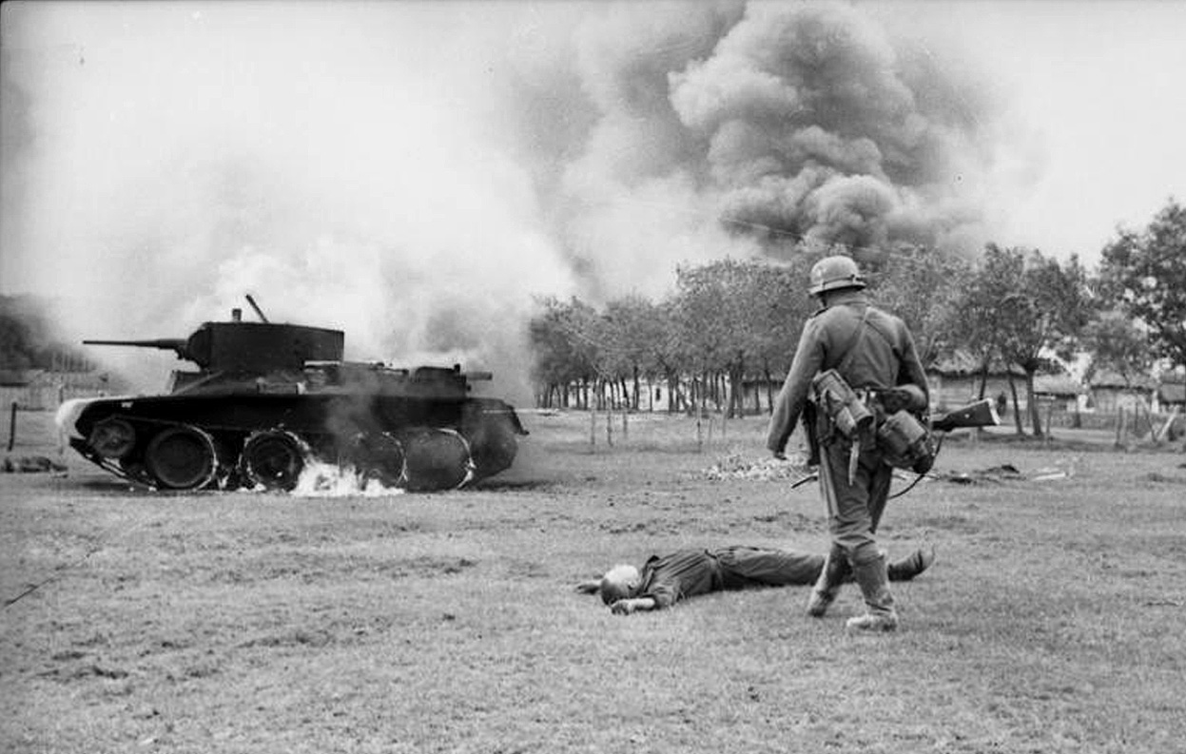
Germany is the aggressor and the Soviet Union is the defender.
The German's lost over 1 million axis.
The Allies lost over 2 million casualties.

Slide 11
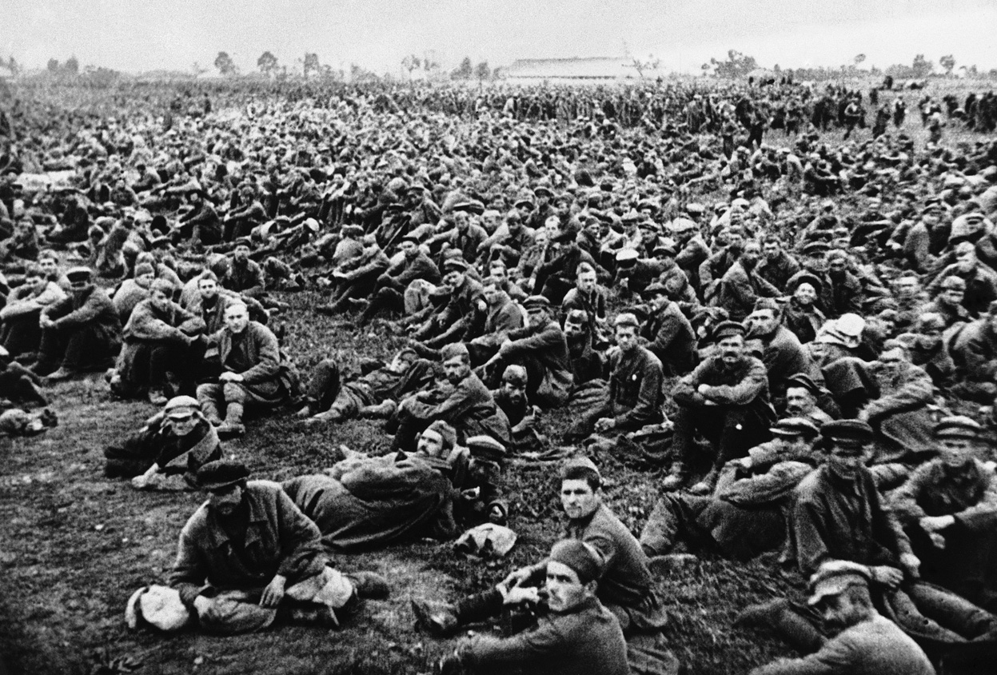
What the significance did the battle play in the outcome of the war?
If the Germans would have left Russia alone they would of probably have taken over the rest of Europe

Slide 12
Germans invade Russia- Mr. Hoy’s Additions
One objective was to take the rich oil fields in the southern Caucuses to feed the blitzkrieg
German military much more advanced than Russian
Russian military outnumbers German army
Initial German success due to the majority of Russian army in the East, expecting a Japanese invasion

Slide 13
Why it was a bad idea to invade Russia
Timing- German soldiers were not prepared for the German winter
As Russian industrial output ramped up, the Russian army quickly became the largest and most powerful army in the world.
Oil in tanks froze in winter conditions
Spread German forces too thin, the west became vulnerable

Slide 14
Pearl Harbor December 7, 1941
Who was involved in Pearl Harbor?
Japan and the United States were the main two groups in the battle at Pearl Harbor. Pearl Harbor is located in Hawaii, and this particular confrontation took place on December 7, 1941.

Slide 15
What were the military units utilized in this battle?
The military units involved included the Japanese Imperial Navy and the US Naval Base. The Japanese ranks included 353 Japanese fighters, bombers, and torpedo planes.

Slide 16
American Casualties;
The casualties for the Americans included; 2386 dead, 1139 wounded and 18 ships sunk, including 5 destroyers.

Slide 17
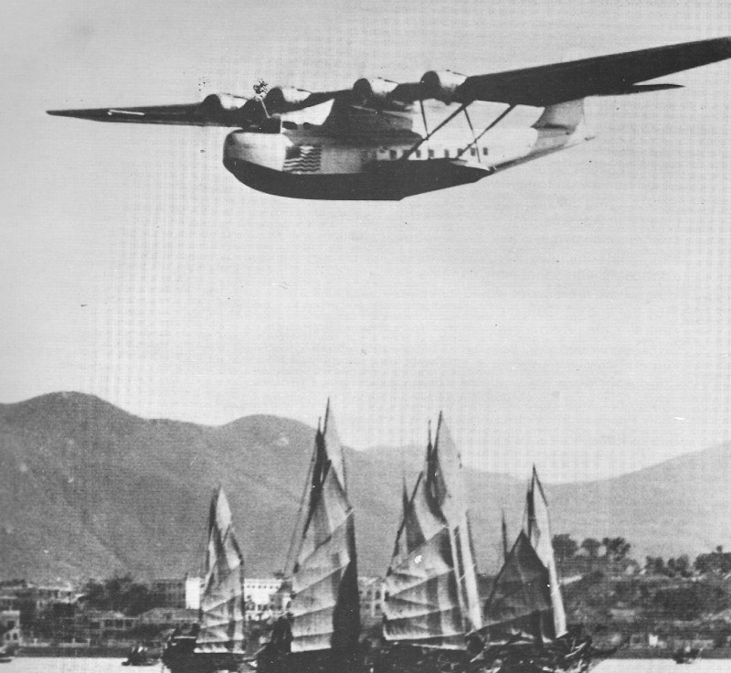
Canadian Involvement;
During the Pearl Harbor war, the Canadian forces weren’t directly involved. However, they did declare war on Japan after Pearl Harbor was attacked. Canadians were stationed at Hong Kong, along with British and Indian forces. They were also the first to see battle in World War II. After being attacked for 17 days, the Canadians surrendered on December 25, 1941.
About 700 soldiers either died or were taken to Prison Camps, where they later died.

Slide 18
Pearl Harbor- Mr. Hoy’s Additions
The Japanese surprise attack on Pearl Harbor officially drew the USA into WW2
By drawing the Americans into combat the Axis now had the worlds biggest industrial power fighting against them
Canadians started to fear a Japanese uprising in BC and sent Japanese-Canadians to internment camps.

Slide 19
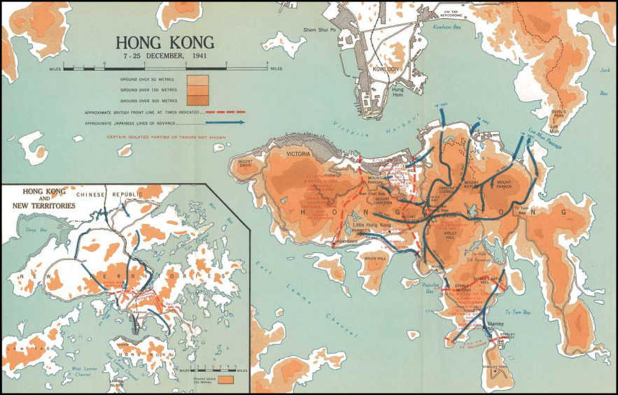
Battle of Hong Kong 1941
Occurred same morning as Pearl Harbor attack
Japanese invade British Hong Kong
In 1940 British military deemed Hong Kong less important and moved reserves back to Europe, leaving Hong Kong vulnerable

Slide 20
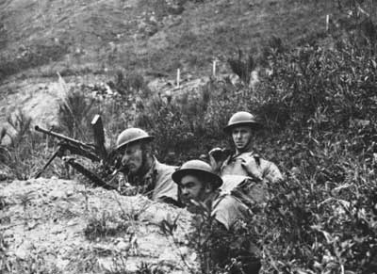
Battle of Hong Kong 1941
Japanese soldiers outnumbered Allied soldiers nearly 4 to 1
Japanese soldiers more experienced than allied soldiers
Allied soldiers under
equiped

Slide 21
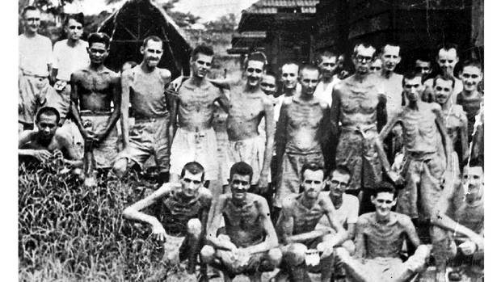
Battle of Hong Kong 1941
After 17 days of fighting, Allied forces surrendered
Many POW’s went to work camps where they died from mistreatment

Slide 22
Battle of Ortona
By: Aiyana, Brad, Brady, Bridget, Seamus

Slide 23
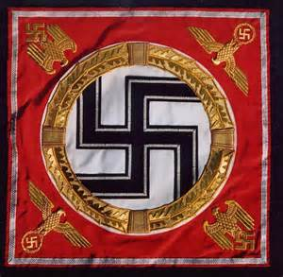
Where did the battle occur?
The battle was fought in the small oceanic town of Ortona, Italy and was dubbed “Little Stalingrad”
The was fought between the German Parachute Division led by Generalleutnant Richard Heidrich, and the first Canadian Infantry Division.
Who was involved in the battle?

Slide 24
What were the major military units involved in this battle?
Adolf Hitler ordered the German first parachute division to defend Ortona and on December 20th 1943 The Canadian First Infantry Division launched an assault on Ortona under the command of Chris Vokes.
Germany lost 100-200 men while Canada suffered 1375 deaths.
How many casualties for each side?

Slide 25
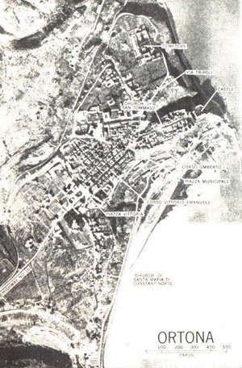
What was Canada’s role in the battle?
Canada’s role was to relieve the 78th British Infantry on the Adriatic Coast pushing within 2 miles of Ortona, who were relieved by the 2nd brigade infantry.
The Defender was Germany as they originally held the city and Canada was making the aggressive advances
Who was the aggressor and the defender?

Slide 26
What significance did the battle play in the outcome of the war?
It allowed Canadian's to push the allied front further and was one of Canada’s greatest war time achievements

Slide 27
Italy Campaign
In 1943 Allies invaded Italy called the “soft underbelly” of Europe.
Italian resistance was weak however garrisoned German forces proved difficult
Many Italian soldiers surrendered quickly as they had lost faith in Mussolini and Fascism

Slide 28
Next Class Preview: D-Day
Storming Juno
D-Day invasions
Liberation of Holland
Japanese Internement

