Slide 1
Lecture 4b

Slide 2
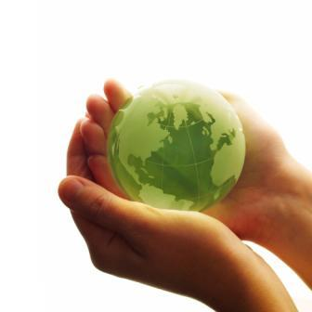
Sustainability
What do you think sustainability is?
Each table come up with a definition and share on board.

Slide 3
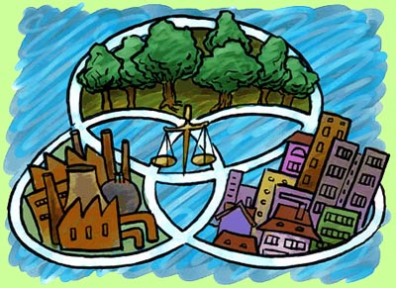
Sustainability
Development that meets the needs of the present while not compromising future generations needs.

Slide 4
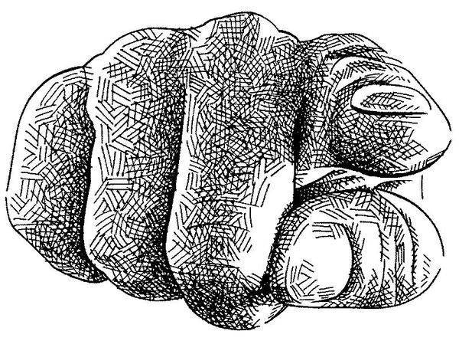
Sustainability
Development that meets the needs of the present while not compromising future generations needs.
What steps can YOU take to live a more sustainable life?

Slide 5
Sustainability
Renewable resources: can regenerate over time
Ex: trees
Non-renewable resources: can only be used once
Ex: oil

Slide 6
Sustainability
Peak Oil: is the theory of when oil extraction has peaked, production will enter a terminal decline.
It is estimated we have consumed 50% of the worlds oil resources.
As resources become scarce their value increases, this means that the cost of gas is going to go up.
What implications does this have on YOUR life today?

Slide 7
Life on Earth
Water, air, and soil are the 3 conditions that make up the resources for life on earth.
Human activities affect these conditions, and so our activities affect life on earth
Our education system calls these “environmental challenges”, I prefer to call them human impacts.

Slide 8
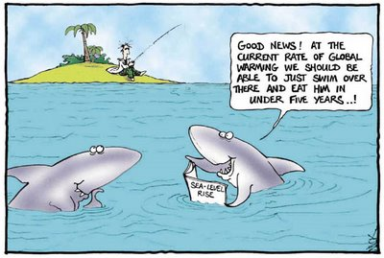
Class preview
Current events
Lecture
Textbook assignment
Study/homework

Slide 9
Review from yesterday
So what new stuff did we learn about?
Environment
Spheres
Sustainability
Peak oil
Renewable & non-renewable resources

Slide 10
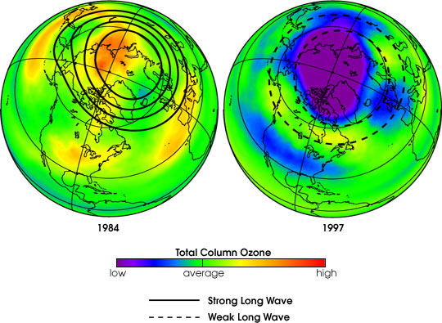
Human impacts: Ozone
1. Ozone Depletion: A layer of the atmosphere that blocks UV rays has developed holes due to chlorofluorocarbons (CFC’s).
UV rays cause cancer and kill plankton
Montreal Protocol- aims to eliminate use of CFC’s
CFC’s are found in aerosol sprays and air conditioners and fridges.

Slide 11
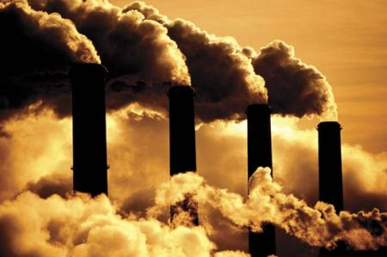
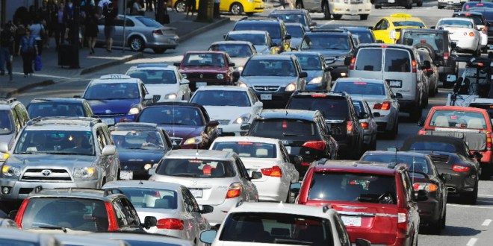
Human Impacts: Climate Change
Hot topic!
2. Green House Gasses (GHG’s): Prevent heat from leaving the planet

Slide 12
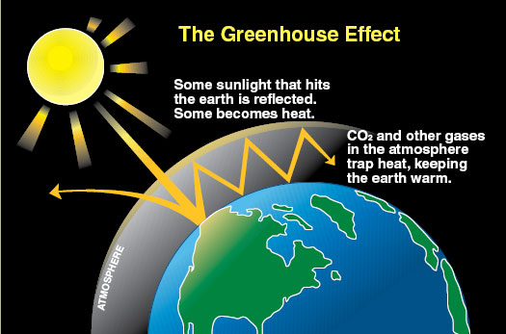
Human Impacts: Climate Change
GHG’s: CO₂ , water vapor, methane, nitrous oxide
Cartoon to help Mr. Hoy explain how this works

Slide 13
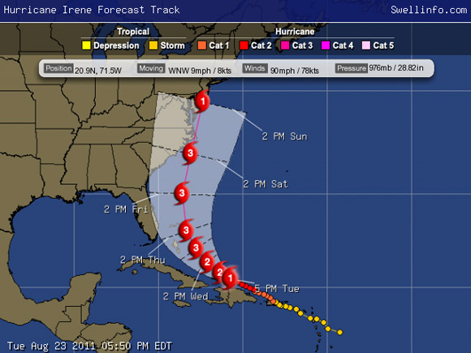
Human Impacts: Climate Change
Canadian impacts: warmer temperatures, melting of the permafrost, melting of glaciers and arctic ice, rising sea levels. Shifting animal ranges. Erratic weather patterns.

Slide 14
Human Impacts: Climate Change
Actions taken?
Kyoto Protocol: in 1997 countries of the UN declare they will reduce GHG emissions to stabilize carbon emissions in the atmosphere.
Canada initially signs up but withdraws in 2011

Slide 15
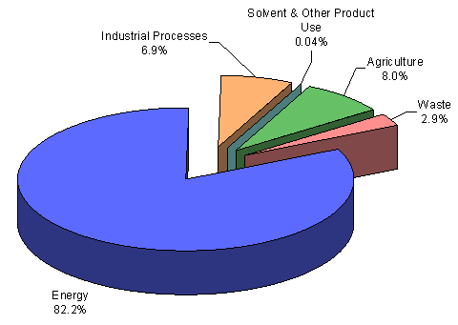
Human Impacts: Climate Change
What are the main contributors of GHG’s in the world?
Industry, forest fires, cattle, cars, deforestation.
How have scientists proven this?

Slide 16
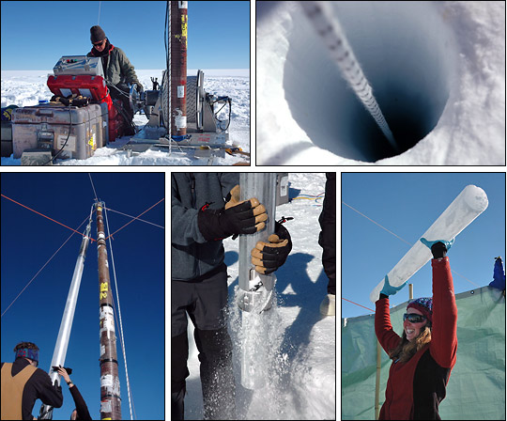
Human Impacts: Climate Change
Ice cores from the arctic can be date back 1000’s of years and keep a record of the atmosphere.
Around the industrial revolution there is a huge spike in GHG’s= human caused.

Slide 17
Human Impacts: Acid rain

Slide 18
Human Impacts: Acid rain
Acid Rain: Sulfuric Acid released into the atmosphere, then falls to the earth with rain, snow, or fog.
Main contributor: Coal Power plants, burning of fossil fuels.
Acid rain effects vegetation by limiting their ability to absorb nutrients from the soil. Aka: BAD for the environment.

Slide 19
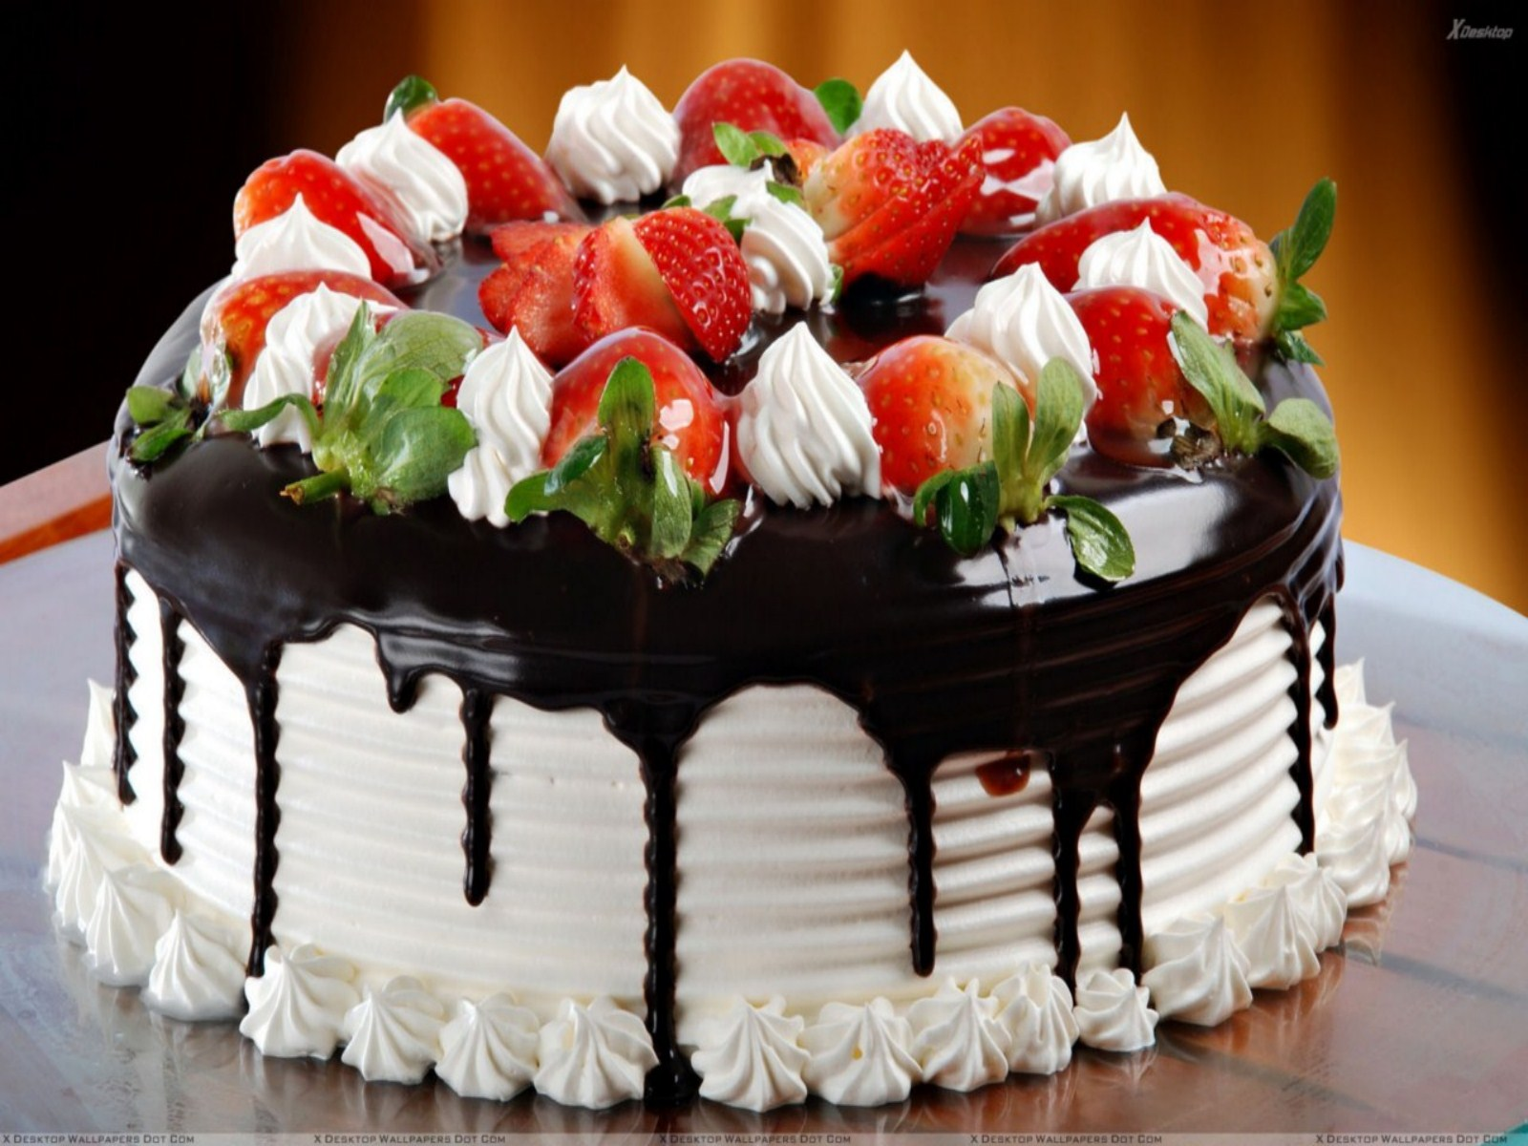
Human Impacts: Desertification

Slide 20
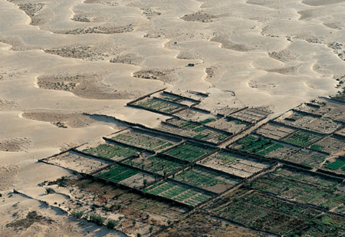
Human Impacts: Desertification

Slide 21
Human Impacts: Desertification
As we use up aquifers, natural vegetation can longer get the water it needs and dies, creating deserts.
When water evaporates it leaves behind salt. Overtime soils become too salty to grow vegetation.
As aquifers reach low levels near the sea, salt water starts to seep in speeding up the process.

Slide 22
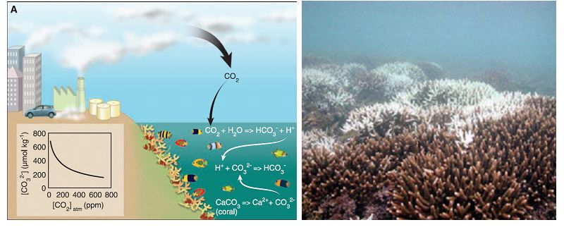
Human Impacts: Ocean Acidification
30-40% of the carbon in the atmosphere is absorbed by bodies of water. This causes a drop in pH, turning the water more acidic.
Acidic water makes it harder for shellfish and other sea organisms with exoskeletons to grow.

Slide 23
Fresh Water resources
Read pages 423-429 in your text book
Answer the following questions:
How much of the world’s water is fresh?
What form is this water found?
What are the main causes for for fresh water shortages?
What is an aquifer?
What are the consequences if countries like India, China, and USA run out of groundwater?
What actions can be taken to reduce surface water contamination?

