Slide 1
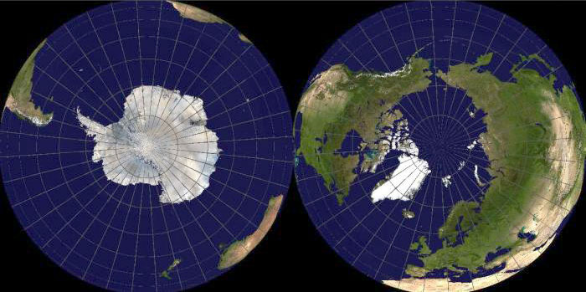
Geography
Mr. Hoy’s LAST
week with you!!

Slide 3
Class preview
Current events
Review
Lecture
Close

Slide 4
Review
Poverty cycle
SAPS
Obsolescence
True cost production

Slide 5
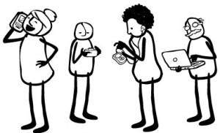
Story of Stuff Terms
Planned obsolescence: designing a product with a limited life span to promote future sales.
Ex: iPod’s new port, when fixing something costs more than buying a new one, a battery pack that can’t be replaced
Perceived obsolescence: when an owner feels inadequate with the product and needs to upgrade or get the newest style.
Ex: iPhone 4 or iPhone 5?

Slide 6
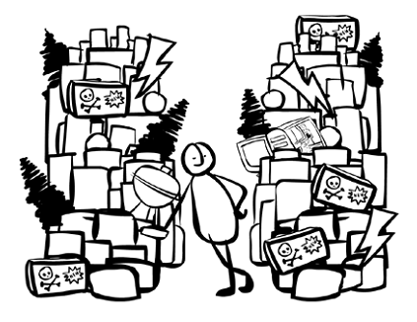
Story of Stuff Terms
Planned obsolescence was first coined in 1932 as a strategy to combat the great depression.
True cost of production: examines the environmental, social, and economic advantages and disadvantages of a product or service.

Slide 7
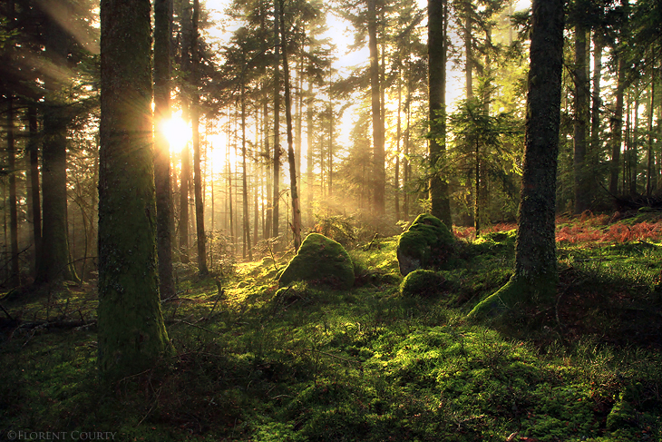
Environment

Slide 8
Question?
What does the word ‘environment’ mean to you?

Slide 9
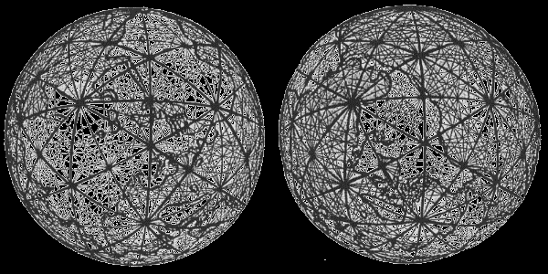
4 Spheres
Lithosphere: Rocks
Hydrosphere: Water
Atmosphere: Air
Biosphere: Life

Slide 10
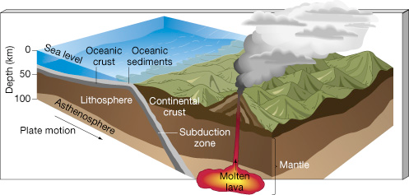
4 Spheres
Lithosphere: soils portion of the earths surface. Think rocks, soils, and tectonic plates.

Slide 11
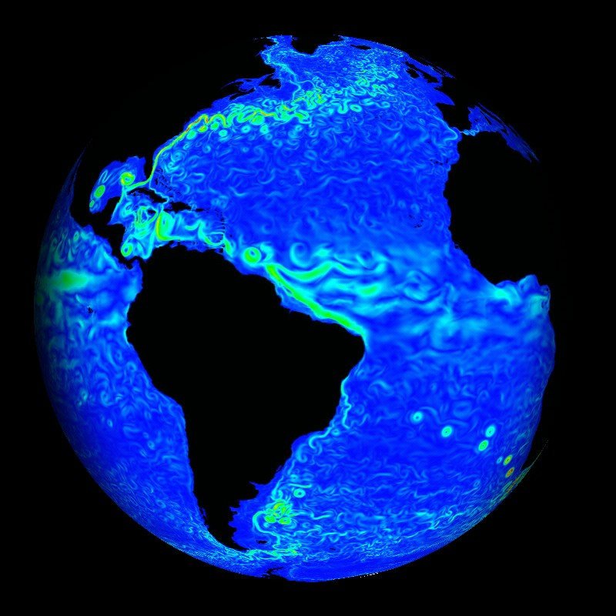
4 Spheres
Hydrosphere: All water on the planet in every form.

Slide 12
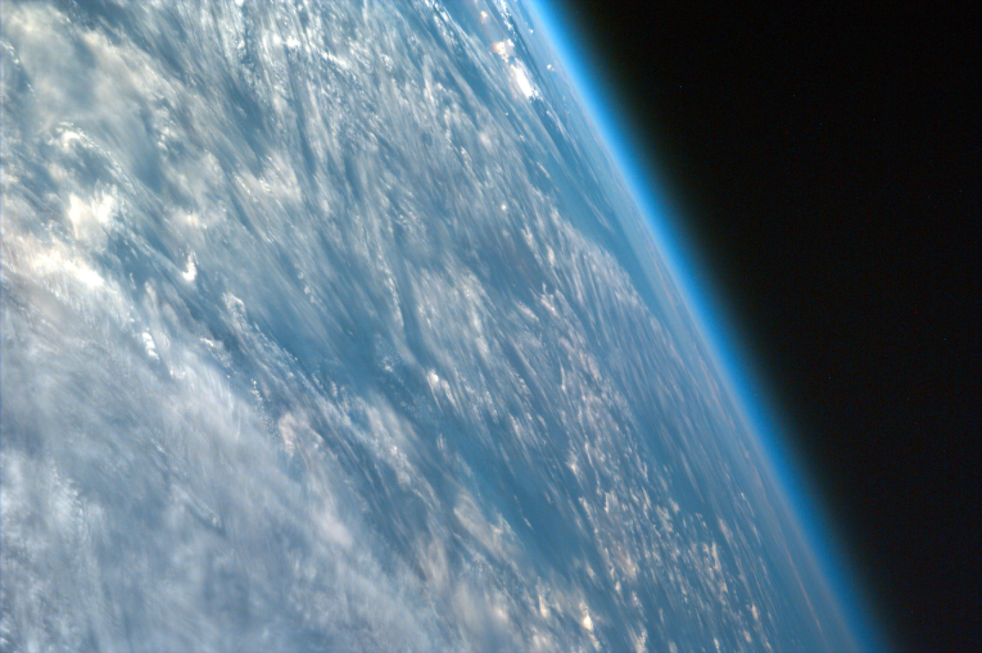
4 Spheres
Atmosphere: The layer of gasses extending from the earths surface.

Slide 13
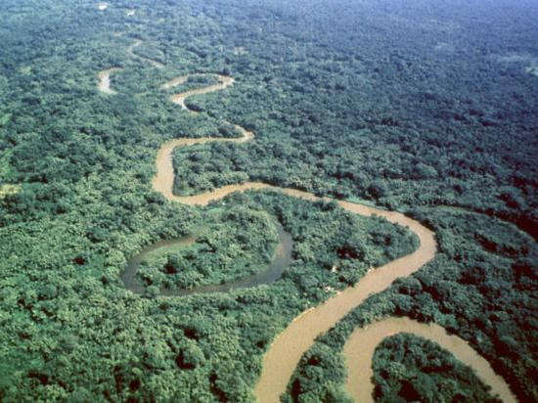
4 Spheres
Biosphere: where earth, water, and air interact to create a habitable environment.

Slide 14
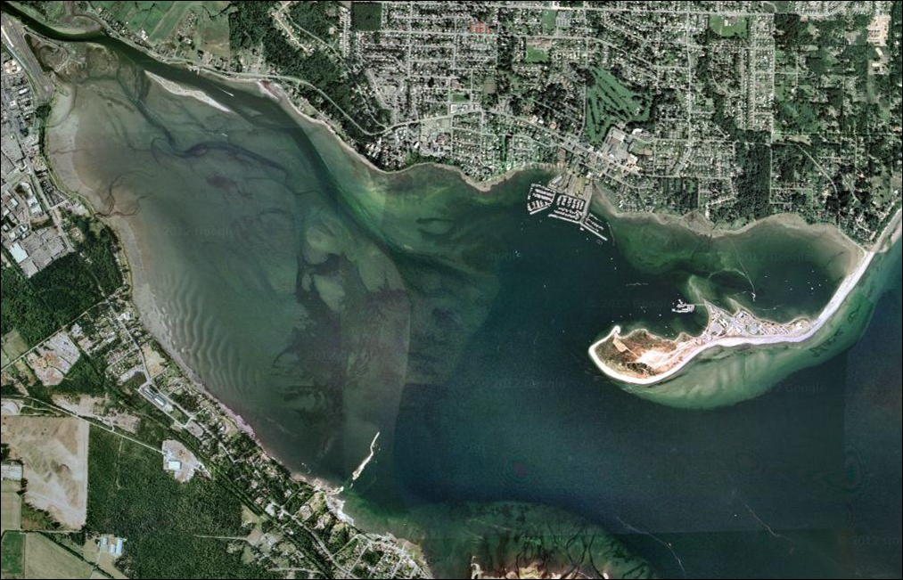
Question
What are the most biologically productive ecosystems on the planet?

Slide 15
Biosphere
This is where we are.
Human activities influence every sphere.
Litho., hydro., atmo., bio.
Some of our activities in one sphere can effect the biosphere and even ourselves.
Anyone have an example of this?

