Slide 1
Geography Lesson 3

Slide 2
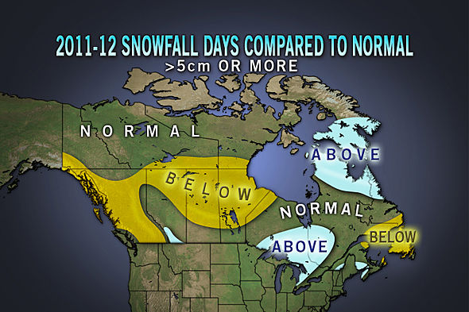
Daily forecast
Current events
Video
Lecture
Activity

Slide 3
Question…
What do you need to get you through life?
What do you want to get you through life?
What is the difference between a need and a want?
Honestly ask yourself: how often do you say “I need a…” when really that thing is want?

Slide 4
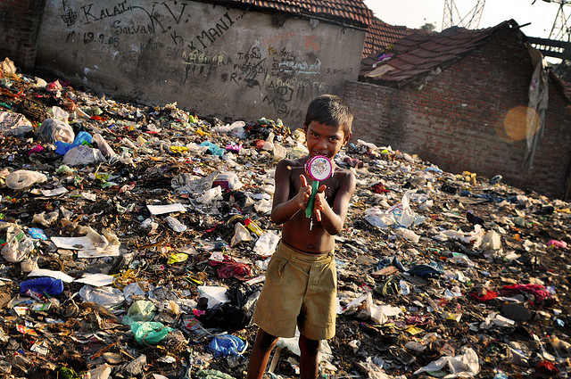
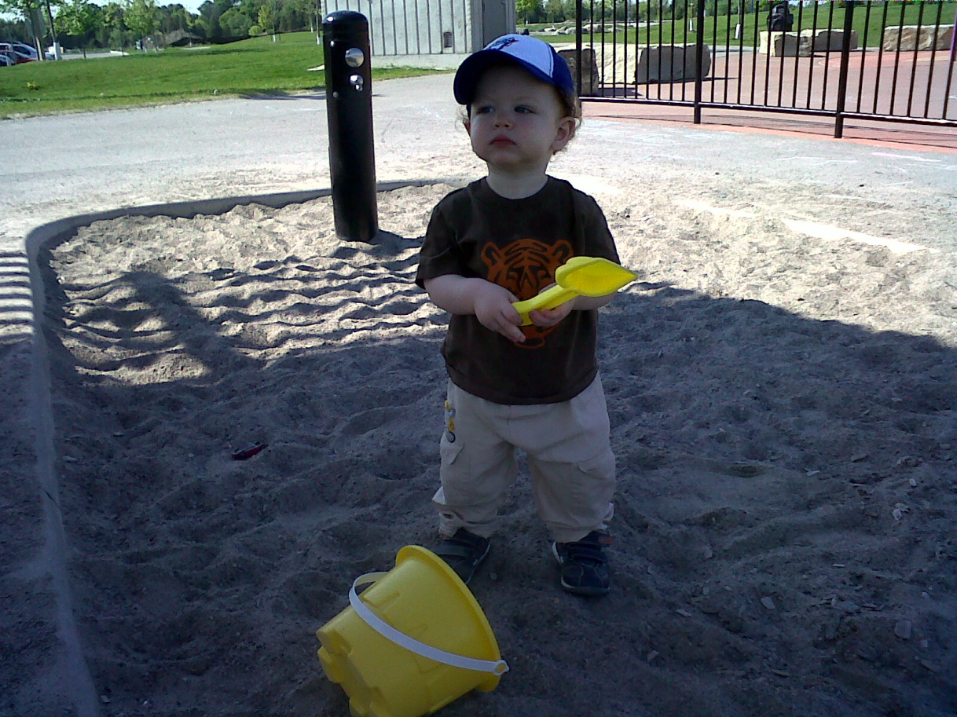
Standard of Living: “SOL”

Slide 5
Standard of living – developed countries
UN Human Development Report: ranks countries based on..
Adult literacy
Life expectancy
Per capita Gross Domestic Product (GDP)
GDP: total value of all goods and services produced in a country in one year.

Slide 6
Activity-
What do you expect to be Canadian living standards?
Volunteer please write on board….

Slide 7
Activity-
Read the article on your own in silence
As you read, underline or Highlight sentences that stand out to you.
If your read something that gives you an idea or question, write it on the side of the page.

Slide 8
Standard of living
Hard to compare countries based on economic production as some countries have large informal economies.
Informal economy: transactions of goods and services dealing with barter system of trade, not taxed or monitored by the government.
Ex: black market, under the table,

Slide 9
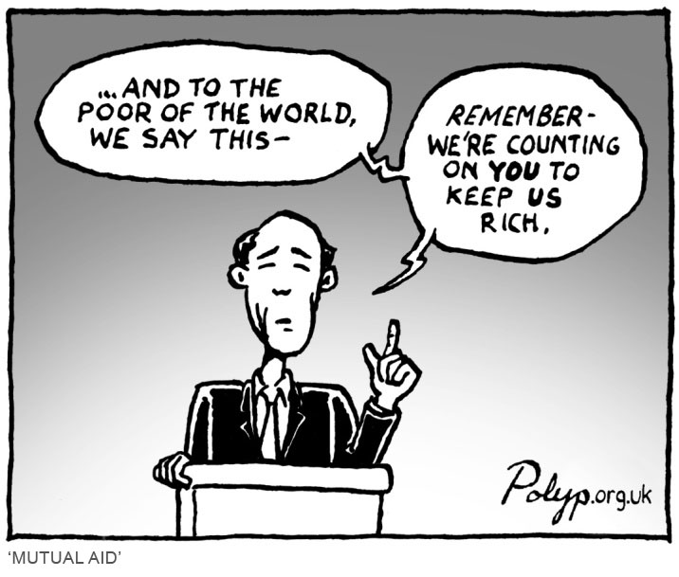
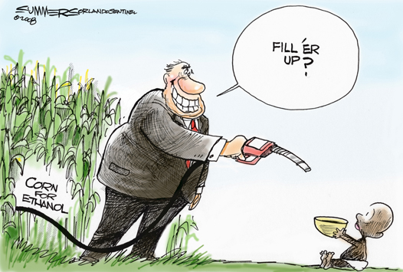
The poverty cycle
As we know many countries are straddled with massive debts they cannot pay back, some can only make the interest payments.

Slide 10
The Poverty Trap
What stage of this cycle do you think
intervention would be the most effective?

Slide 11
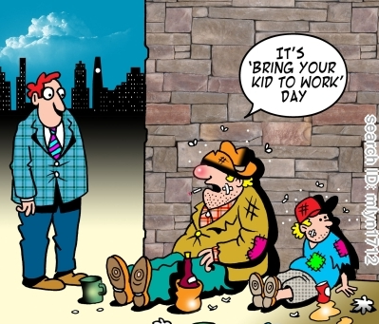
The Poverty Trap

Slide 12
The poverty trap
Developed countries and the International Monetary Fund (IMF) have loaned billions to developing nations around the world with little results-= countries remain poor.

Slide 13
SAPs
Structural Adjustment Programs (SAPs)- conditions on loans given by the IMF.
Examples include:
Cash crops for export-environmental degradation
Foreign investment- exploitation of resources
Government services run by foreign companies- threaten soverignty

Slide 14
Ticket out the door
What do you think is the best way to break the poverty cycle?
-with your name on it, hand in on a piece of paper before you leave.

