Slide 1
Geography Lesson 2
Geography's focus’ is on the evolving character and organization of the Earth’s surface, the way in which the interaction of physical and human elements creates distinctive places, and the way those places interact with, or influence others in space and over time.

Slide 2
Day’s preview
Current events
Netbook Activity
Lecture
Vanier pop pyramid
Lecture
Video

Slide 3
Population pyramids
Use the notebooks- go to
http://populationpyramid.net/
Work on questions, if we finish today we will share our findings. If not we’ll pick up on Tuesday after the test on Monday!

Slide 4
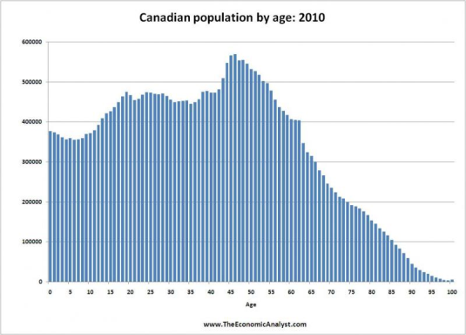
Population Pyramids(pop. Pyramid)
Pop. Pyramid: A graph that shows the age and sex structure of a population
Horizontal bar graphs that display the number of people in a age category (cohort)

Slide 5
Population Pyramids(pop. Pyramid)
X axis is the percentage of the total population
Y axis is the cohort or age group
Graph on the left side is male population
Graph on the right side is female population

Slide 6
Vanier's pop pyramid
Age | M | F | Total
12 | 0 | 3 | 3
13 | 41 | 37 | 78
14 | 71 | 72 | 143
15 | 118 | 128 | 143
16 | 137 | 150 | 287
17 | 166 | 154 | 320
18 | 59 | 62 | 121
19 | 4 | 6 | 10
Total | 596 | 612 | 1208
Make a population pyramid for Vanier. X axis ranges from 0% to 15%

Slide 7
Population Pyramids(pop. Pyramid)
Expanding population: high birth rates and many children
Typical of developing nations

Slide 8
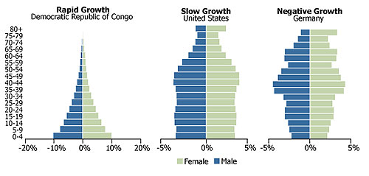
Population Pyramids(pop. Pyramid)
Stable population: Low death rates low birth rates
Typical of developed nations

Slide 9
Population Pyramids(pop. Pyramid)
Contracting population: growth rate below replacement level
Typical of developed nations

Slide 10
Question what kinds of things effect the shape and growth of population pyramids?
Write ideas on board and take notes on them. Volunteer?
Birth rate, death rate, immigration, emigration,
Immigration: people moving into a country
Emigration: people moving out of a country
Birth rate: number of babies born per 1000 people
Death rate: number of people dying per 1000 people

Slide 11
Birth Rates
What do you think determines or effects a countries birth rate?
Hands please!
Factors effecting birth rates:
-Women’s education #1, education, unemployment, access birth control, medical access, culture, values and beliefs.

Slide 12
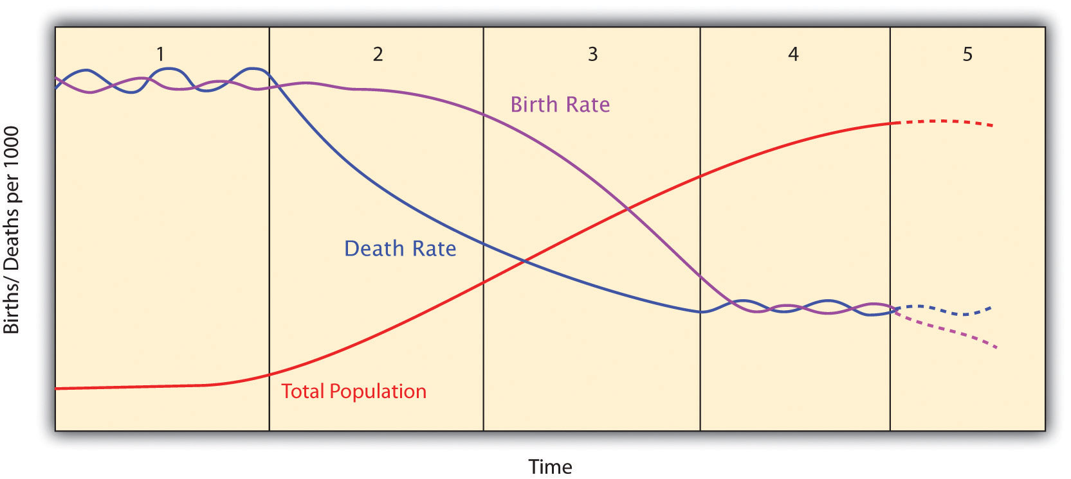
Birth and death rates on population- Demographic transition model
Where would Canada be on this graph?
Example found pg. 324 of your text book

Slide 13
So……. What now?
Now that we know what different models of demographics look like and what causes some populations to expand while others contract, what does this all mean?

Slide 14
Class forecast
Current events? (write on board)
Review
Video finish
Lecture
Activity
X-block reminder- test ☺

Slide 15
Review
Population pyramids show what?
Age and sex characteristics of a population
How would you describe the following countries in terms of pop growth?

Slide 16
Review
What things effect the size/growth of a population?
Birth rate, death rate, immigration, emigration
In regards to the movie; what challenges do countries with a lot of youth have? Conversely, what challenges do countries with few youth and many elders have?

Slide 17
Dependency ratio
Young (1-14) and old (65+) typically do not work, and therefore depend on the working cohort (15-64) to support them.
If a country has a higher proportion of young or old, this puts strain on the working cohort to provide for the others.
Too old: heavy burden on health care if it exists

Slide 18
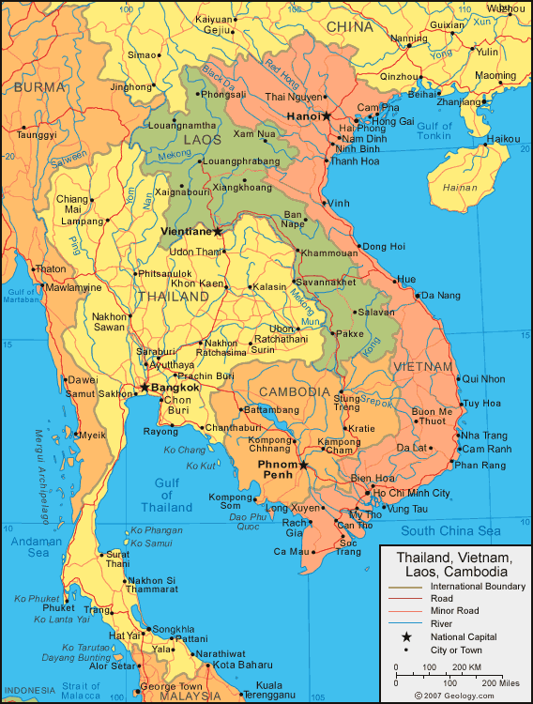
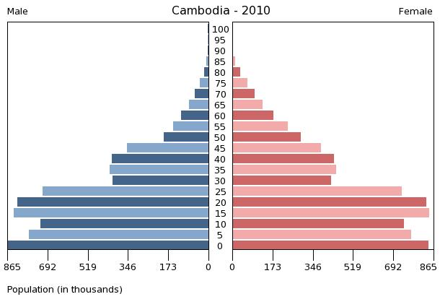
Dependency ratio
Too young: leads to work shortages
Ex: Cambodia

Slide 19
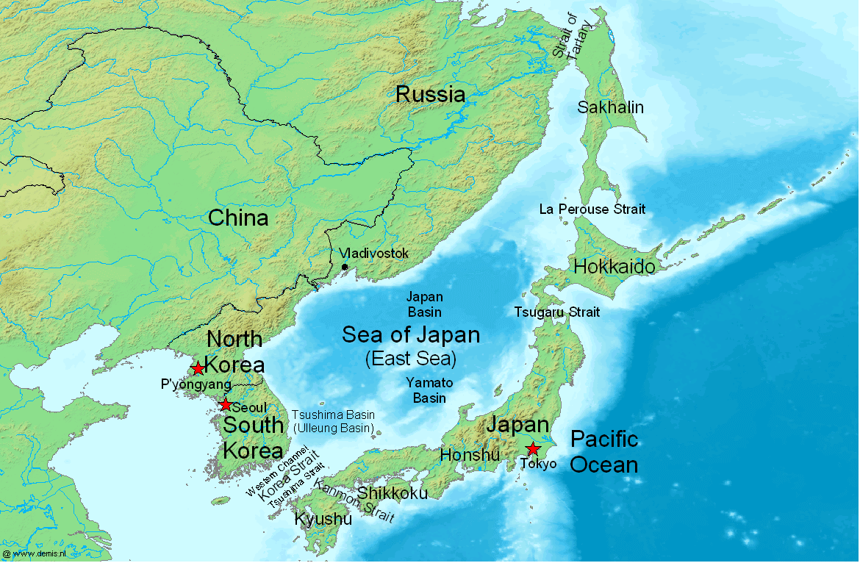
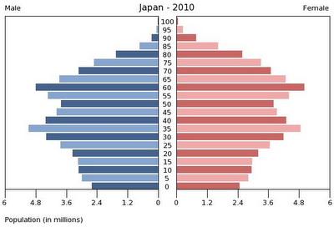
Dependency ratio
Too old: heavy burden on health care if it exists, not enough workers to care for them.
Ex: Japan

Slide 20
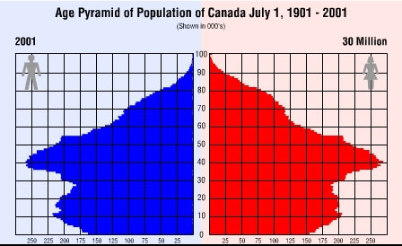
Canada’s Pop pyramid
Old data (2001), but you can imagine what this would look like today, 12 years later.
Notice the bulge around ages 35-55?

Slide 21
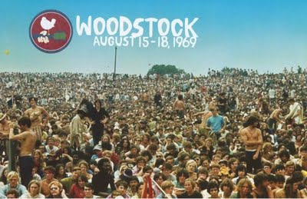
Canada’s Pop pyramid
Baby Boomers: a surge in births after WW2 resulted in a large cohort being born between 1945 and 1965
This large cohort has very far reaching effects on the world from elections to pensions and health care.

Slide 22
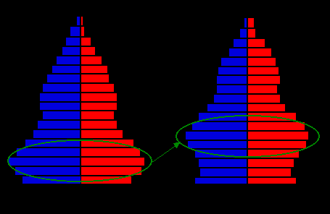
Canada’s Pop pyramid
Pop pyramids change, over time.

Slide 23
Poverty Cycle Preview
Watch this short clip on rickshaw drivers in Bangladesh.
Take point form notes on what you think the poverty cycle is about.- TICKET OUT THE DOOR
http://www.youtube.com/watch?v=n-9_FIJpy4c

