Slide 1
Geography!

Slide 2
Today’s class
Current events
Slide show
Lecture
Activity
Closure

Slide 4
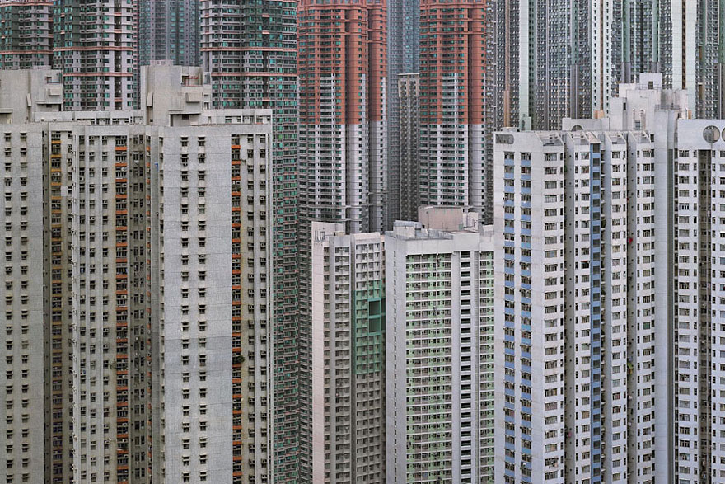

Slide 5
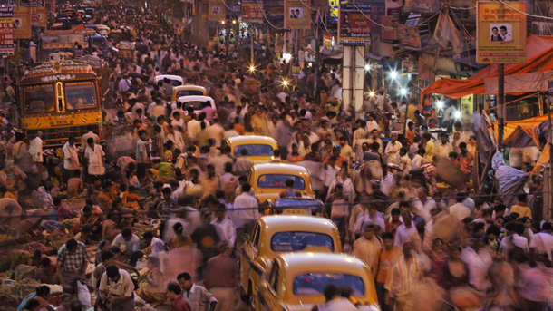

Slide 6
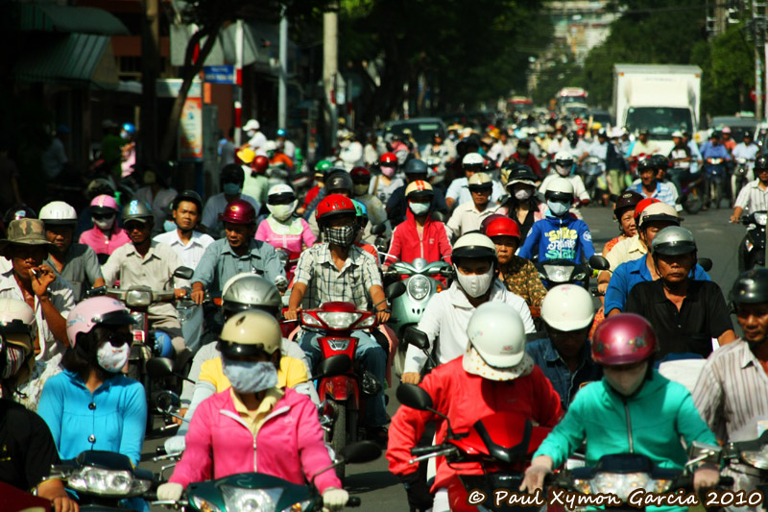

Slide 7
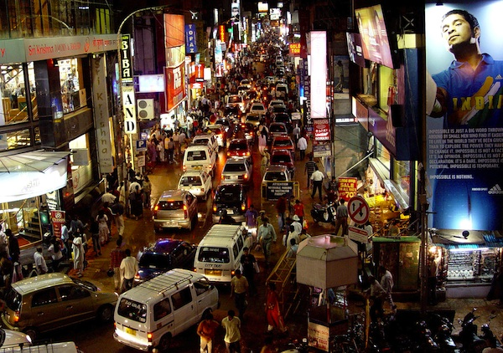

Slide 8
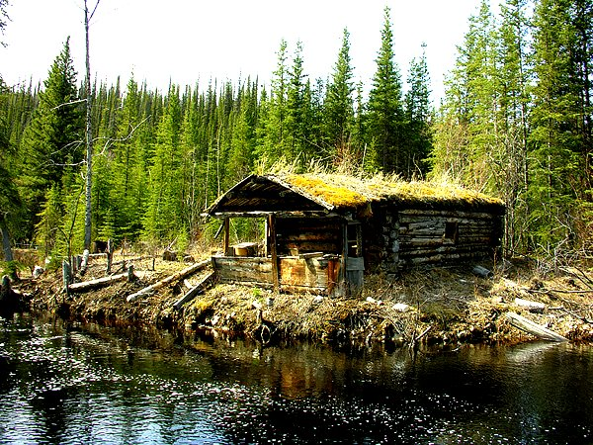

Slide 9
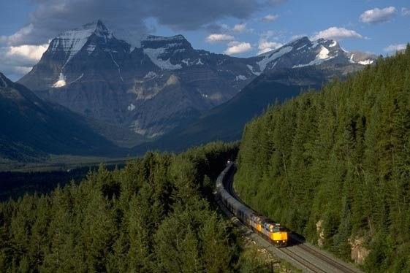

Slide 10
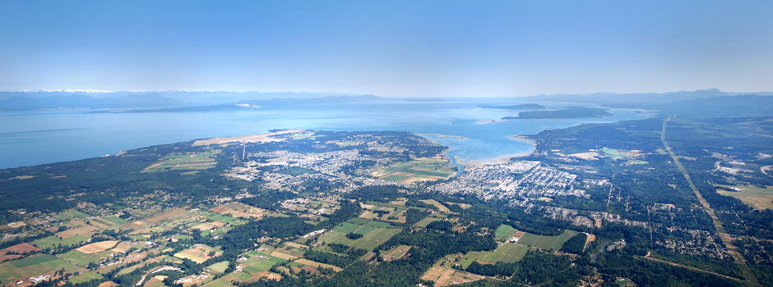

Slide 11
Population
What factors determine where people live?
Work, family, education, recreation, access to facilities, social gatherings, etc. etc.
Mr. Hoy’s 5 year plan:
-live in the Comox Valley for 5 years, BC parks in the summer and subbing in the fall/winter/spring until full time in one of the two jobs.

Slide 12
Push and pull factors
Pull: family, job, friends, location, recreation
Push: job
Consider your plans once you graduate, what is pushing you away from the Comox valley and what pulls you here?

Slide 13
Push and pull factors
Push factor: things that push someone to move from one area to another
Example: social life or lack of
Pull Factor: things that pull someone to move to an area from another
Example: better paying jobs

Slide 14
Push and Pull
Ever since industrialization, people have been moving from rural (towns) areas to urban (cities) areas.
Urban areas are associated with higher population densities.

Slide 15
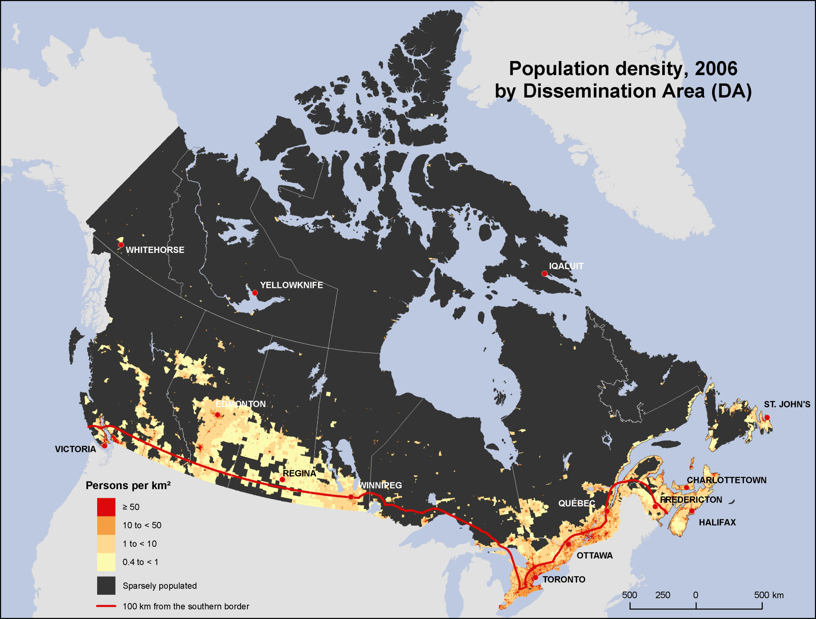
Population Density
90% of Canada’s population lives within 100km of the American border. Why is this?

Slide 16
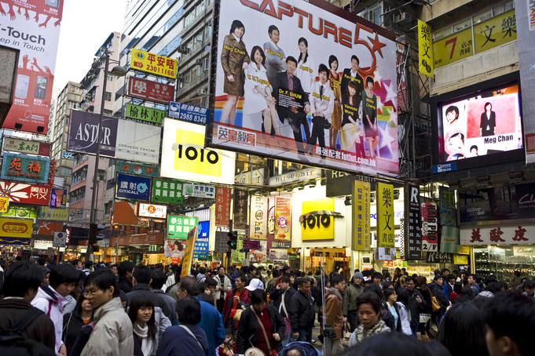
Population density
Population density is measured by how many people live in a square kilometer.

Slide 17
Population density
Singapore pop density: 7301 people per km ²
population- 5,183,700 land area- 710 km ²
Canada pop density: 3.71 people per km²
What is the mostly densely populated area in North America?
Vancouver- down town area!

Slide 18
Population density
Highest population densities are at river deltas.
Any suggestions as to why this may be?
Original settlements began in these areas and grew over time. These locations provided necessities for sustaining large populations.

Slide 19
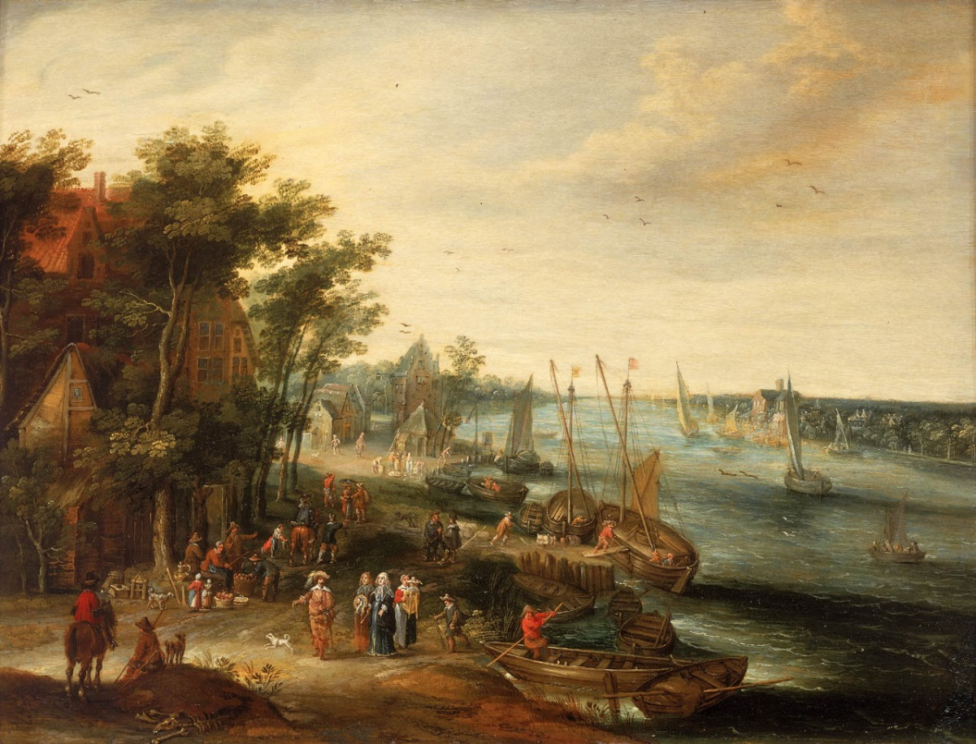
Population density
Original settlements began in these areas and grew over time. These locations provided necessities for sustaining large populations.

Slide 20
Population density
As trends show our population is moving from rural to urban areas.
This migration is putting pressure on land surrounding cities to become developed with suburbs.

Slide 21
Population density
Therefore the most fertile regions of the earth are the most populated; we are essentially paving over the best agricultural land on the planet.
What kind of problems will this create for future generations?
What can we do mitigate this loss of agricultural land?

Slide 22
Population pyramids
Use the notebooks- go to
http://populationpyramid.net/
Work on questions, if we finish today we will share our findings. If not we’ll pick up on Tuesday after the test on Monday!

