Slide 1
THEGREAT DEPRESSION Part deux
1929-1939

Slide 2
Recap
What caused the depression?
What part of Canada was hit hardest? Why?

Slide 3
Daily Forecast
Current Events- sign up sheet
Lecture- what was done to stop the depression
Introduction to WWII assignment
See ya!

Slide 4
THEGREAT DEPRESSION
Canada was hit hard by the depression because it’s economy was largely resource based
A global glut in what and pulp production meant Canadian materials were not needed= no $$ + no jobs

Slide 5
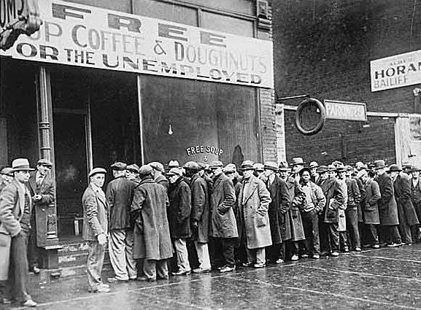
THEGREAT DEPRESSION
Unemployed people don’t buy consumer goods
No one buying goods, factories have lay-offs
Millions of Canadians were laid off as a result (unemployment 25%)

Slide 6
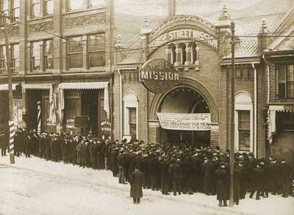
The great depression
Pogey- unemployment insurance of the 1930’s
Had to publicly declare financial failure
Food vouchers were insufficient to feed a person
It was a humiliating experience

Slide 7
The great depression
Mackenzie King- Canadian PM unprepared to deal with the economic depression- thought it was temporary.
King lost the 1930 election to R.B. Bennt

Slide 8
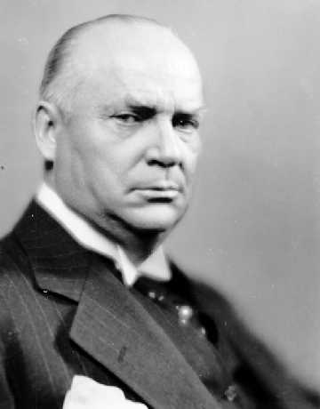
R.B. Bennet- response to the depression
PM during the depression
Gave $20 mill to provinces for work
creation- did not work
Raised tariffs 50% to protect Can
Industry- did not work

Slide 9
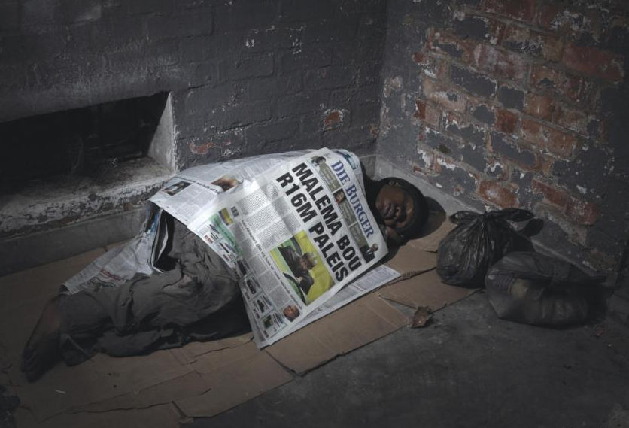
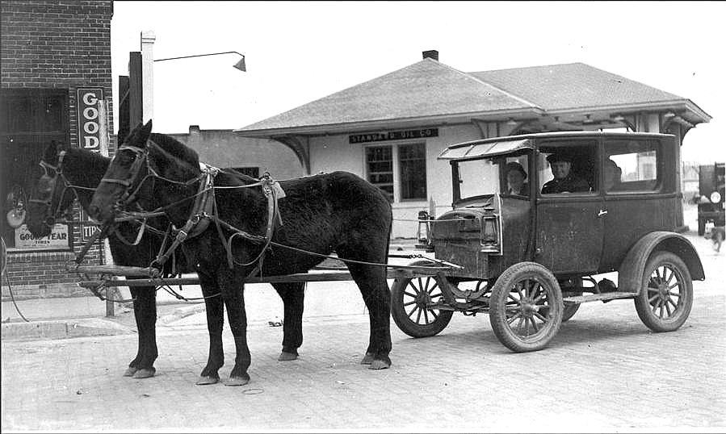
R.B. Bennet- response to the depression
Created work camps for the growing
number of unemployed men roaming
the country> birth of the “Hobo”
Bennet buggy, Bennett blanket,
eggs Bennett

Slide 10
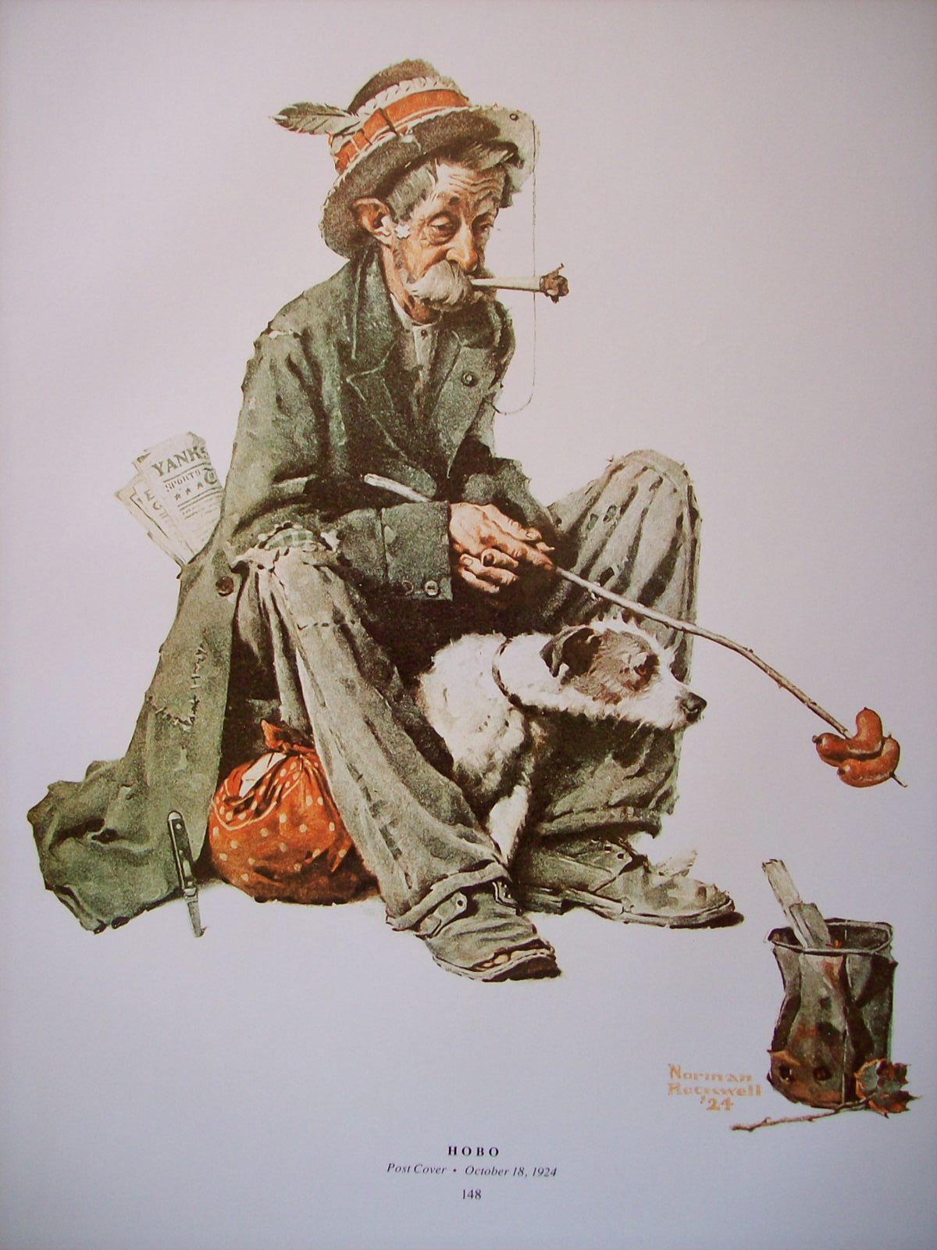

Slide 11
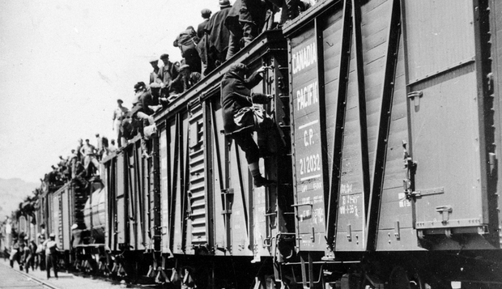
On-to-ottawa trek

Slide 12
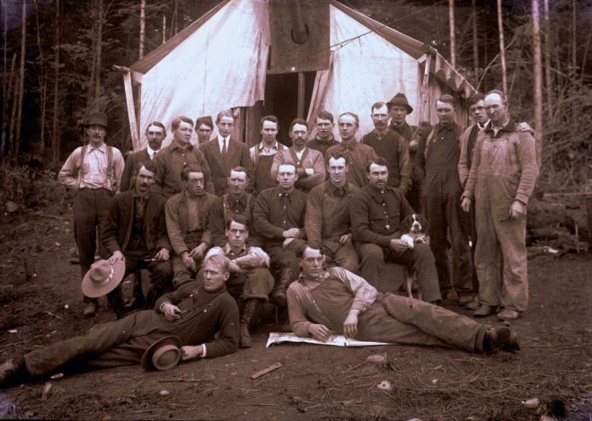
On-to-ottawa trek
Work camp conditions: 20c/day, hard labor, bad food, bug infestations, but room and board was provided.
170,000 spent time in these camps
Frustration boiled over in the camps, men began reading works of Lenin and communist ideals- scared government b/c of European uprisings
1935- 1,500 men leave BC work camps, heading to Ottawa to bring their grievances to the attention of the government

Slide 13
On-to-ottawa trek
Riding on top of rail cars, the protestors picked up supporters through the prairies

Slide 14
On-to-ottawa trek
When the trains reached Regina the RCMP prevented the mass from going further
Leaders went to meet with Bennet while the rest stayed in a stadium in Regina
When RCMP tried to clear the stadium, riot broke out, 1 man died, 130 arrested

Slide 15
Socialism
In your table groups come up with a definition for “Socialism”

Slide 16
Socialism
Andrew Heywood(2010) defines Socialism as:
“The vision of human beings as social creatures linked by the existence of a common humanity”.
Neil McNaughton (2005) defines Socialism as:
“Socialism proposes that humans are naturally sociable, prefer to achieve goals collectively rather than individually and are content to cooperate with others to serve the common good”.

Slide 17
Socialism
Equal Rights- As a birth right we should receive the same treatment as every other citizen.
Equality of Opportunity- We should all get an equal chance. All barriers should be lowered so that those who can achieve, will!

Slide 18
Socialism
Equality of Outcome- You reap what you sow! If you work hard you will get rewards that match that. (Is this really equal and secondly isn’t that capitalism?)
Absolute Equality- Everyone will receive the same reward. We all do a similar amount of work to the best of our ability and thus we reach total equality.
Welfare Equality- Inequality is inevitable, it’s how we’ve built our society. However there should be a minimum threshold of welfare available to ensure that no-one falls below a certain level.

Slide 19
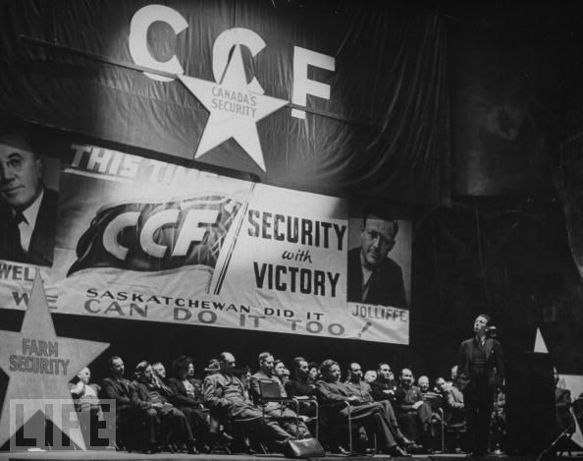
Political change
Cooperative Commonwealth Federation (CCF)
Wanted to address the governments lack of social support during the depression
Lead by: J.S. Woodsworth
Woodsworth was an activist
Involved in the Winnipeg general
strike

Slide 20
Political change
CCF created the Regina Manifesto
Regina Manifesto- supported public ownership of key industries, social programs for people in need, and public works programs to generate jobs.
CCF was the forerunner for the New Democratic Party (NDP)

Slide 21
Political change
Social Credit Party- lead by William Aberhart
Wanted to give $25 month to every Alberta citizen.
Supreme court rule against a province creating its own currency and disallowed.

Slide 22
End of The Great Depression
Total War: All Canadian manufacturing and production is turned towards helping the allies on the battle front.
Gross Domestic Product (GDP): value of all goods (food, cars, airplanes) and services (education, nursing, insurance) produced in a country in one year.
GDP in 1939=$5.6 bill to $11.5 bill in 1945
Canadian economy was solely focused on war production and supporting the Allied cause overseas. This caused the economy to expand.

Slide 23
Slang of the 30’s
Directions: Review the following common slang terms from the 1930’s and write a story using at least 30- 40. Be creative. Your story can be about anything at all, including weekend plans, a funny event, your life goals etc. You may also choose to write a letter to someone instead.

Slide 24
Ticket out the door
List 3 causes for the great depression and 3 things done to try to stop it.

Slide 25
Preview of next class
World War II begins!
War Connections Assignment

