Slide 1
I’M Back!
April 15- May 18

Slide 2
Day Plan
Current events & sign up sheet
Activity
Lecture

Slide 3
THEGREAT DEPRESSION
1929-1939

Slide 4
THE GREAT DEPRSESSION
What do YOU know about the great depression (think-2min)
Talk with your neighbour and share ideas. (pair 3min)
Talk with other pairs at your table to see if anyone has new stuff to add. (share 3min)
Each table in shares the main points they come up with (7min)
Class discussion
Music

Slide 5
Lets play the stock market
Situation:
You are a farmer in the Canadian prairies circa 1928. Last seasons harvest was very successful and you have an extra $500 laying around even after you upgraded your tractor.

Slide 6
Lets play the stock market
Your cousin who lives in Toronto has been making some serious money in the stock market over the last 2 years. He tells you he invested $500 two years ago and now that same investment is worth $1500! He gives you a list of companies he has mad a lot of money on lately and he thinks they will keep making a profit.

Slide 7
Lets play the stock market
You decide to invest your $500 in two of the four following companies (pick 2 companies to invest your money into. You decide how much each company gets):
A. Mr. Krutzmann’s Football Manufacturers
B. Mr. Hoy’s Washer and Dryer Machine Corp.
C. Mr. Tuckers Fence Building Supply Company
D. Mr. Angelski’s Student Teacher Handbook Company
If you want to withdraw you money from the market there is a $100 fee to do this.

Slide 8
But wait- there is more!
*If you want to invest additional money the bank will lend you as much as you want with only 10% down! If you put all your money down for a bank loan, they will give you $5000
*Raise your hand if you would like a one time loan at 10% from the Royal Bank of Social Studies Teachers?!

Slide 9
Lets play the stock market: Example
Company Name | Initial Investment $$
1. B (Mr. Hoy’s) | 250
2. C (Mr. Tucker’s) | 250

Slide 10
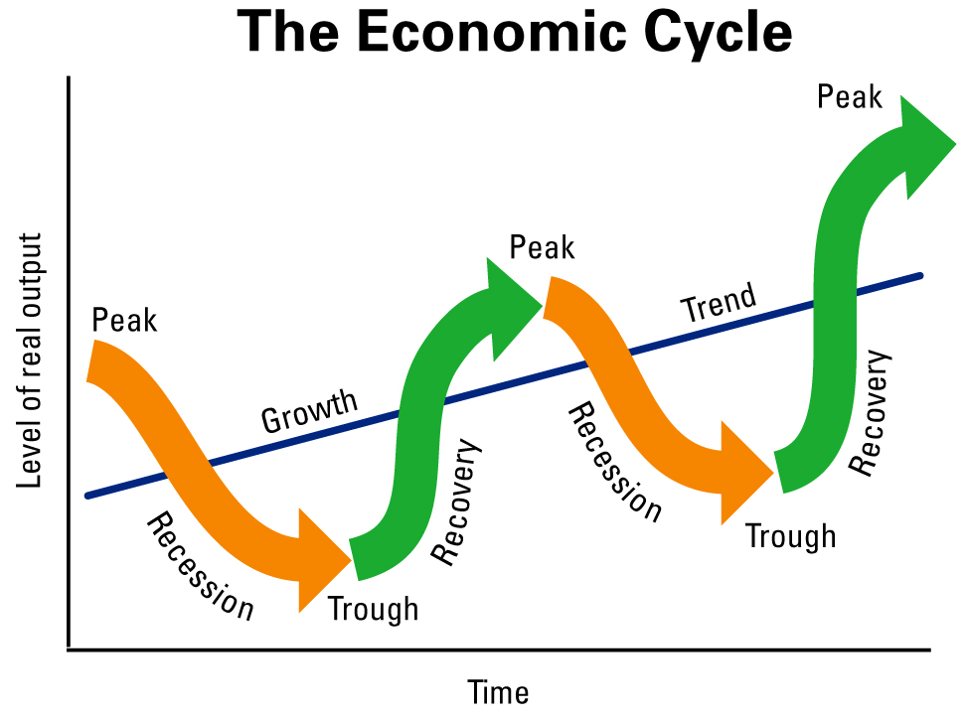

Slide 11
Economic cycle: Expansion
Expansion: consumer spending is
Early interest rates are
As economy grows interest rates
Stock market

Slide 12
Economic cycle: Peak
Peak: businesses are
Interest rates are because of risk of inflation
interest rates make =less affordable for some consumers.
Construction jobs
Stock market

Slide 13
Economic cycle: recession
Recession/depression:
Early sales of consumer products
Manufacturing
Unemployment and personal income
Interest rates then
Most stocks

Slide 14
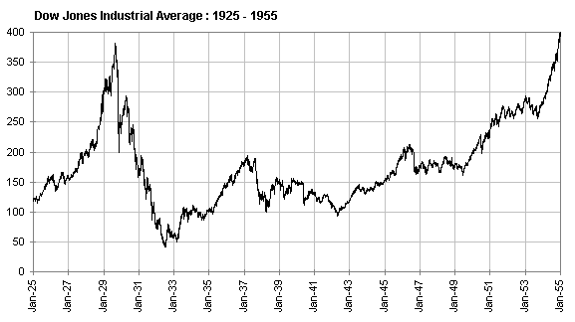
Stock market: 1925-1955

Slide 15
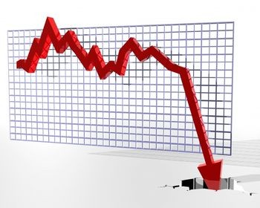
The great depression: Causes
N.Y. Stock Market crash: 1929
Investors paying 10% on a purchase
Loans were easy to get
Massive sell-offs cause stocks to
plummet

Slide 16
The great depression: Causes
World wheat prices fall
Overproduction
Countries stopped buying Can. wheat= prairie farmers hit hard

Slide 17
The great depression: Causes
3. Protectionism
Canada increased tariffs to promote growth- but this backfired as other countries put up high tariffs in response therefore nobody could afford to import goods- trade came to a standstill

Slide 18
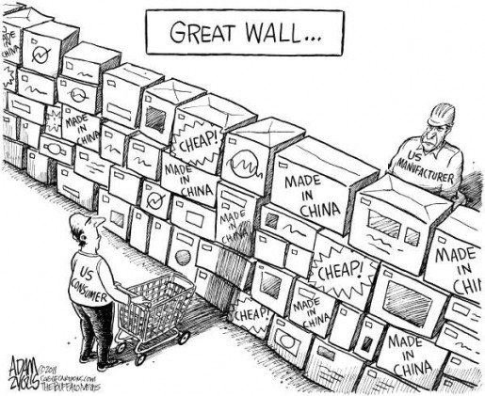
Discussion piece

Slide 19
The great depression: Causes
4. German Debts
WW1 bills
Germany owed France and GB
France and GB owed USA
USA demanded payments- Germany couldn’t make them

Slide 20
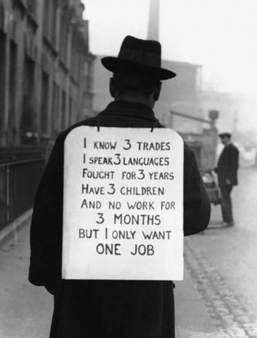
The great depression: AKA dirty 30’s
Unemployment in resource sectors caused a lack of demand for consumer goods (people didn’t have credit cards)
Factories didn’t need to produce so much consumer goods
Factories began lay-off workers, continuing the cycle
1933- 25% unemployment. Today around 7%
Look familiar?

Slide 21
Economic cycle: recession
Recession:
Early sales of consumer products
Manufacturing
Unemployment and personal income
Interest rates then
Most stocks

Slide 22
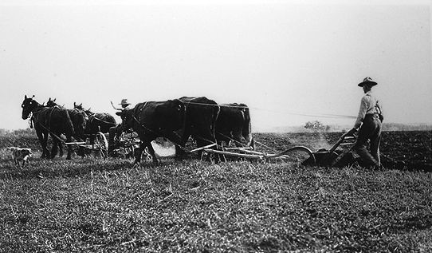
The great depression: Hard hit Prairies

Slide 23
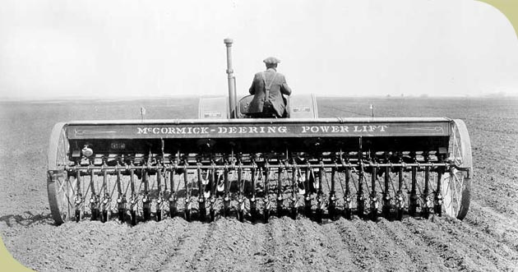
The great depression: Hard hit Prairies

Slide 24
The great depression: Hard hit Prairies
8 year drought
Intensive farming practices cause winds to rip topsoil away causing dust storms and poor growing conditions
Dust storms black out the sky, people fear it is the apocalypse

Slide 25
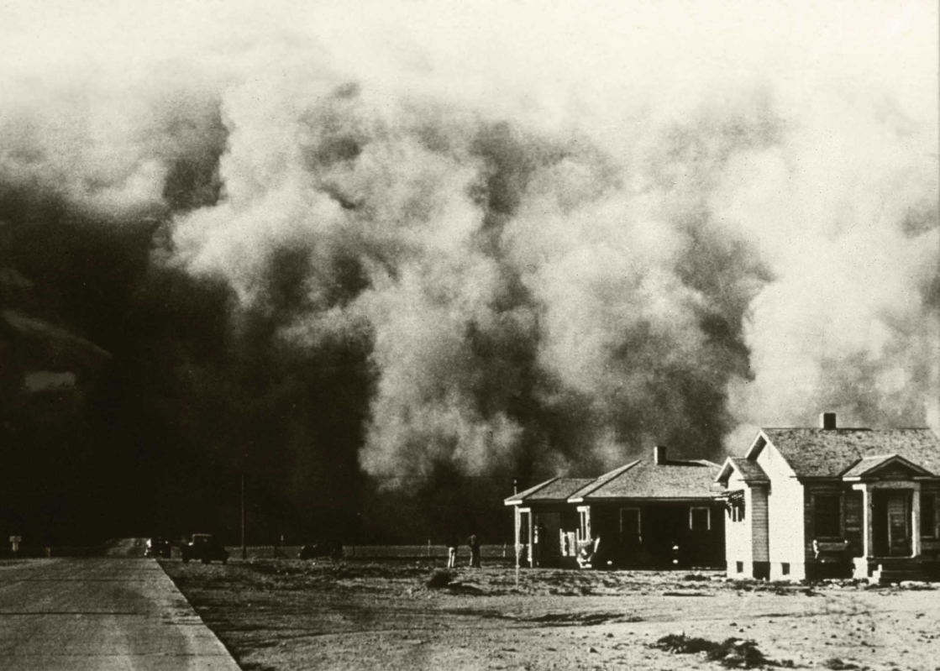
Dust storms

Slide 26
Dust storms

Slide 27
The great depression: The disadvantaged hit hard
During difficult times men hate those of difference
1st Nations: $5 month, and live off the land
Chinese- unemployable, starving no government aid
Immigrants targeted with anti employment – especially Jewish people

Slide 28
Canadian troubles
Canada hit especially hard because:
Economy deeply reliant on USA, when their economy crashed, so did ours
Canadian economy mostly exporting of raw resources, as wold production fell, need for Canadian resources fell.- led to lay offs.

Slide 29
Critical question
Think –Pair – Share
How does the depression of the 1930’s compare to today’s economic situation?

Slide 30
ReCap
What were the main causes for the 1930’s economic depression?
What part of Canada was hit particularly hard?

Slide 31
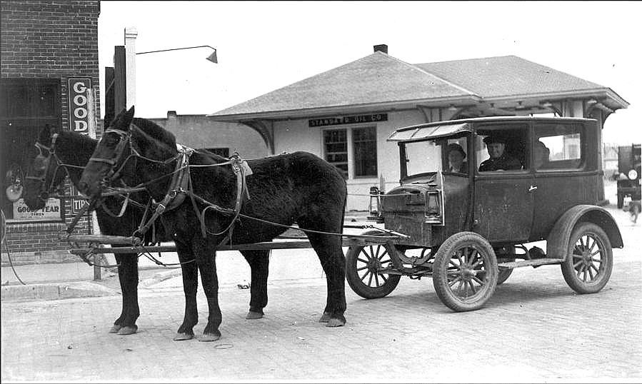
Preview for next class Bennet buggy….

