Slide 1
Final review
May 16, 2013

Slide 2
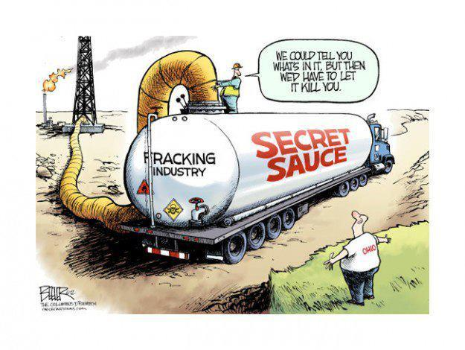
Canada’s fresh water supply

Slide 3
Fracking
How it works..
http://www.youtube.com/watch?v=PQKjLFY5YEY
Results..
http://www.youtube.com/watch?v=4LBjSXWQRV8

Slide 4
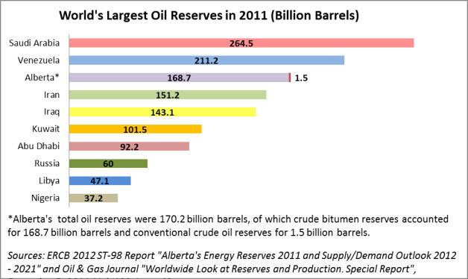
Alberta oil!

Slide 5
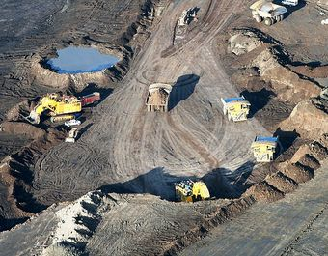
Alberta Oil!
To extract oil from the tar sands it takes a LOT of water
1 barrel of oil= 2.5 to 4.5 barrels of water
To extract oil from the tar sand it takes a LOT of energy
Conventional oil ha3 a return of 25:1
Tar sands have a return of 5:1

Slide 6
Test Questions! Answer 3 of these questions
1. Describe the poverty cycle (You may draw a diagram to illustrate) when do you think the best time to intervene in the poverty cycle would be? Justify your answer with reasons.
2. In reference to settlement patterns, why is it bad that traditional settlement areas are becoming developed with urban sprawl and commercial development? What measures can be taken to preserve this land while expanding our cities?
3 Asses the environmental concerns facing Canadians including climate change, ozone layer depletion, and acid rain. Provide 2 solutions for each of these problems that would mitigate these effects.
4. According the video “The Story of Stuff” we are consuming our resources at an unsustainable rate. Describe how our culture is contributing to this and what steps can be taken to slow this process.
5. What challenges do countries with very old and very young populations face? What steps can be taken to alleviate these problems?
6. Compare Canada’s standard of living with those of developing countries, with reference to poverty and key indicators of human development.

