Slide 1
Earth Science 8/9
systems

Slide 2
Sustainability
On a sheet of paper write down what you think “sustainability” is.
Turn to your neighbor, compare definitions.
Get into groups of 6. construct a group definition.

Slide 3
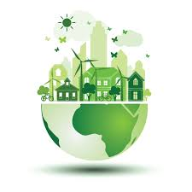
Sustainability
Sustainability: meeting the needs of the present without compromising the ability of future generations to meet their own needs.
What are our needs today?
What will our needs be in 100 years?

Slide 4
3 lenses
When looking at issues in this unit we will look at them through 3 lenses.
Looking at a topic through a certain “lens” lets us analyse the issue from different perspectives or points of view.

Slide 5
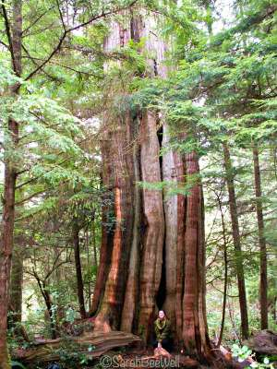
3 lenses
1. Economic lens: How will the activity affect the economy?
Example: A Tree (through the lens of “economy”): this tree is worth $20,000 if we cut it, turn it into lumber, and sell it.
https://www.youtube.com/watch?v=ZngyGHHeS1g

Slide 6
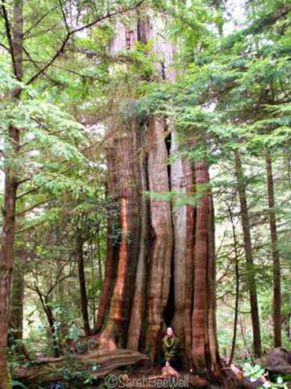
3 lenses
1. Economic lens: How will the activity affect the economy?
2. Society: How will the activity affect the culture amongst the people of that area?
Ex: A tree might be sacred to some people. Or walking through the woods might be a hobby for others
Loggersports
Aboriginal tek
Hiking

Slide 7
3 lenses
1. Economy: all human actions that take place in order to produce money and wealth.
2. Society: How will the activity affect the culture amongst the people of that area?
3 environmental: How does the activity affect the environment?
Ex: a tree is habitat for many animals
Conservation

Slide 8
Looking through the lens’
 | Economic Lens -how will it impact the economy? | Cultural Lens -how will it impact people locally and/or internationally? | Environmental Lens -how will it impact the environment?
Tree/logging | Jobs for surveyors, loggers, truck drivers, mechanics, mills, home building supply stores
Salmon/fishing

Slide 9
The 4 spheres
Lithosphere
Hydrosphere
Atmosphere
Biosphere

Slide 10
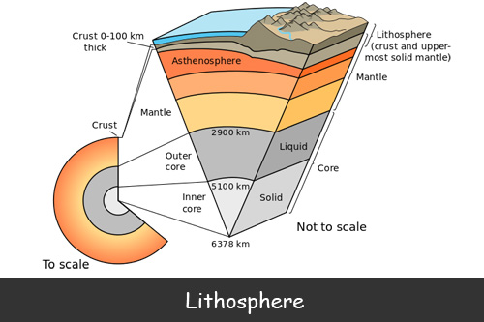
The 4 spheres
Lithosphere: The ridged outer layer of the earths surface

Slide 11
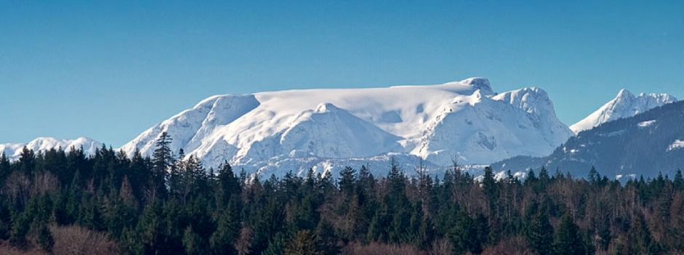
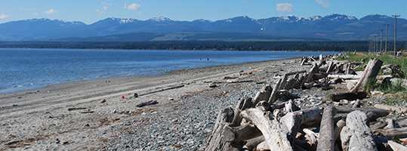
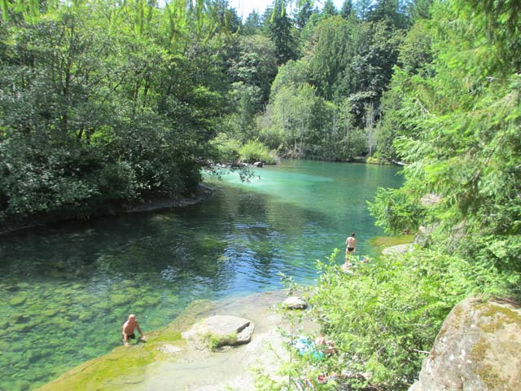
The 4 spheres
Hydrosphere: all water on the planet
Liquid, solid, and vapor are all the states of the hydrosphere

Slide 12
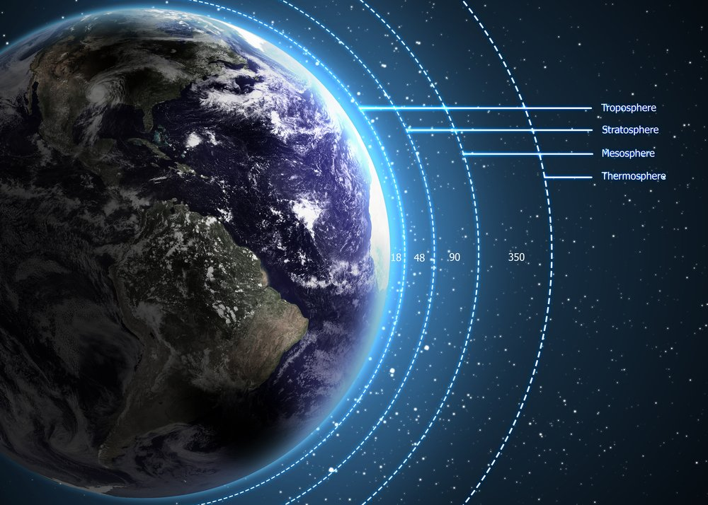
The 4 spheres
Atmosphere: The gasses that surround the earth. They are held in place by gravity.
Composed of:
Nitrogen 78%
Oxygen 21%
Argon 1%

Slide 13
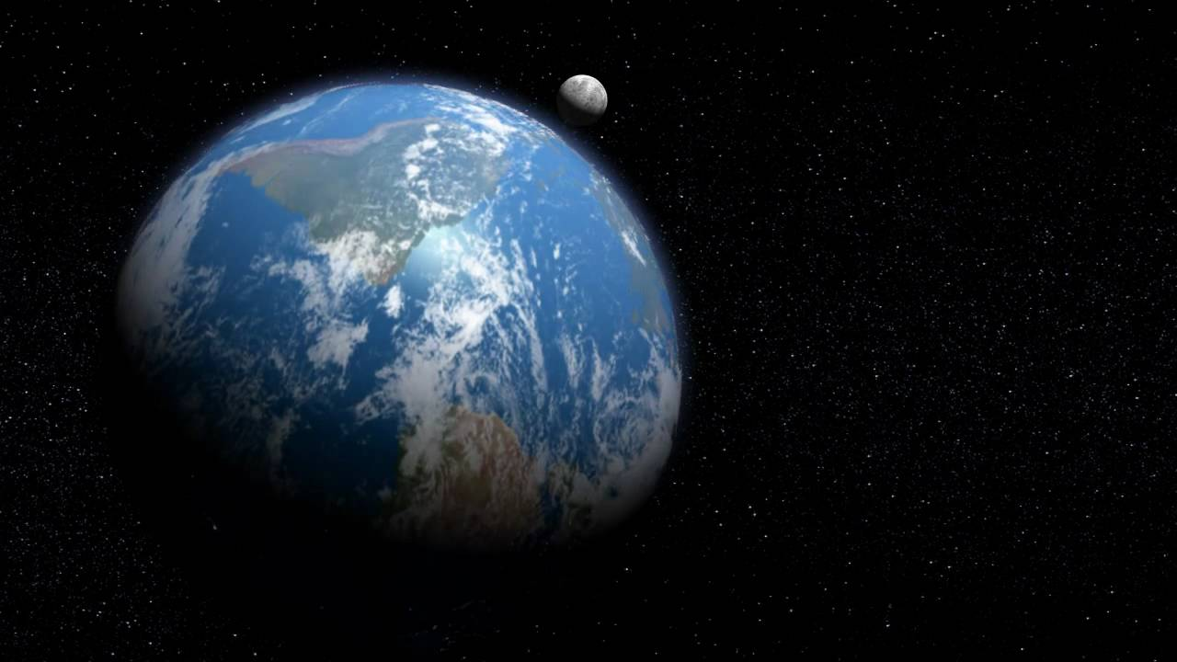
The 4 spheres
The make up of the lithosphere, atmosphere, and hydrosphere are all abiotic factors (air, water, rock)
When the right conditions of these factors merge, life can exist. We call this area of the planet the biosphere.

Slide 14
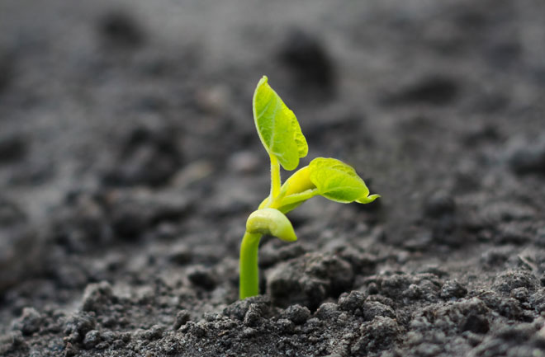
The 4 spheres
Biosphere: encompasses all living organisms on earth.
Biotic factors: any living thing in an ecosystem.

