Slide 1
Unit 3 Ch. 8- Motion
mo·tion/ˈmōSH(ə)n/
Noun
the action or process of moving or being moved.

Slide 2
In pairs: Describe the motion of this soccer ball before and after it is kicked

Slide 3
Motion Definitions
Quantities that are measured or counted have a magnitude but may also contain a direction.
Magnitude refers to the size of a measurement or the amount you are counting.
Example: 100km/hr.
Quantities that describe magnitude but do not include direction are called scalar quantities or scalars.
Example: 25 seconds
Quantities that describe magnitude and also include direction are called vector quantities or vectors.
Example: 5 km north

Slide 4
Motion Definitions
When you use maps, what kind of quantity are you using?
Answer: Vectors

Slide 5
Motion Definitions
Distance (d) is a scalar quantity that describes the length of a path between two points or locations.
Example: A person ran a distance of 400 m.
Position ( ) is a vector quantity that describes a specific point relative to a reference point.
What is an example of position?
Example: The school is 3.0 km east of my house.
*What does SI unit stand for? What is an example of an SI unit

Slide 6
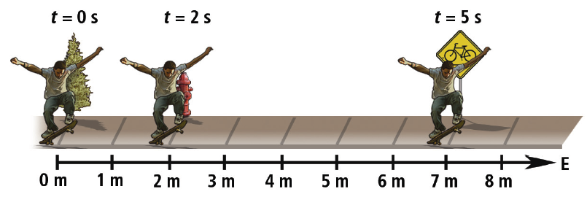
Time Interval and Position
Time (t) is a concept that describes when an event occurs.
Initial time (t_{i}) is when the event began.
Final time (t_{f}) is when the event finished.
Time interval is the difference between the final and initial times.
Time interval is calculated by:
The time interval to move from the fire hydrant to the sign is calculated by:
The position of the sign is 7 m east of the tree.
See page 348

Slide 7
Time Interval and Position
Who needs to stretch?
I need 3 volunteers with cell phones!
Time (t) is a concept that describes when an event occurs.
Initial time (t_{i}) is when the event began.
Final time (t_{f}) is when the event finished.
Time interval is the difference between the final and initial times.
Time interval is calculated by:
The position of the sign is 7 m east of the tree.
See page 348

Slide 8
Time Interval and Position
Who needs to stretch?
I need 3 volunteers with cell phones!
Jog around the perimeter of the class or outside.
person A with cell phone stands at start
person B with cell phone stands at a given location
Persons A & B take note of time as runner passes.
Record on board
What is Time interval between different points?
The position of the sign is 7 m east of the tree.
See page 348

Slide 9
Motion Definitions
Displacement describes the straight-line distance and direction from one point to another.
Displacement describes how much an object’s position has changed.
Displacement is equal to the final position minus the initial position.
The SI unit for displacement is metres, m.

Slide 10
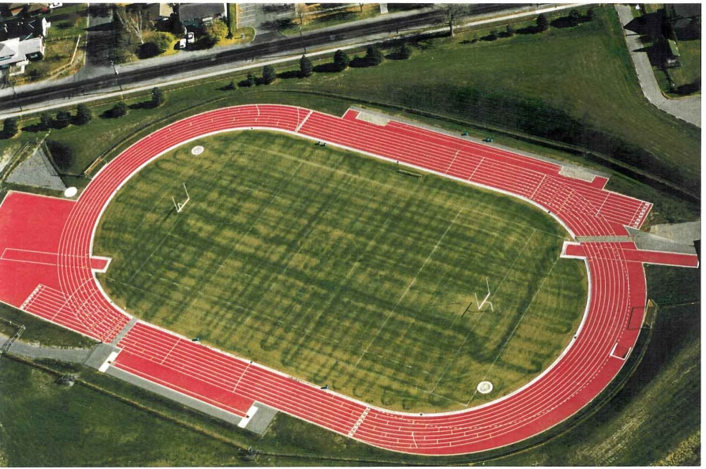
Motion Definitions
What is the displacement of a runner who runs 1 lap on a track?
Hint: Displacement describes how much an object’s position has changed.

Slide 11
2 friends: Scalar and Vector
 | Description | Example
Scalar Quantity | Describes Magnitude only | A bag of gold lies 20m from here
Vector Quantity | Describes Magnitude AND direction | A bag of gold lies 20m North West of here
Scalar’s directions= S
Vector's directions= V

Slide 12
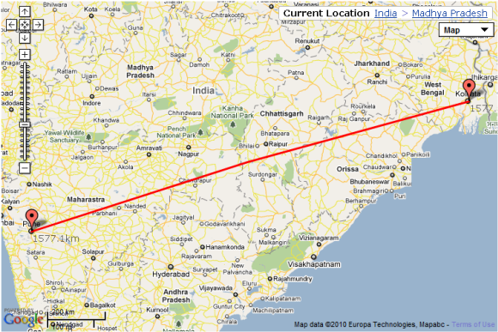
Learning Check:
What is the quantity that describes the length of a path between two points or locations?
Answer: Distance
What is the quantity that describes a specific point relative to a reference point?
Answer: Position

Slide 13
Learning Check
What is the term used for the difference between the final and initial time?
Answer: Time interval

Slide 14
Now that we know a little about motion, time, position; what other concept of motion are we missing? (hint: think vector)
Direction!!

Slide 15
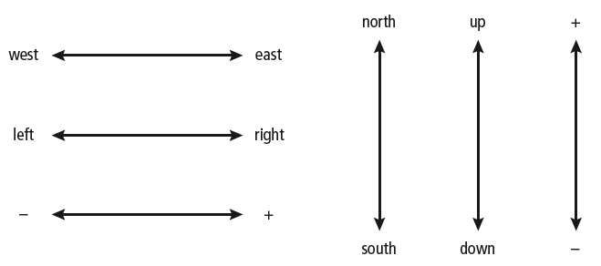
Watch for Signs
When using vector quantities, opposite directions are given opposite signs.
Common sign conventions
See page 349

Slide 16
Watch for Signs
When using vector quantities, opposite directions are given opposite signs.
Common sign conventions
Between 0 s and 15 s the person’s displacement is
= 10 m [W] – 5 m [E]
= -10 m – 5 m
= -15 m
= 15 m [W]
See page 349

Slide 17
A graph
What distance did the person walk in this same time interval?
0-15 sec

Slide 18
End of Lecture 1
In your own words, on a piece of paper, tell me the difference between displacement and distance.
Work on pages 2-3 of your work book

Slide 19
Uniform Motion
Objects in uniform motion travel equal displacements in equal time intervals.
Objects in uniform motion do not speed up, slow down, or change direction.
The position of the ball in this photo is shown at equal time intervals. How would you determine if this motion is uniform motion?
See page 350

Slide 20
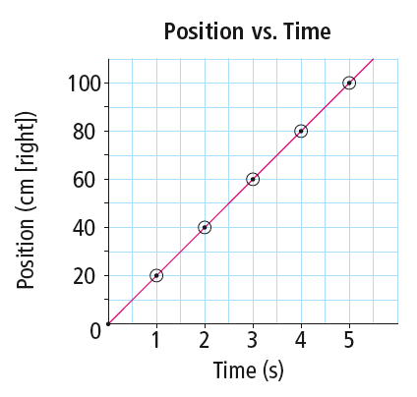
Graphing Uniform Motion
Motion of an object can be analyzed by drawing a position-time graph.
A position-time graph plots position data on the vertical axis (y axis) and time data on the horizontal axis (x axis).
See page 351

Slide 21
Graphing Uniform Motion
A best-fit line is a smooth curve or straight line that most closely fits the general shape outlined by the points.
Uniform motion is represented by a straight line on a position-time graph.
The straight line passes through all the plotted points.
A straight line passing through the plotted data indicates uniform motion.
See page 351

Slide 22
Graphing motion
Is this Uniform or ununiformed motion?

Slide 23
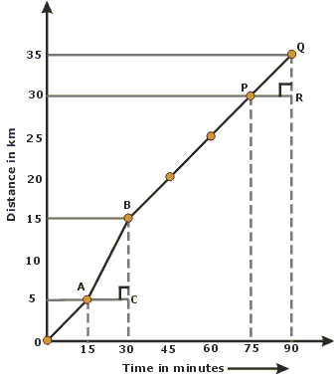
Graphing motion
Is this Uniform or ununiformed motion?

Slide 24
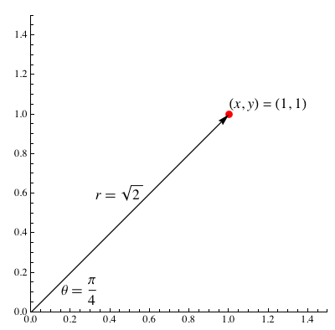
Graphing motion
Is this Uniform or ununiformed motion?

Slide 25
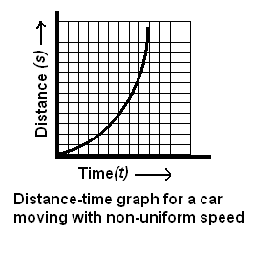
Graphing motion
Is this Uniform or ununiformed motion?
What is happening to this object as time increases?

Slide 26
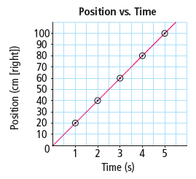
Slope
The slope of a graph refers to whether a line is horizontal or goes up or down at an angle.
Positive slope
Slants up to the right
Indicates motion in the direction of the positive y axis
Learning check: give me an
example of on object that would
have this type of graph/slope
See pages 353 - 354

Slide 27
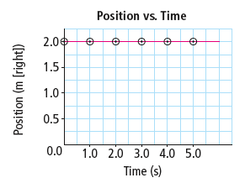
Slope
Zero slope
Horizontal line
Indicates that the object is stationary
Learning check: give me an
example of on object that would
have this type of graph/slope
See pages 353 - 354

Slide 28
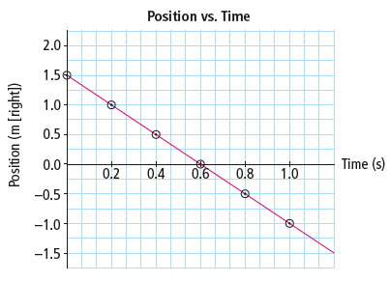
Slope
Negative slope
Slants down to the right
Indicates motion in the direction of the negative y axis
Learning check: give me an
example of on object that would
have this type of graph/slope
See pages 353 - 354

