Slide 1

A little bit about me:Mr.Hoy

Slide 2
What have I done since High school?
From the Valley, Graduated in 2001
Travelled- Central America
SPL
VIU
Travelled again- SE Asia

Slide 3
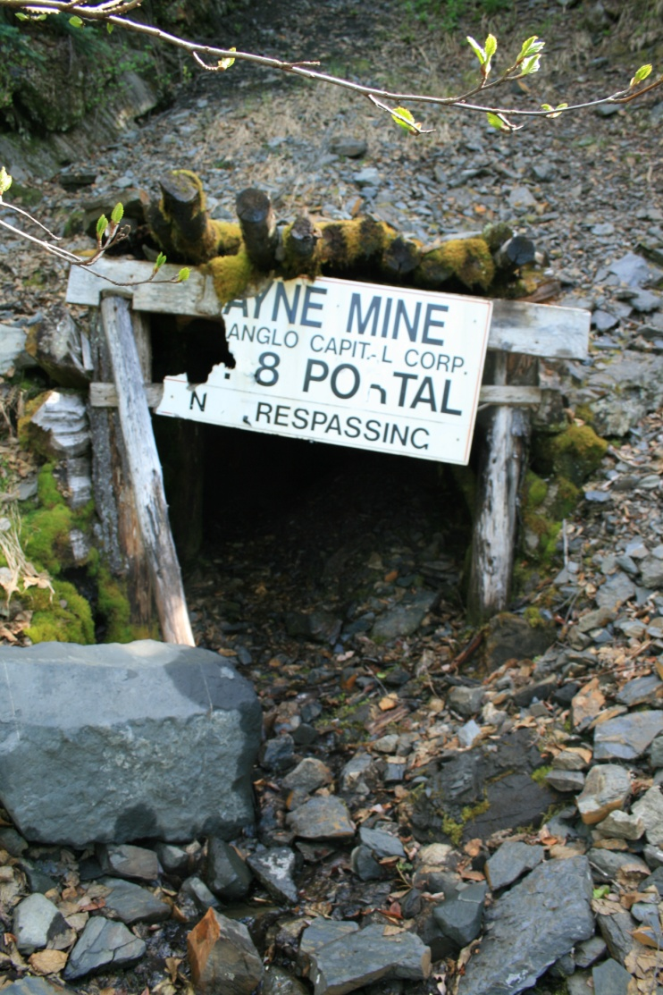
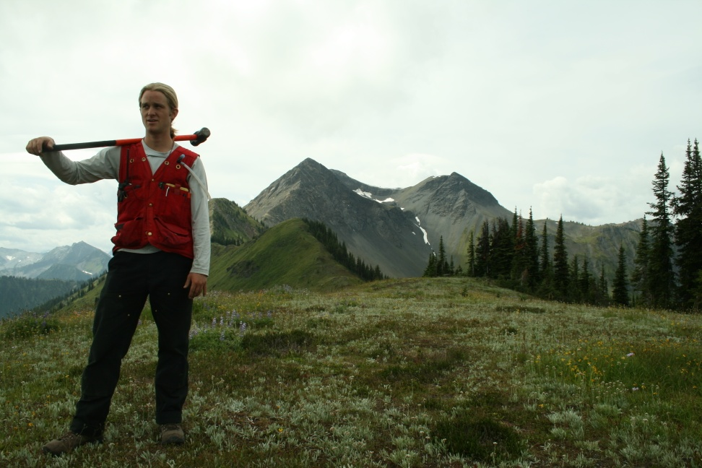
Summer- Slocan Valley

Slide 4
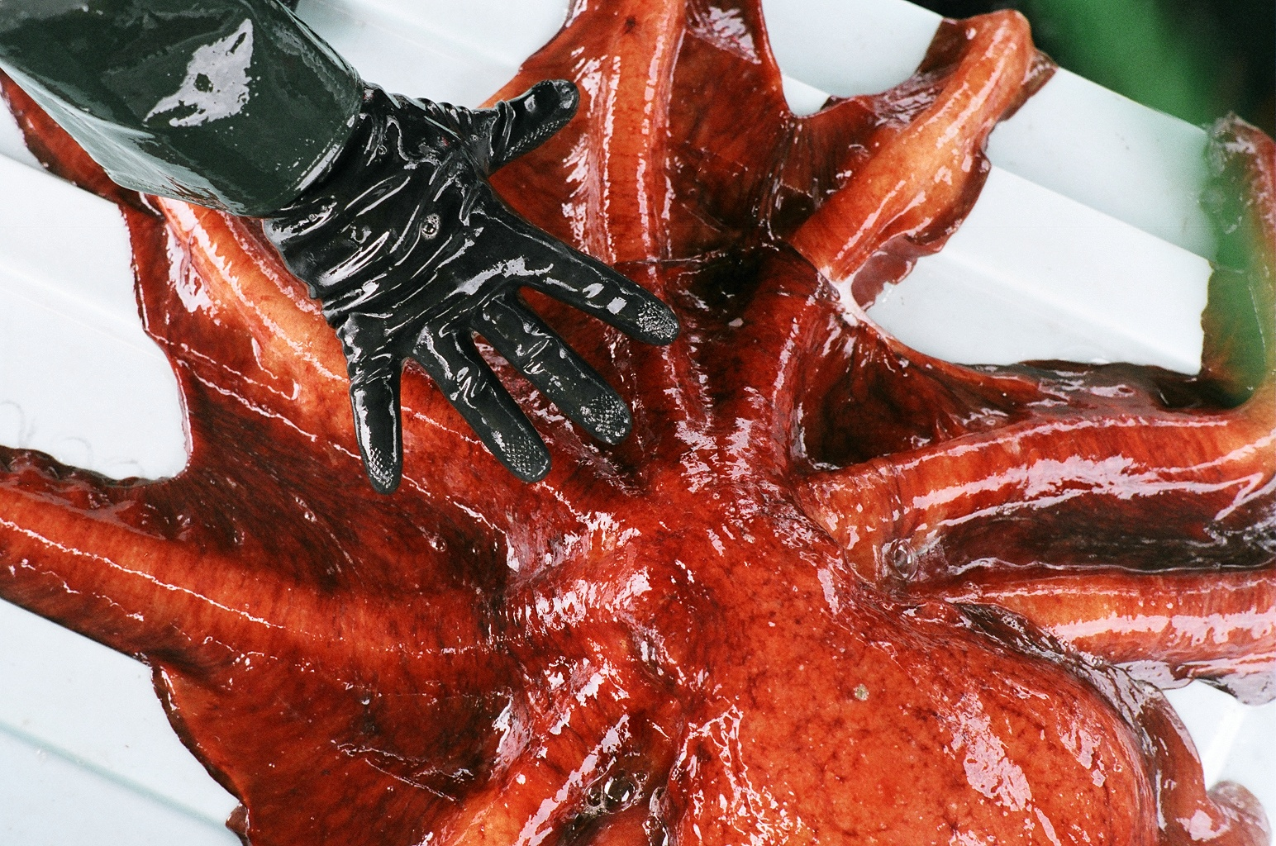
Summer- Desolation Sound

Slide 5
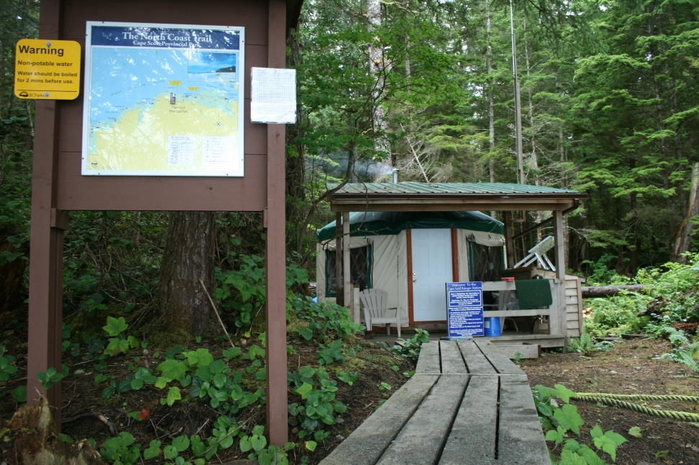
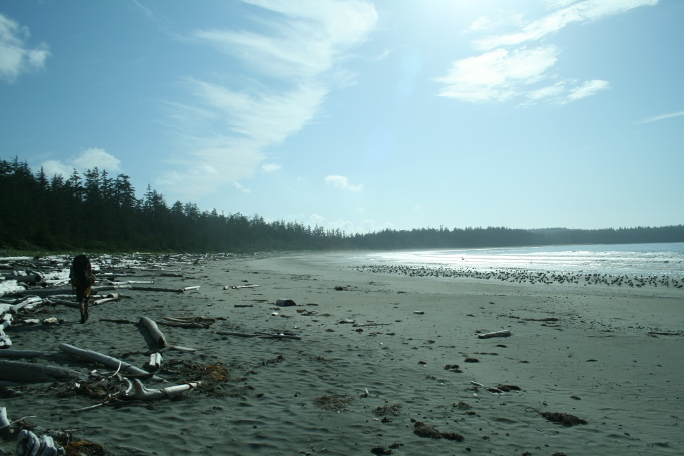
Summer- Cape Scott

Slide 6
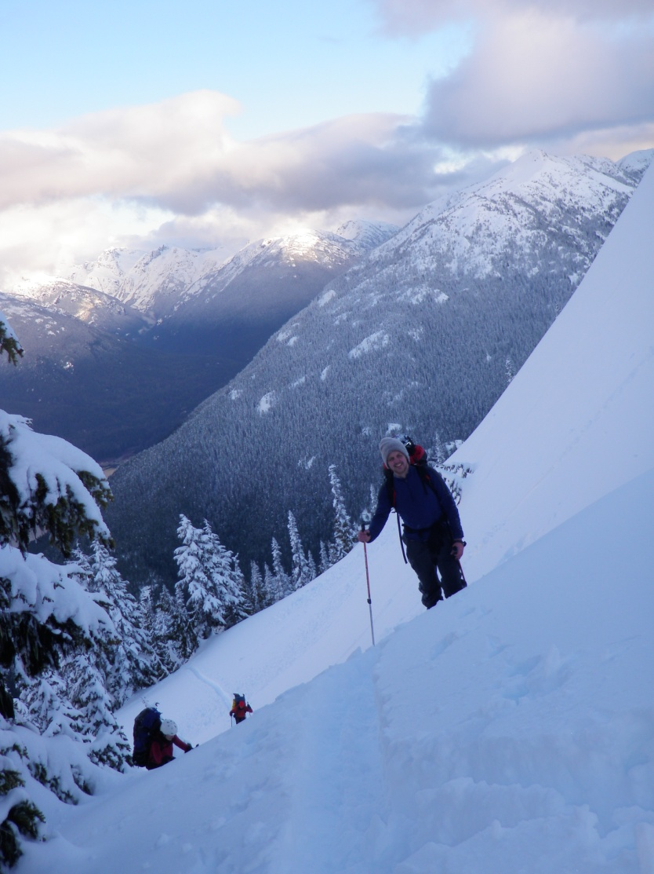

Winter fun

Slide 7
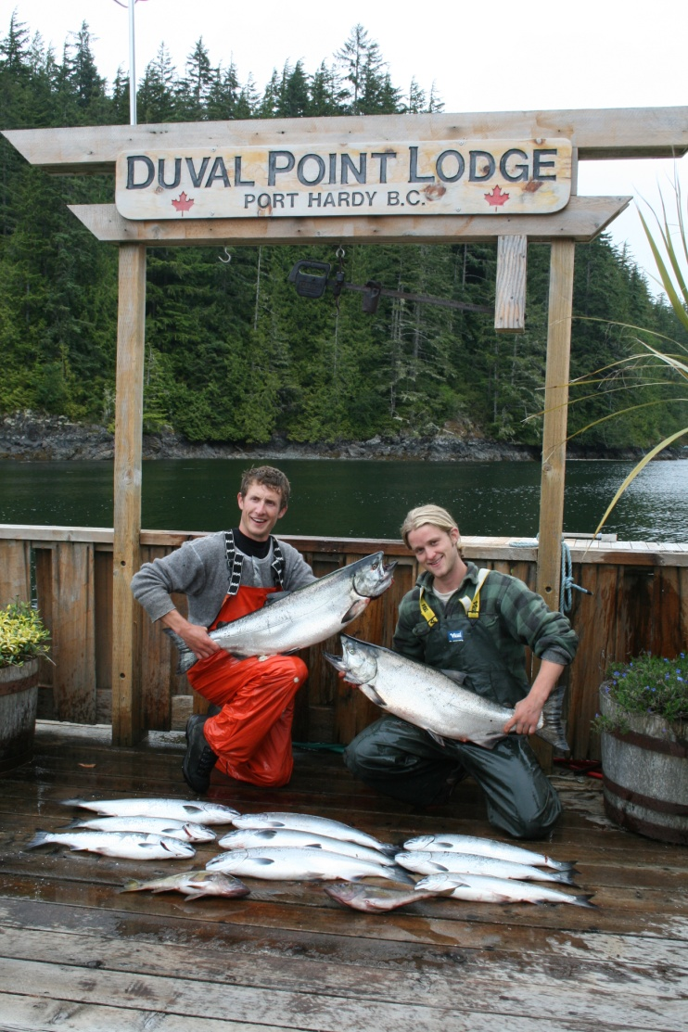
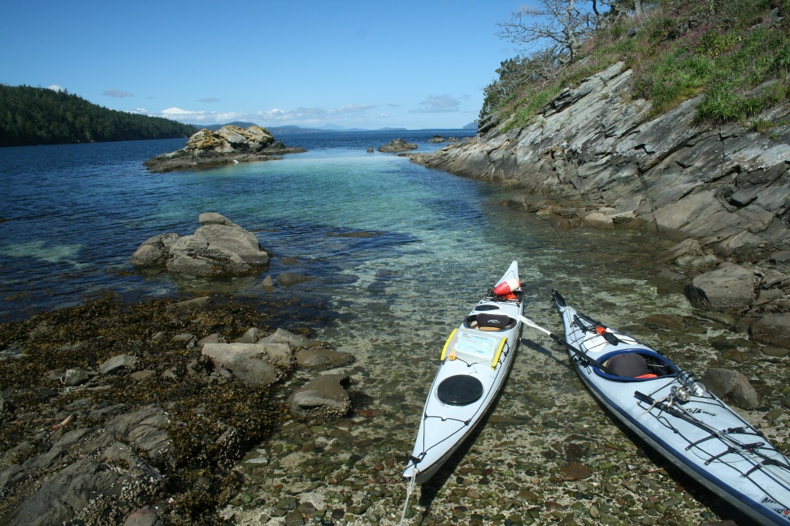
Summer fun

Slide 8
Ok on to business..
Today’s agenda
Parti Quebecios (review)
1980 Referendum & Sovereignty- association
Meech Lake Accord
Charlottetown Accord

Slide 9
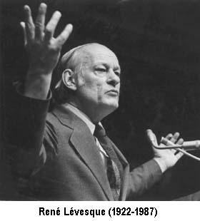
Parti Quebecios (PQ)
Leader was Rene Levesque
Main agenda was to separate from Canada
Elected to power in 1976 by Quebec voters

Slide 10
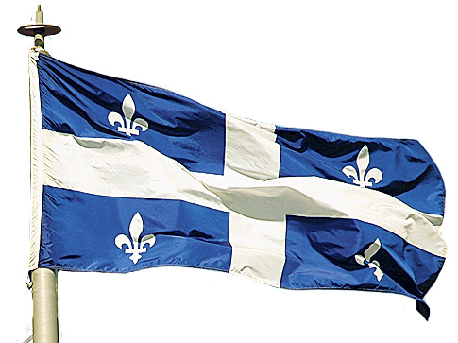
1980 Quebec Referendum
Rene Levesque asked the voters of Quebec if they wanted to negotiate a new agreement with Canada called the sovereignty-association .

Slide 11
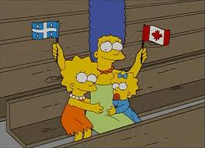
1980 Quebec Referendum continued (cont’d)
Sovereignty-association 2 main points:
A) Quebec would become politically independent
B) Quebec would maintain close economic ties with Canada.

Slide 12
1980 Quebec Referendum continued (cont’d)
Who won the 1988 referendum?
Hypothetical question:
If a political party in BC wanted a sovereignty-association with Canada, what would you vote and why? (give three examples supporting your position)

Slide 13
1980 Quebec Referendum continued (cont’d)
40% of Quebec voted ‘Oui’ and 60% voted ‘non’ to sovereignty-association
Prime Minister Pierre Trudeau urged Quebecers to vote no. He promised if they did vote no he would rewrite the constitution to declare Quebec as a distinct society within Canada.

Slide 14
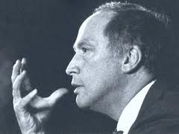
Trudeau’s Influence
Patriating the constitution:
Before 1982 Canada could not make changes to its constitution without Britain's approval. In 1982 the Queen Elizabeth visited Ottawa and signed over the constitution to the Canadian parliament.

Slide 15
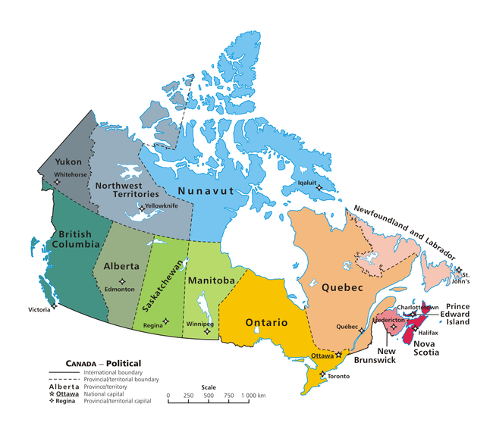
Trudeau’s Influence
Amending formula- 7 out of 10 provinces representing 50% of Canada’s population had to agree to any constitutional changes.
In 1982 all provinces signed on except Quebec
Why is the opposite map not in line with the topic we are discussing?

Slide 16
Meech Lake Accord
Recognized Quebec as a distinct society.
Quebec liked the Accord but other provinces saw it as giving Quebec too much power.
First Nations did not like it as they had not received distinct society status.
The Accord was not accepted and voted down, Quebec saw this as an insult and further entrenched separatist beliefs.

Slide 17
Charlottetown Accord
A revised version of the Meech Lake Accord
Addressed Quebec’s concerns similar to the Meech Lake Accord
Contained senate reform- elected from all over the country
Supported First Nations Self Government
Voted down (54% “no”) because it tried to address too many issues and too many people found fault in it.

